Slide 1
Radiative processes in the atmosphere
Krzysztof Markowicz
Institute of Geophysics, University of Warsaw
kmark@igf.fuw.edu.pl

Slide 2
Introduction
Radiation scattering is a process associated with a change in the direction of propagation of an electromagnetic wave.
In the atmosphere, elastic scattering (no change in wavelength) plays the most important role.
Inelastic scattering (e.g. Raman scattering) is secondary. Despite this, it is often neglected small, but it is used in remote sensing techniques.
Scattering plays a key role for solar radiation, while in the far-infrared it is of less importance and may be neglected in many considerations.

Slide 3
Scattering on a single particle
Single scattering, as it is referred to, assumes that the electric field strength after scattering on a single particle depends only on the external field.
Thus, if the distance between particles is sufficiently large (the total scattered radiation from neighbouring particles is small compared to the external field), the single scattering approximation is fully justified.
In addition, we will assume that the particles are randomly distributed in space, i.e. described by a Poisson distribution.
This means that the scattering is incoherent as there is no relationship between the phases of the scattered waves.

Slide 4
Types of radiation scattering
In the atmosphere, Rayleigh, Mie and geometric scattering are most commonly distinguished.
Size parameter:
The former describes scattering on small particles (compared to the wavelength), the latter on large particles (with dimensions comparable to or greater than the wavelength).
Geometric scattering occurs when the size of the particle is much larger than the wavelength (x>>1).
However, Mie scattering describes the interaction of electromagnetic radiation with particles of any size compared to the incident wavelength.
Nevertheless, Rayleigh-type scattering (x<<1) is distinguished because of its relatively simple analytical solution.

Slide 5
Consider homogeneous radiation incident on a particle
The electric dipoles excited to oscillate in the particle emit coherent radiation of the same wavelength.
The electric field at point P is the sum of the incident field and the field scattered on the particle.
In general, the phase of the individual waves at point P depends on the scattering angle, so we expect a direction dependence of the scattered radiation.
However, if the particle is small compared to the wavelength (x<<1) the radiation emitted by the dipoles is in phase.
Therefore, in this case, we expect little change with the scattering angle. As the size of the particle becomes larger, the mutual amplification and attenuation of the electric field from the individual dipoles also increases.
Consequently, radiation scattered on large particles (x>>1) has many interference maxima and minima.
The relationships between the phases of electromagnetic waves in general depend on geometrical factors: the angle of scattering, the size of the particle, its shape.
The amplitude and phase of the induced dipoles in a particle, on the other hand, depend on the properties of the substance of which it is composed.

Slide 6
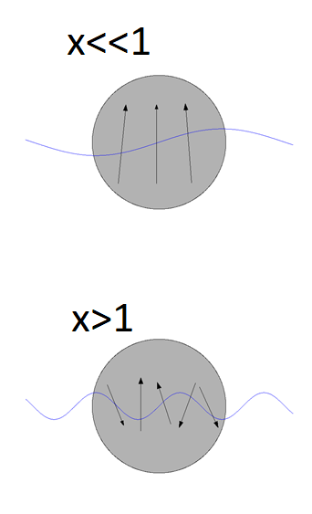
Light scattering regimes

Slide 7
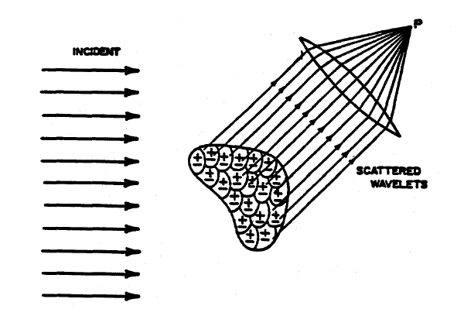
As stated above, electromagnetic radiation incident on a material medium polarises it (not to be confused with radiation polarisation) leading to the formation of electric dipoles.
The polarisation of a medium per unit volume is related to the relative electric permeability coefficient ε_{r} and the incident electric field by the formula .

Slide 8
We will consider the polarisation of a single dipole in a material medium on which an external electric field falls .
The polarisation of a single electric dipole is expressed by the formula
where α is the polarizability of the medium and is the total internal electric field.
Note that in general the polarizability factor is a tensor.
If we denote by N the number of dipoles per unit volume then the polarizability of the medium is
A key problem in scattering processes becomes the determination of the internal electric field, which in dense media can be fundamentally different from the external electric field.

Slide 9
Clausius–Mossotti relation
If the distance between the molecules of the medium is much greater than the wavelength then the total electric field increases due to the interaction of neighbouring dipoles according to the formula:
It is easy to show that there is a relationship
It is relation between microscopic polarizabilities and macroscopic dielectric constant

Slide 10
Rayleigh scattering
Let us consider a small, homogeneous and spherical particle with a radius much smaller than the incident wavelength λ. Using the classical solution of Maxwell's equation in the far-field case (Hertz formula):
where γ is the angle between the dipole moment vector and the direction of observation. Given that the dipole moment can be represented in harmonic form

Slide 11
Rayleigh scattering
The electric field of diffuse radiation is expressed by the formula
Let us define a certain plane by the direction of the incident and scattered radiation and then decompose the components of the electric field into: a perpendicular component E_{or} and a parallel component E_{ol} to this plane. Then the components of scattered radiation have the form
Θ - is scattering angle

Slide 12
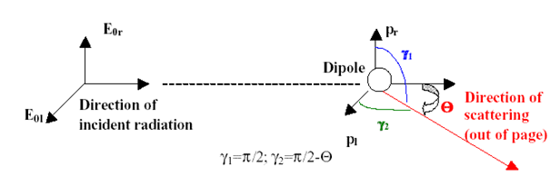
Using the relationship between the electric field strength and the radiance (I=const|E|² ), we can write the formula for the radiance of the scattered radiation in the form:
where I_{r}, I_{l} are the polarisation components of the radiation.
The total intensity of scattered radiation is expressed by the formula

Slide 13
If the incident radiation is unpolarised (e.g. solar radiation) then the two intensity components are equal and equal I_{o}/2. In this case the total intensity of the scattered radiation is
Conclusions
The intensity of scattered radiation is inversely proportional to the fourth power of the wavelength. Thus, the scattering of radiation decreases very rapidly with wavelength and therefore Rayleigh scattering is important in the visible region and in the ultraviolet. Since the radiation of the sky (outside the solar disk) consists only of scattered radiation so Rayleigh scattering is responsible for the blue colour of the sky.
Rayleigh scattering is anisotropic, but the deviation from isotropy is not large (in compare to Mie solution).
Rayleigh scattering is symmetric i.e. the intensity of the forward and backward scattered radiation is the same.

Slide 14
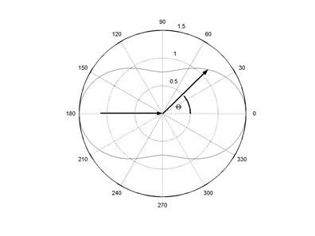
Scattering phase function
For Rayleigh scattering
Normalization
P(cosΘ), due to its normalisation, has a probability density interpretation.
Thus, it defines the probability that a photon incident on a particle will be scattered at an angle Θ.

Slide 15
The intensity of the diffuse radiation can be written as
The scattered radiation flux at a distance r from the scattering particle is equal to the integral over the radiation flux density (IdΩ) and can be calculated from the formula
where F_{o} is the incident radiation flux ( ).
We define the scattering cross section as
Finally
This formula is universal and true for any size parameter

Slide 16
Lorentz–Lorenz equation
It can be shown that the polarisability of α is related to the refractive index m and the number of particles N_{s} per unit volume
This equation is similar to the Clausius–Mossotti relation, except that it relates the refractive index (rather than the dielectric constant) of a substance to its polarisability.
For the visible part of solar radiation, the imaginary part of the refractive index of air molecules is negligibly small. The real part m_{r}, although close to unity, shows a wavelength dependence. It can be approximated using the following empirical formula
λ[μm]

Slide 17
Rayleigh scattering –final marks
Given that the real part of the refractive index is close to unity, the formula for the polarisability of air takes the form of
where the added factor f(δ) takes into account the anisotropic properties of the air molecules (deviation from particle sphericity) and is defined as follows
δ for air particles is about 0.035

Slide 18
Lorenz-Mie Scattering
Rayleigh scattering occurs for particles whose radius (or volume equivalent) of the particle is much smaller than the wavelength.
For larger particles, the scattering process is described by the theories of Lorenz-Mie, who in 1890 and 1908 independently solved the problem of radiation scattering on homogeneous spheres.
The Lorenz-Mie theory describes a method for solving Maxwell's equations. It boils down to solving an equation for the electric field
and an identical one for the magnetic field with boundary conditions on the sphere.
In this method, the internal electric field is calculated as the sum of the external field and the field from the internal particles.

Slide 19
Lorenz-Mie solution (far-field approximation)
where the functions Ψ and ζ are the Ricatti-Bessel functions corresponding to the spherical Bessel functions. The magnitude parameter in the formulae for a_{n} and b_{n} is defined for the wavelength inside the medium and is the refractive index m=m_{p}/m_{a},
where m_{p} is refractive index for a particle and m_{a} for air

Slide 20
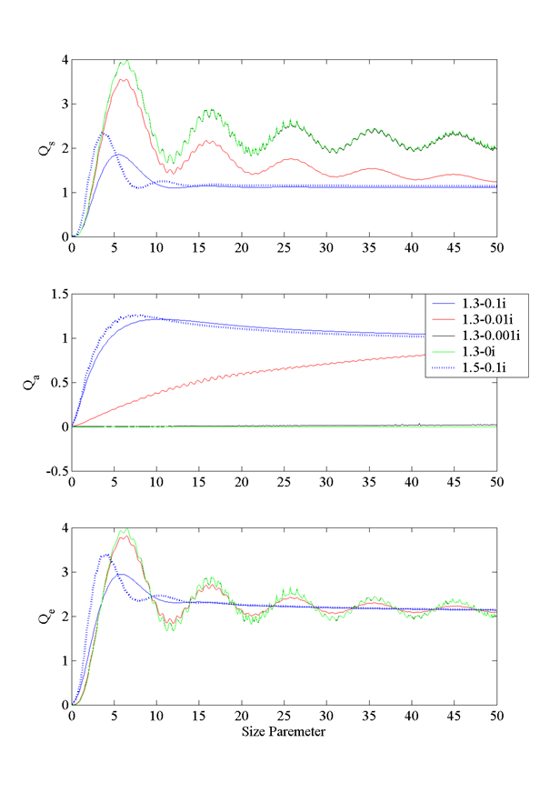
Effective scattering cross-section
σ_{s} – scattering cross section
σ_{a} – absorption cross section
σ_{e} – extinction cross section
Different color shows solution for different refractive index (real and imaginary part)

Slide 21
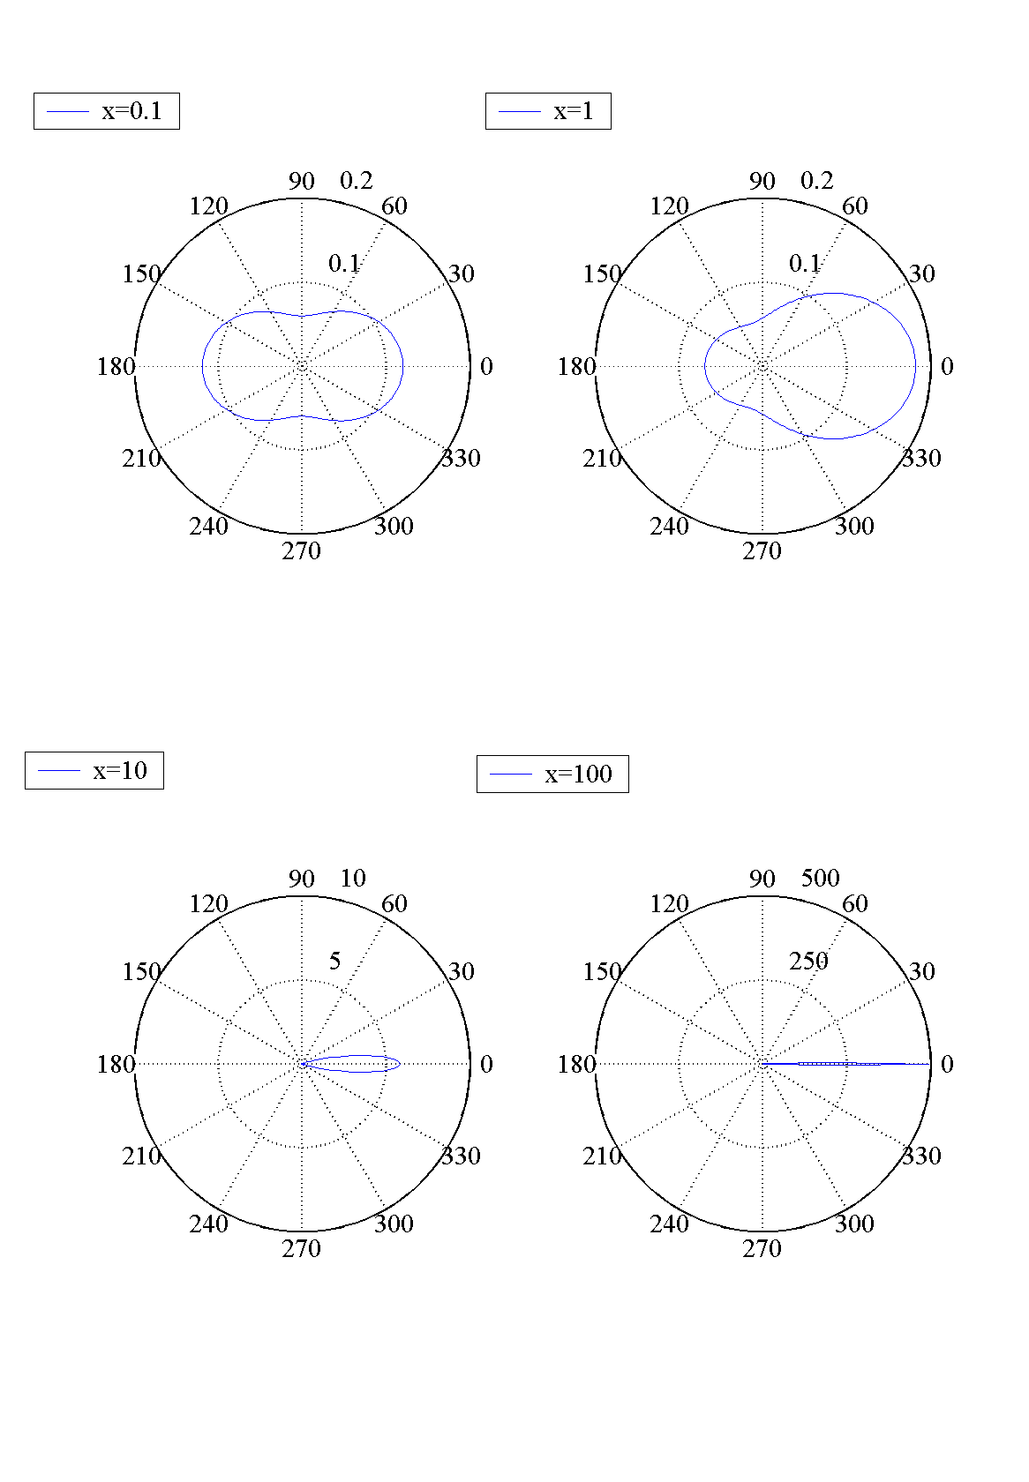
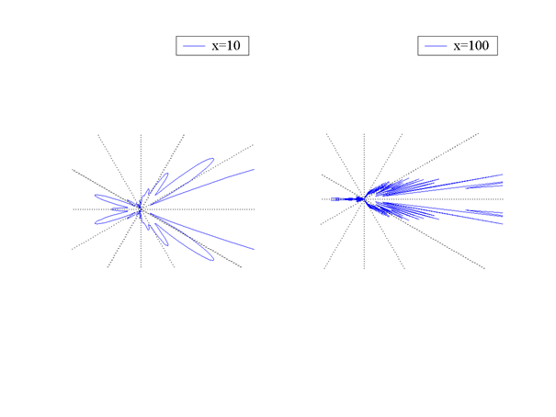
Scattering phase function

Slide 22
Simulation of single-scattering properties of spherical and uniform particles
MatLAB: mie.m or mie.mex
https://www.igf.fuw.edu.pl/~kmark/stacja/kody.php
How to use it?
[S1,S2,Qext,Qscat,Qback,g]=mie(x,nref,nangles)
Coefficients:
For monodispersive particles: i=scat, ext, abs
For polidispersive particles:
n(r) – particle size distribution

Slide 23
Simulation of single-scattering properties of coated sphere particles
MatLAB: coat.m or coat.mex
https://www.igf.fuw.edu.pl/~kmark/stacja/kody.php
How to use it?
[Qext,Qscat,Qback]=coat(x_{core},x_{coat}, nref_{core}, nref_{coat})
r
R
Example: melting hail, hygroscopic aerosol

Slide 24
Generalisation
Consider the electric field strength at a far distance from the spherical particle with a scattering angle close to zero (Θ≈0). Let us assume that polarised radiation in the perpendicular direction falls on the particle, then the electric field strength is
At a far distance from the particle (x,y <<z) we can write
The superposition of the electric field associated with an incident and a scattered wave in the direction (Θ) is expressed by the formula

Slide 25
The radiance is proportional to the expression
Let us denote by 1+Z the expression in square brackets then the square of the modulus of this impression is:
where is the complex coupling. Since we are interested in the long-range solution, so the expression in which 1/z² occurs is omitted
Dividing by a constant factor on both sides and integrating over the geometric section of the particle, we have

Slide 26
where, on the right-hand side of the equation, we have the cross-sectional area of the particle and the extioncion cross-section.
The physical interpretation of the second factor is as follows: the radiation in the forward direction is reduced as if the particle had a geometrical cross-section equal to σ_{e}.
If we assume that the change in the limits of integration for the second term in the above formula for integration along the whole plane (x,y) is a small correction then we have
This results in the basic extinction formula, for a homogeneous and spherical particle
where S(0)=S₁(0)= S₂(0).

Slide 27
Anomalous diffraction theory
For large values of the size parameter (x>>1) and so-called soft particles |m-1|<<1, there is an approximate theory, called anomalous diffraction theory (ADT), which approximately describes the interaction of particles with electromagnetic waves.
The second condition (of soft particles) means that a ray of light running inside a particle is negligibly weakly deflected from its original direction. Similarly, reflection from the particle can be neglected due to the small difference in the reflectance of the particle and the air.
Radiation extinction coefficient is therefore dominated by absorption, which is the physical basis of the anomalous diffraction theory.
The electric field strength after absorption by the particle (in the forward direction,Θ=0) E is a superposition of the incident field strength on the particle E and the scattered field strength on it E_{scat} is expressed by the formula

Slide 28
ADT
.
It can be shown that
where
The anomalous diffraction theory does not allow the determination of phase functions but only of extinction and absorption coefficients limited for large particles with a refractive index close to unity.
This theory agrees surprisingly well for a small value of the size parameter x with the exact solution resulting from Lorenz-Mie theory.

Slide 29
Mueller matrix
The description of the polarised state of radiation requires a generalisation of the definition of the phase function, which has so far been a scalar quantity. The components of the electric field intensity after scattering on a single particle are expressed by the formula
where the expressions S_{1…4} are elements of the scattering amplitude matrix. It follows from previous considerations that for spherical and homogeneous particles the off-diagonal values of the matrix S vanish.
Let us calculate the total energy per unit time and wavelength carried by the scattered wave
where the integration proceeds along the Ξ-sphere.

Slide 30
The total energy of scattered radiation is equal on the other hand , since σ_{s} determines the scattering cross section and is therefore the incident energy of the particle.
From the above formulae it follows that the scattering cross section is expressed by the formula
It is therefore convenient to write the expression for the phase function as
Integrating this on both sides of the Ξ-sphere, we obtain the energy conservation condition, which is also a normalization of the phase function

Slide 31
In order to describe the scattering using the Stokes parameters, we need to introduce the phase matrix.
It can be shown that for a certain class of particles it has the following form
The Mueller matrix above describes scattering not only on spherical particles but also on non-spherical particles with a certain rotational symmetry.
.

Slide 32
Notes
For spherical particles
Additionaly for Rayleigh scattering S₁₂ =0 for scattering angle of zero and 180º .
Finally, the scattered radiation can be expressed by the matrix formula
The normalization condition has to be fulfilled only for the first diagonal element
In the general case (not considered here), the Mueller matrix has 16 non-zero real elements.

Slide 33
Scattering on non-spherical particles
Mie scattering allows scattering calculations only for simple geometries (e.g. homogeneous spheres, rotating ellipsoids). For complex shapes (sand particles or ice crystals), scattering theories for non-spherical particles have to be applied.
One of these is the discrete dipole theory introduced by Purcell and Pennypacker in 1973.
In this theory, incident radiation of intensity E_{o} is scattered in front of a collection of dipoles of which the particle is composed.
The described scattered radiation field E_{s} is assumed to be far away from the particle and is the sum of the fields produced by the external radiation and that produced by each of the dipoles

Slide 34
The electric field in each dipole is defined by the positions of the index "j" and determined by the dipole moment
Furthermore, the electric field in each dipole is a superposition of the external field and the internal field associated with the N-1 dipoles. Thus
where is the contribution to the electric field at dipole j originating from the oscillation of the dipole at site k.
In the Discrete Dipole Approximation (DDA) method, the above equation is solved for all p_{j} j=1,...,N.
In what follows, we omit the details of this method by referring to the literature [B.T. Draine, P.J. Flatau, 2000].

Slide 35
Just note that this method requires the inversion of a large 3Nx3N complex matrix.
Furthermore, the following relation must be satisfied, where d is the distance between the dipoles.
For example, solving the scattering problem for radiation of length 0.5 μm on a water droplet of radius 1 μm with better than 5 % accuracy requires 65400 dipoles.
This method is effective for a size parameter x of less than 20-30. For higher values, especially for the geometric scattering regime, geometric methods involving consideration of diffraction processes from the reflection from the scattering particle are used.

Slide 36
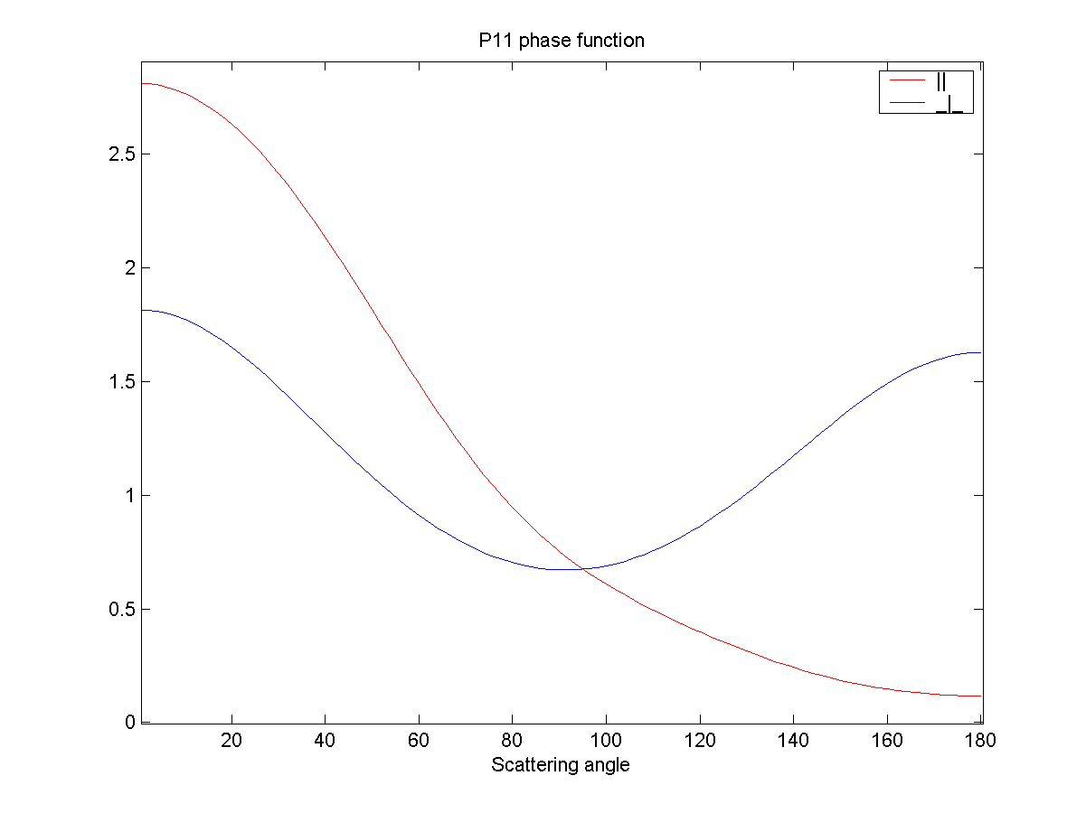
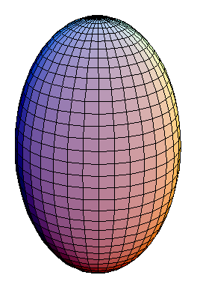
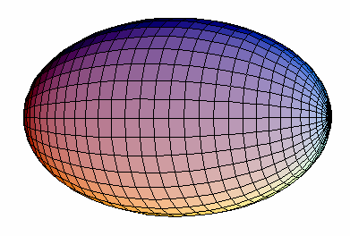
g=0.02
x=0.63
asp. ratio= 5
g=0.41
x=0.63
asp. ratio= 0.2

Slide 37
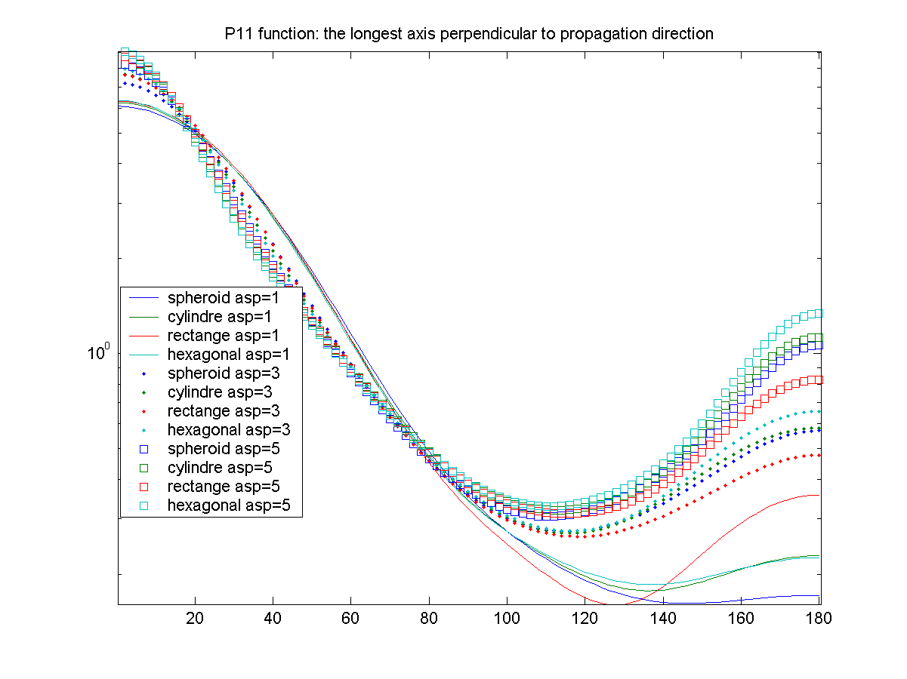
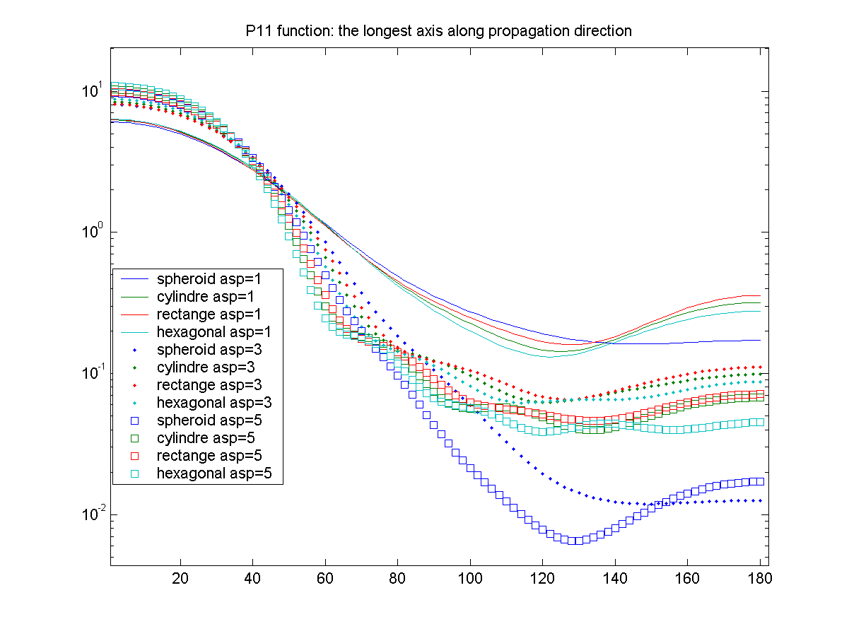

Slide 38
DDSCAT code
http://ddscat.wikidot.com/
Written in Fortran
Matlab version http://ddscat.wikidot.com/matlab-version

Slide 39
Scattering in the geometric regime
Scattering on large particles versus wavelength can be solved by geometrical optics.
The size parameter in this case is at least of the order of a hundred and preferably of the order of a thousand.
In this case, we consider only the processes of reflection from the particle surface and refraction (deflection) within the particle.
A frequently used method for determining optical properties is the Monte Carlo, Ray-tracing method.
It involves simulating the behaviour of thousands of photons incident on a particle at different locations.
Each physical process is simulated using a random number generator with a distribution that depends on the particle's refractive index.
The final result of the simulation is the distribution of the density of photons scattered into the solid angle and the number of photons absorbed inside the particle.
This allows the determination of optical properties including the phase function.

Slide 40
Ray-tracing method
Snell low
1
θ_{i}
θ_{t}
0
Absorption inside
Fresnel equations:
refractive index: m+im_{i}

Slide 41
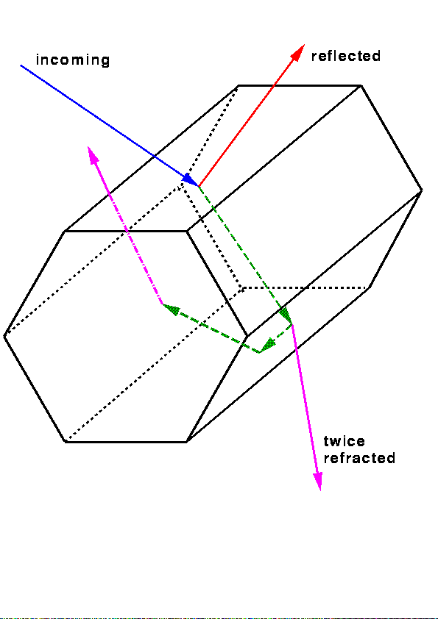
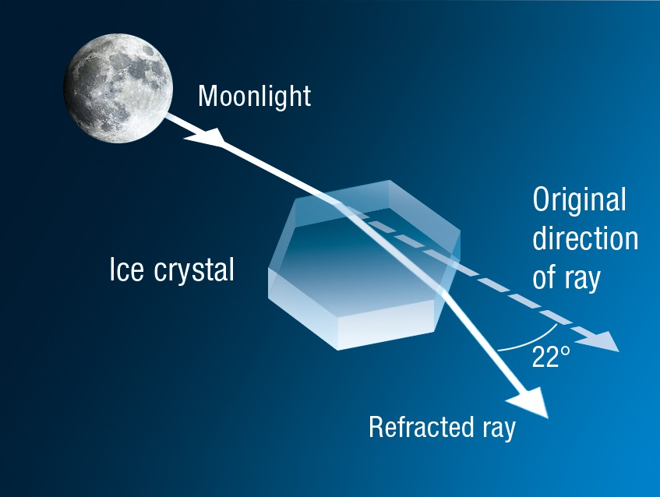
The ray tracing method

Slide 42
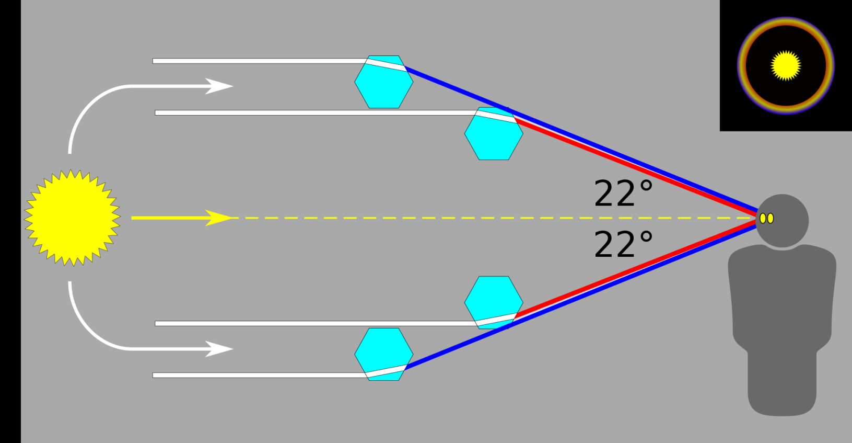
Halo phenomenon
https://en.wikipedia.org/wiki/Halo_(optical_phenomenon)#/media/File:20200712_22_degree_halo_-_diagram.svg

Slide 43
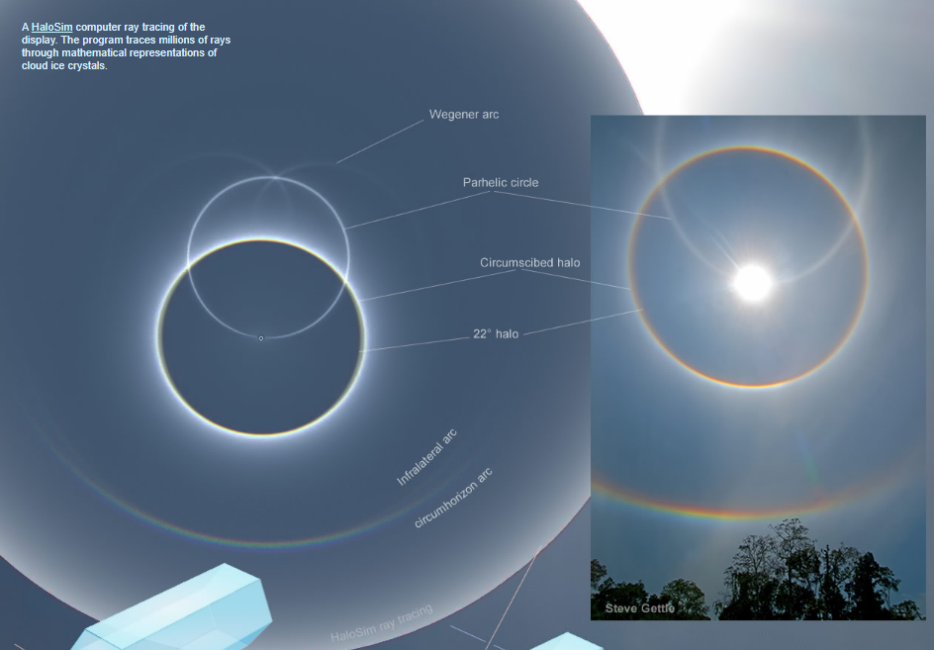
Halo

Slide 44
Halo simulations
Halo Point 2.0
https://web.archive.org/web/20130214130218/http://www.jukri.net/HaloPoint2.zip

Slide 45
Addition scattering methods
T-matrix (https://www.giss.nasa.gov/staff/mmishchenko/tmatrix/)
Applicable to rotationally symmetric particles with equivalent-sphere size parameters exceeding 100.
Finite-difference time-domain method
The FDTD method belongs in the general class of grid-based differential time-domain numerical modeling methods.
The time-dependent Maxwell's equations are discretized using central-difference approximations to the space and time partial derivatives.

