Slide 1
Radiative processes in the atmosphere
Krzysztof Markowicz
Institute of Geophysics, University of Warsaw
kmark@igf.fuw.edu.pl

Slide 2
Credit for the course
Solving of one research topic defined by the lecturer or exam

Slide 3
Program
Definitions of key quantities and principle of black body radiation
Absorption of radiation in the atmosphere
- absorption spectrum of atmospheric gasses
- HITRAN database
- simulation of absorption properties
Scattering of radiation in the atmosphere
- Rayleigh scattering
- Lorenz-Mie scattering
- geometric scattering.
- discrete dipole approximation
- simulation of single scattering properties

Slide 4
Program
Introduction to radiative transfer equation
- Lambert-Beer low
- general form of the radiative transfer equation
- boundary condition at the top of the atmosphere and at the Earth's surface.
Approximate and accurate numerical solutions of radiative transfer equation.
- single scattering approximation
- two streams approximation
- delta-Eddington method
- Monte Carlo methods,
- discrete ordinate method.

Slide 5
Program
Radiative transfer models
- MODTRAN
- Fu-Liou
Simulation of short- and longwave fluxed by radiative transfer models
- definition of different atmospheric conditions and simulation scenario
- estimation of radiative forcing

Slide 6
Literature
K. N. Liou, An Introduction to Atmospheric Radiation.
G. W. Petty, A First Course in Atmospheric Radiation.
G. T. Thomas, K. Stamnes, Radiative Transfer in the Atmosphere and Ocean.
C. F. Bohren, D. R. Huffman, Absorption and Scattering of Light by Small Particles.
G. L. Stephens, Remote Sensing of the Lower Atmosphere. An Introduction.
M. L. Salby, Fundamentals of Atmospheric Sciences.
Course materials:
https://www.igf.fuw.edu.pl/~kmark/stacja/wyklady/ProcesyRadiacyjne/English/
https://www.igf.fuw.edu.pl/~kmark/stacja/wyklady/ProcesyRadiacyjne/2022/WykladRadiacja.pdf
Radiation codes:
https://www.igf.fuw.edu.pl/~kmark/stacja/kody.php

Slide 7
Introduction to atmospheric radiation

Slide 8
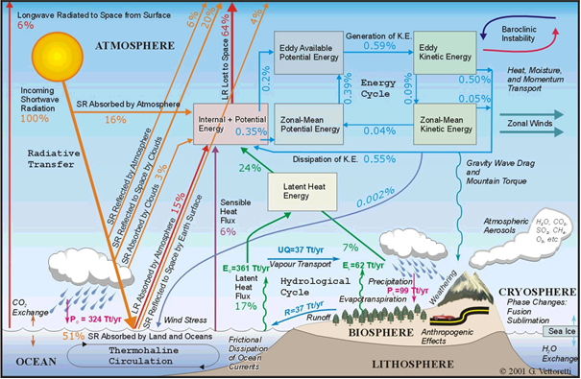
Energy flow in the Climate System

Slide 9
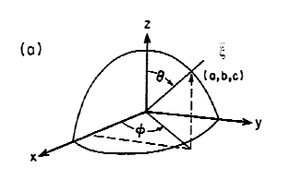
Definition of coordinate system
A spherical coordinate system will be used to describe radiative transfer in the atmosphere. By will be denoted the vector associated with the direction of the radiation propagating

Slide 10
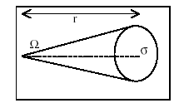
Solid angle
The solid angle will be denoted by Ω and defined as the ratio of the area to the square of the distance [sr].
The differential solid angle in the spherical system has the form:
Example: solid angle of the Sun as seen from Earth
for small angles

Slide 11
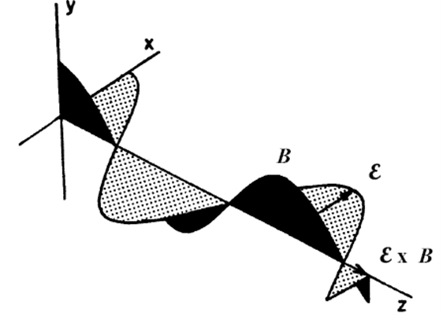
Electromagnetic radiations
Electromagnetic radiation is a transverse wave generated by oscillating electrical charges. The propagation velocity of electromagnetic waves in a medium is v=c/n,
where n is the index of refraction and for air at room temperature and in the visible region of the spectrum is approximately 1.00029.
Let us consider a plane electromagnetic wave

Slide 12
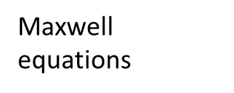
Let us consider a plane electromagnetic wave
After substitution into the formulae
Multiplying the penultimate equally by and then using the last equally we have

Slide 13
From
We have
From relation for refractive index
Finally, we obtain the formula for a plane electromagnetic wave propagating in the z-axis direction as
The first exponential factor in the above equation is related to the vanishing amplitude of the electromagnetic wave and is determined by the imaginary part of the refractive index. The real part of the refractive index (refractive index) determines the phase velocity of the wave.

Slide 14
Poynting vector
The energy of electromagnetic waves per unit area perpendicular to the direction of motion and per unit time is defined by the Poynting vector
Due to the large time variation of the electric and magnetic fields, the time-averaged value of the Poyting vector is important in practice.
Taking into account that the electric and magnetic fields have a harmonic form
It is easy to show that the average value of the Poyting vector is

Slide 15
Thus, the energy of electromagnetic waves is determined by the square of the amplitude of the electric field. Note that the intensity of the radiation I is proportional to the exponential factor
is absorption coefficient

Slide 16
Stokes vector
,
,
A complete description of radiation requires the introduction of parameters describing its polarization. In 1852, Stokes defined the following four parameters
where E_{l} and E_{r} are the parallel and perpendicular components of the electric field strength vector with respect to the reference plane. They describe the vibration of the vector and the phase differences between the components of this vector.
By writing the components of the electric field in harmonic form

Slide 17
it can be shown that the Stokes vector has the following coordinates
where δ is the phase difference and is δ = δ_{r}- δ_{l}.
The above formulae describe a single wave, but in reality, when measuring them, averaging over multiple waves of independent phase is performed. Therefore, to describe the polarization we use the time-averaged elements of the Stokes vector

Slide 18
Polarisation
For sunlight (completely unpolarised) Q=U=V=0.
An important parameter in describing the polarisation of radiation is its degree of polarisation.
One can define the degree of linear polarisation in the following form
and the degree of circular polarisation as

Slide 19
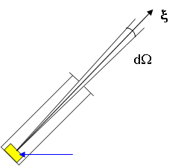
Radiation parameters
Radiance (intesity)- the amount of energy measured in a specific direction per unit time dt per unit area dA, solid angle dΩ and narrow spectral interval dλ.
In the general case, radiation in the atmosphere is a function of a vector of position, direction , wavelength and time.
detector
Thus, it depends on seven independent variables: three spatial, two angles, wavelength or frequency and time.
If the radiation does not depend on the direction of the electromagnetic radiation then it is called isotropic radiation, and if, in addition, it does not depend on the position in the atmosphere then the radiation is homogeneous.

Slide 20
Flux- the amount of energy per unit time passing through a unit area dA for a narrow spectral interval dλ of electromagnetic radiation.
I(θ,φ)
detector
difuser
From the definitions of radiance and, it is easy to see that the relationship of these quantities is of the form:
For isotropic radiation we have a simple relationship

Slide 21
The total radiance and flux are defined by formulae:
In addition, for the radiation flux, a distinction is made: direct radiation flux - F_{dir} defined as the intensity of solar radiation coming from the direction of the solar disc measured per unit area perpendicular to the direction of radiation propagation.
In addition, diffuse radiation flux - F_{diff} defined as the intensity of radiation scattered onto a plane surface.

Slide 22
Scalar radiance
This means that the scalar irradiance sums up the radiation distribution with the same weight irrespective of the angle of incidence of the radiation.
The figure below shows a schematic of an instrument for measuring scalar irradiance for radiation going downwards.
difuser
Absorbing plate
detector

Slide 23
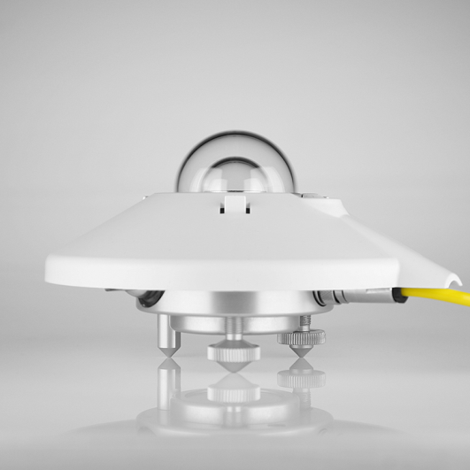
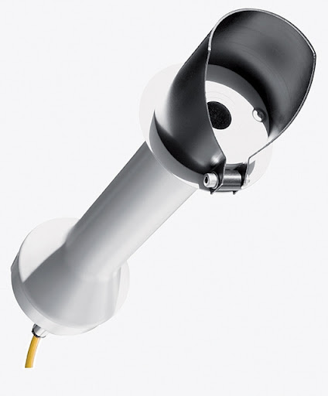
Radiation observation
Pyranometer (solar flux) CMP22
Pyrgeometer (infrared flux) CGR4
Pyrhelometer (direct solar flux) CHM1
Net radiometer (total solar+infrared flux)
Sun tracker (diffuse and direct flux)

Slide 24
Sun tracker with radiometers

Slide 25
Blackbody radiation
In thermodynamic equilibrium, the spectral distribution of the energy emitted by a blackbody is described by the Planck equation:
h=6.626x10⁻³⁴ Js,
k=1.3806x10⁻²³ J/K

Slide 26
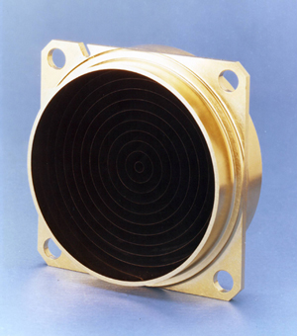
Properties of a blackbody
Radiation is isotropic, homogeneous and non-polarised.
For a given wavelength, radiation depends only on the temperature of the body.
Any two blackbody with the same temperature emits the same amount of energy.
There are no objects that emit more energy than a blackbody.

Slide 27
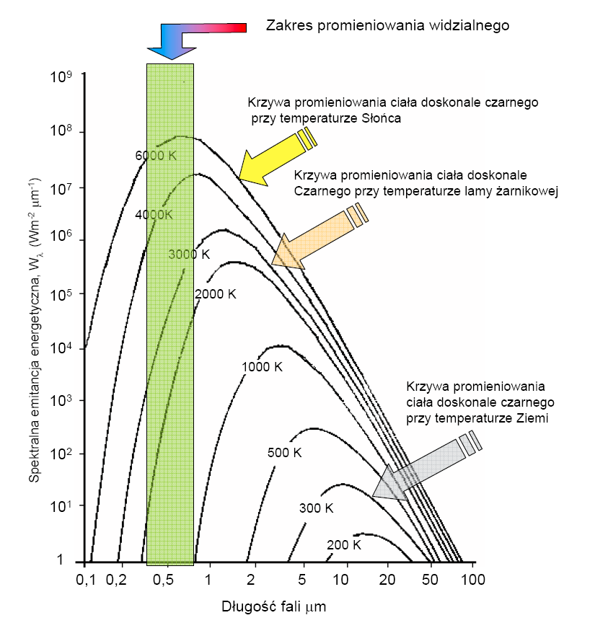
Blackbody radiation

Slide 28
The total radiance of a blackbody is expressed by the formula:
By substituting the variable we obtain:
The integral in the above expression is π⁴/15. Thus, the total radiance energy of a blackbody is expressed by the formula:
Since a blackbody radiates energy isotropically, the radiant flux is therefore
- Stefan-Boltzmann constans
= 5.67x10⁻⁸ Wm⁻²K⁻⁴.

Slide 29
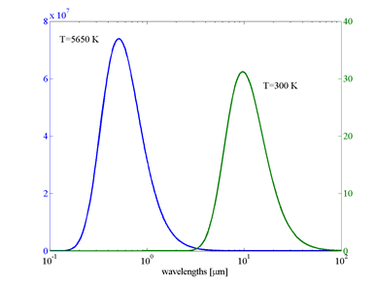
Example
The radiation of a blackbody with temperature=5650 K is 10⁵ times greater than that of a body with T=300 K.
Wavelength for which the maximum energy is emitted depends on the temperature of the blackbody.
By differentiating Planck's formula by the wavelength and then equating the derivative to zero, we arrive at Wien's law:
a=2.897x10⁻³ mK.
λ_{max} for T=5650 K is about 0.5 μm
λ_{max} for T=300 K is about 10 μm

Slide 30
Kirchhoff law
The Planck formula describing the radiation of a blackbody relates to thermodynamic equilibrium conditions characterised by a constant body temperature and isotropic radiation.
Since a blackbody is in thermodynamic equilibrium, it emits as much energy as it absorbs.
We define the following quantities:
emissivity ε_{λ} - as the ratio of the radiance emitted by a physical body to the radiance emitted by a blackbody (Planck formula)
absorptivity A_{λ} - as the ratio of the radiance absorbed by a body to the Planck function.
ε_{λ}= A_{λ}

Slide 31
Modified Stefan-Boltzmann law
In nature, black bodies do not occur, so the concept of a perfectly grey body is often defined, by which is meant a body for which the absorptivity A is constant less than unity (A<1) and independent of wavelength.
In this case, the total energy emitted by the body can be determined from the formula
F=εσT⁴

Slide 32
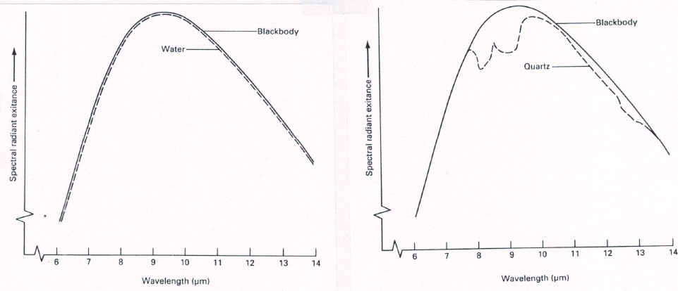
Deviations from the black body model
The sun or the Earth's surface, clouds are radiated approximately as a blackbody. Deviations from this model are generally at the level of a few per cent.

Slide 33
Emissivity λ>4μm

Slide 34
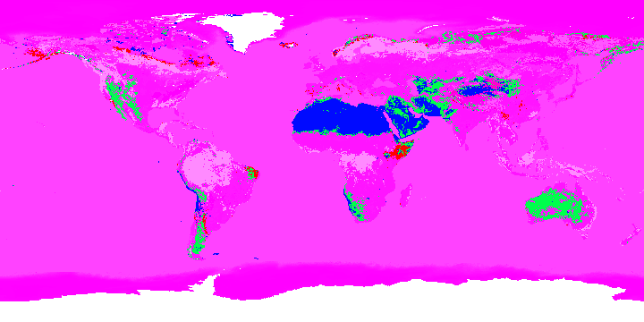
Emissivity in atmospheric window 8μm<λ<12μm

Slide 35
Solar Enegry
Since the radiation spectra of the Sun and the Earth are basically disconnected when considering radiation in the atmosphere, solar radiation and terrestrial radiation can be analysed separately.
In meteorological nomenclature, the former is called shortwave radiation (λ<4 μm) and the latter longwave radiation (λ>4 μm).
The fundamental quantity in radiation is the solar constant, which determines the flux of direct radiation coming from the Sun and reaching the upper limit of the atmosphere.
It amounts to 1361 W/m² and, despite its rather misleading name, is not a constant quantity as it depends on the Earth-Sun distance.

Slide 36
Solar energy variation
The variation in the solar constant over the year reaches ±3.3 %, or approximately ± 45 W/m² .
In addition to distance, solar activity also influences the solar constant.
There is an 11-year and an 81-year cycle, during which the Sun increases its activity, increasing the amount of energy it emits in the form of electromagnetic radiation.
As the results of direct and indirect measurements show, the change in the solar constant associated with solar activity is about 1-2 W/m².

Slide 37
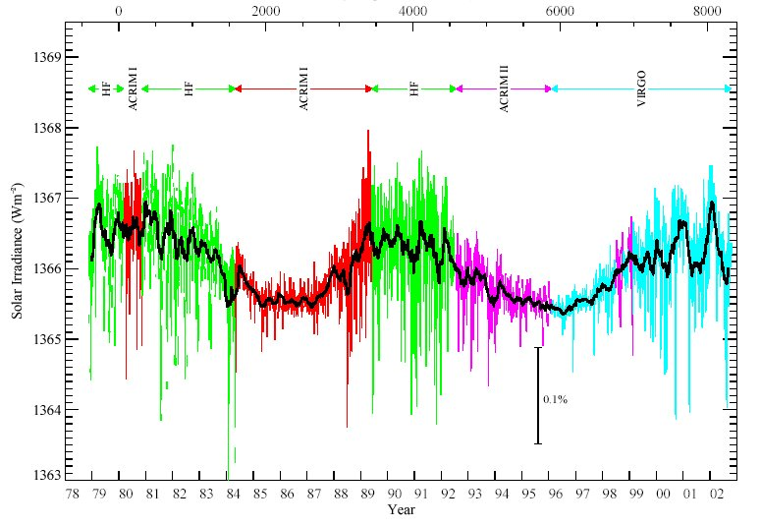
https://pl.wikipedia.org/wiki/Sta%C5%82a_s%C5%82oneczna

Slide 38
Solar radiation is spectrally distributed in the following proportions:
9 % UV radiation (λ<0.4 μm)
38 % visible radiation (0.4< λ <0.7 μm)
53 % infrared radiation (λ >0.7 μm).
Terrestrial radiation is subject to greater variations than solar radiation because the temperature of the earth's surface varies significantly. The maximum energy radiated by the Earth is in the far infrared (10 μm).

Slide 39
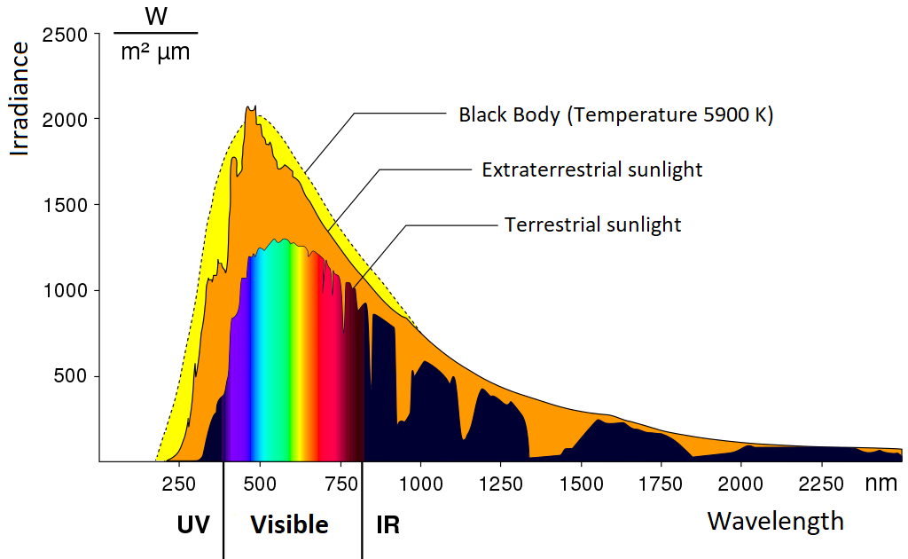
Solar spectrum
https://seos-project.eu/earthspectra/earthspectra-c02-p12.html

Slide 40
