Slide 1
Radiative processes in the atmosphere
Krzysztof Markowicz
Institute of Geophysics, University of Warsaw
kmark@igf.fuw.edu.pl

Slide 2
Adding, doubling method
One of the methods used to solve the transfer equation is the method called summation (adding) developed by Stokes in 1862.
This method allows the transfer equation to be solved exactly in the case of multiple scattering.
In this method, the transmission and reflection from each of the two layers are calculated from the transmission and reflection coefficients from the two layers as a whole.
When both layers have the same optical depth, the method is called doubling.

Slide 3
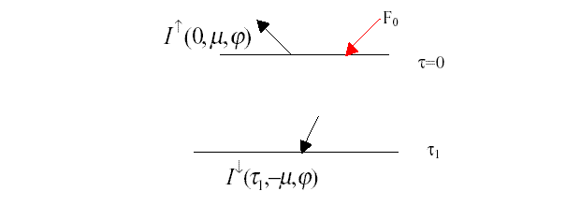
Adding method
Let us consider an atmospheric layer with an optical depth of τ₁.
Let be the radiance of the reflected radiation (scattered radiation) and the radiance of the scattered radiation that has passed through this layer.

Slide 4
Definitions
We define the reflection function (coefficient) from the layer on which solar radiation falls as
Transmission
In general, these definitions are set out in a more implicit form

Slide 5
The direct transmission function is
Let us consider two layers of air with reflectance R₁ and R₂ and total transmission (diffuse plus direct radiation transmission) .
Let us denote by R₁₂ and the reflection and transmission through the system thus defined.
U and are the reflection and transmission between layer 1 and layer 2.

Slide 6
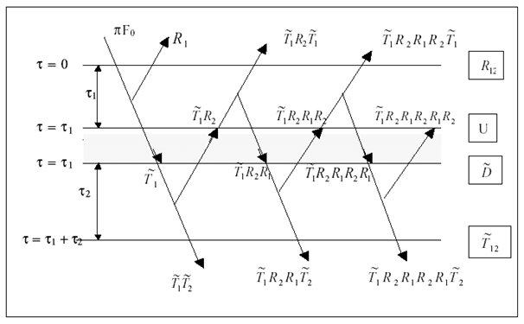
The total reflection coefficient can therefore be written in the form

Slide 7
Similarly, the overall transmission by the two layers
.

Slide 8
These coefficients can be written in a simple form
By introducing designations
and dividing the transmission into diffuse and direct radiation, we have
We can similarly split the coefficient and then
where T1, T2, D denote the components for diffuse radiation.

Slide 9
Finally, all coefficients have the form
.
Note that the multiplication of two functions involves the calculation of an integral as in the following example

Slide 10
Numerical procedure of the adding method
1. We start with an optically very thin layer ( ) for which the single scattering approximation can be used.
2. Then, using the derived transmission and reflection formulae, calculate these coefficients for a layer of optical depth equal to
3. Repeat step 2 until the optical depth reaches the required value.

