Slide 1
Radiative processes in the atmosphere
Krzysztof Markowicz
Institute of Geophysics, University of Warsaw
kmark@igf.fuw.edu.pl

Slide 2
Probabilistic aspect of the transfer equation - the Monte Carlo method
We can look at the radiative transfer equation in a different way.
The electromagnetic wave has a dual nature, so we can describe it by the flux of photons passing through the Earth's atmosphere.
Let us consider radiation that passes through a layer of optical depth τ_{o}.
We will assume for simplicity that the atmosphere is homogeneous (however, this is not a necessary condition and the case of an inhomogeneous atmosphere can also be considered).
The radiation flux after passing through it is reduced by a factor T=exp(τ_{o}) called transmission.

Slide 3
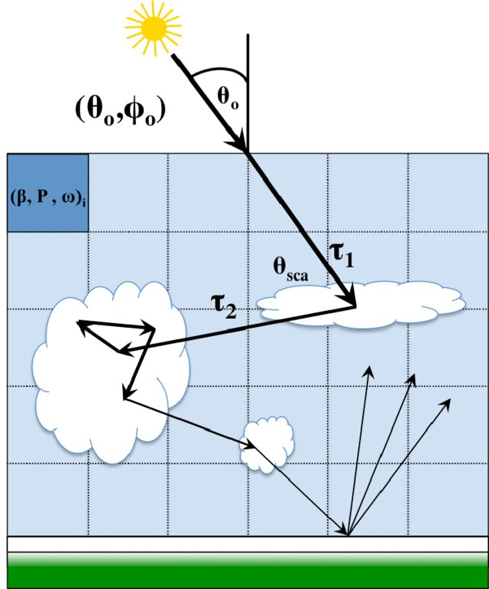
https://www.researchgate.net/publication/284464700_Implementation_of_polarization_in_a_3D_Monte_Carlo_Radiative_Transfer_Model

Slide 4
Transmission of the radiation
Since transmission takes values between 0 and 1 so can be interpreted in terms of probability.
Optical depth is related to transmission by the formula τ=-lnT.
If we now consider electromagnetic radiation as a beam of photons passing through a layer of optical depth τ, then using a random number generator with a flat distribution in the interval 0 to 1 we can assign to each photon a value from this interval corresponding to its transmission.
Now, if the optical depth for an individual photon determined from the formula is greater than τ_{o}, the photon passes through the layer without interaction.
Otherwise it will undergo absorption or scattering depending on the single-scattering albedo ω.

Slide 5
Photon scattering or absorption
Single-scattering albedo parameter can be equated as a probability, only that in this case it is the probability that the photon will be scattered.
Continuing the photon's journey through the atmosphere, we have to draw another number using the same generator.
If this time the number drawn is greater than ω, then the photon will be absorbed and its journey ends there.
Otherwise, it will scatter, but the new direction of propagation is not yet known to us.

Slide 6
Scattering angles
Due to the fact that the scattering phase function is normalised to unity, it can be interpreted as the probability that the photon will be scattered at an angle Θ
where Θ scattering angle
while the prim is denoted by the angles for the initial radiation. In the following, however, we will omit these angles from the arguments of the phase function.
For particles with rotational symmetry, the zenithal and azimuthal angles are independent.

Slide 7
Scattering angles
Moreover, the scattering at the azimuthal angle is equally probable, and therefore, using a random number generator with a uniform distribution, one can determine this angle from the formula , where r is a random number.
Using the independence of angles, we have
phase function related to the
zenith angle
Cumulative distribution D of the phase function with respect to cosθ

Slide 8
It takes values from zero to unity, so it can be generated using the same random number generator with a uniform distribution.
Determining the angle of scattering of the photon thus boils down to inverting the formula for the distribution, which in general can only be done numerically.

Slide 9
Example 1 – Rayleigh scattering
The phase function (azimuthal part) for Rayleigh scattering has the form
Cumulative distribution has the form
After solving the third degree equation, we have
where
r=D is a random number with a uniform distribution in the interval (0,1)

Slide 10
Example 2 - Henyey-Greenstein
Henyey-Greenstein phase function (zenith part)
Cumulative distribution function

Slide 11
Surface reflection
,
Once the new direction of the photon's propagation has been determined, another number is drawn, which will correspond to the photon's optical path to the point where the next interaction with matter will occur.
If the photon passes through the layer or is absorbed, the trajectory of the next photon is calculated.
The condition at the surface still needs to be specified.
For simplicity, we will assume that we have a Lambertian surface with constant reflectance ρ.
If the photon reaches the ground surface, we draw another number and if it is less than ρ, then the photon is reflected from it and the new propagation direction is determined by the angles
Otherwise, the photon is absorbed by the ground surface.
As can be seen, taking into account the change in reflectance from the angle of incidence of the radiation is not difficult.

Slide 12
General consideration
Solving the radiative transfer problem using the Monte Carlo method is therefore very simple and easy to implement.
After simulating a certain number of photons, a counting of them is performed and the inaccuracy of the method is determined.
For this purpose, the atmosphere is divided into layers and the photons absorbed in successive layers are counted.
In addition, the number of photons that pass through the upper and lower surfaces.
However, it is known that one photon can pass through a given surface many times and adding it up each time would be an error.

Slide 13
To avoid this, a photon is assigned a weight 'w' from 0 to 1 depending on how many times the photon passes through a particular horizontal surface. The radiance at level "z" from the solid angle is expressed by the formula
where N the number of photons used in the simulation, the first sum follows the photons and the second follows their successive realisations.
N_{c} is the number of photons that at height z had a direction defined by the solid angle Ω, while n_{k} is the number of times a photon 'k' passed through the surface at height z in the solid angle Ω .
Similarly, the radiant flux can be determined from the formula
where the angle θ_{i} denotes the zenithal angle of the photon.

Slide 14
Monte Carlo uncertainty
The relative standard deviation can be calculated from the formula
where N_{c} is the number of photons recorded and N is the number of photons used in the simulation.
The uncertainty of the method for N_{c} <<N is proportional to
For example, if we are interested in the uncertainty of the absorption coefficient in a certain layer or the uncertainty of the radiation flux at the ground surface then in these cases N_{c} is the number of photons that have been absorbed in the atmosphere or that have reached the ground surface, respectively.
It is therefore not the number of photons used in the simulation.

Slide 15
Properties of the Monte Carlo method
Relatively long calculation time because, as a rule, the desired accuracy requires at least one million photons
Allows the polarisation of the radiation to be taken into account. Calculation time in this case increases by about a factor of two.
Allows simple calculations in spherical geometry.
The method can be easily applied to three-dimensional problems (such as complicated cloud field or surface reflectance). However, the numer of photons which must be used is large (10⁸ -10⁹)

Slide 16
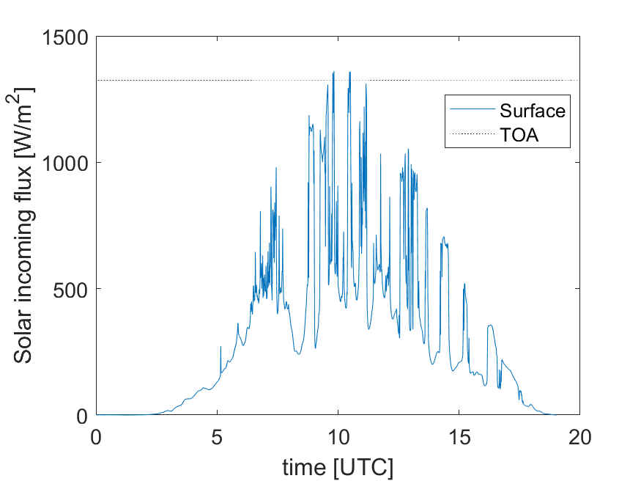
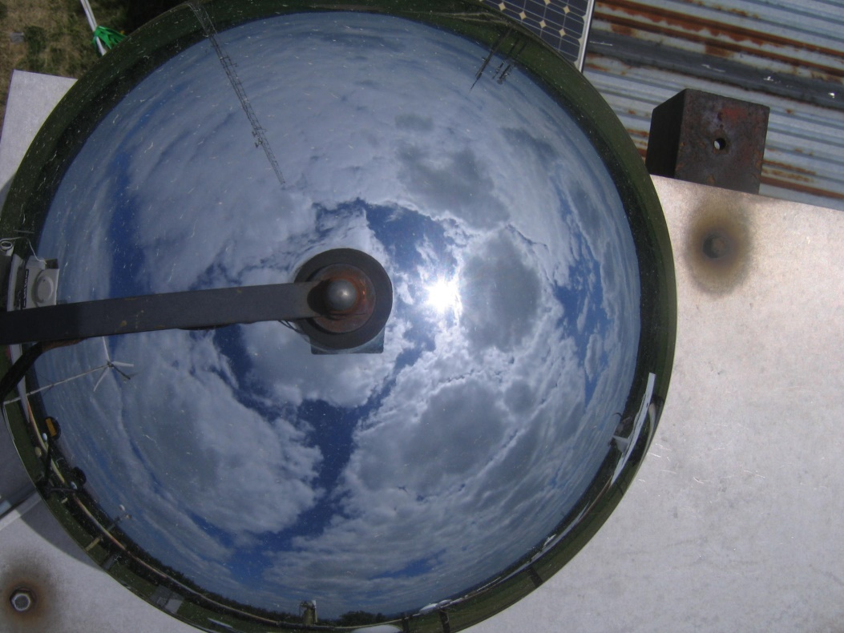
Example:
Surface solar flux exceed solar flux at TOA

