Slide 1
Radiative processes in the atmosphere
Krzysztof Markowicz
Institute of Geophysics, University of Warsaw
kmark@igf.fuw.edu.pl

Slide 2
Introduction
Solar and terrestrial radiation undergoes scattering and absorption during propagation through the atmosphere.
Directly related to the absorption process is the emission of radiation. These processes have a key role in the radiation budget on the Earth’s surface, top of the atmosphere, and in the atmosphere.
Knowledge of them is crucial when determining radiation transfer in the atmosphere.
When discussing absorption processes, instead of the wavelength we will use the wave number k[cm⁻¹] (k=10000/λ) where λ is in μm.

Slide 3
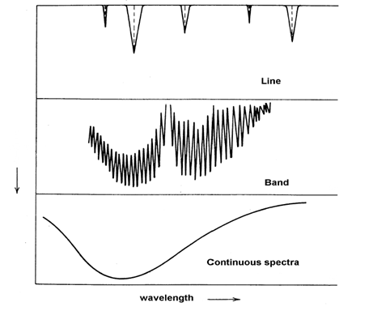
Type of spectrum
Absorption (emission) of radiation occurs during electron transitions in atoms and molecules.
In the case of the latter, the structure of the absorption bands is much more complex due to vibrational and rotational transitions.
Three types of spectrum can be distinguished:
linear
band
continuous

Slide 4
Absorption
In order to analyse the spectral structure of molecules, it is necessary to know their geometrical structure.
The molecules present in the atmosphere can be divided into:
Linear (CO₂, N₂O, C₂H₂ )
Symmetric (NH₃, CH₃CL)
Spherically symmetric (CH₄)
Asymmetric (H₂O, O₃)
The total energy of a molecule is expressed by the sum of
where E_{el} - potential energy of electrons, E_{vib} - kinetic-vibrational energy of molecules, E_{rot} - kinetic energy of rotational movement of molecules, E_{tr} - kinetic energy of exchange during collision of molecules

Slide 6
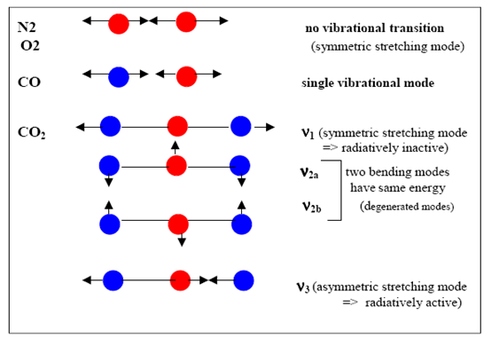
Due to the fact that the energies of the molecules fulfil the relations E_{rot} < E_{tr} < E_{vib} < E_{el}, it follows that spectral lines in the visible and ultraviolet region are associated with electron transitions, with vibrational transitions absorption of radiation from the near to far infrared, with rotational transitions absorption in the far infrared and in the microwave region.

Slide 7
Line broadening
Monochromatic absorption lines are practically never observed in nature as the spectral lines broaden.
A distinction is made between:
Natural broadening
Doppler broadening
Pressure (collisional) broadening
Doppler broadening results from a shift in the frequency of the wave emitted or absorbed by moving molecules. Atoms or molecules subject to Maxwell–Boltzmann distribution will have different velocities, so will see photons shifted to the red or blue side of the spectrum.
In this case, the higher the temperature of the gas, the greater the differences in velocities and the greater the broadening of the line.
Widening due to pressure is related to the modification of the energy levels of atoms or molecules when they collide. In this case, the broadening depends on the density of the gas.

Slide 8
Lorenz distribution
where f_{L} is the shape parameter and, ν_{o} defines the centre of the spectral line, α is the half-width of the spectral line defined by the formula:
where α_{o} is the half-width for standard conditions (T_{o}=273 K, p_{o}=1013.25 hPa) and varies between 0.01 and 0.1 cm⁻¹ for most optically active atmospheric gases.

Slide 9
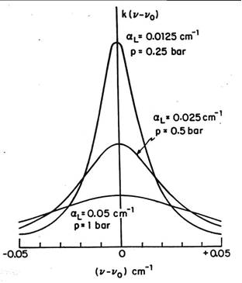
Notes to Lorenz distribution
The pressure dependence of spectral line shape is important in the lower layers of the atmosphere.
Pressure broadening is assumed to be important from the surface to 40 km, where the pressure varies by 3 orders of magnitude.
The Lorenz profile plays a fundamental role in radiative transfer in the lower atmosphere.
Collisions between the same types of molecules lead to much greater broadening compared to collisions between different molecules.
As the optically active gases in the atmosphere have a low concentration, so the second type of molecule collisions dominates.

Slide 10
Doppler broadening is described using the shape parameter f_{d} in the form:
where α_{d} is the half-width in [cm⁻¹] and is expressed by the formula
where m is the mass of the molecule and M_{A} is the atomic mass of the molecule or atom. Doppler broadening is significant at altitudes between 20 and 50 km.
Example:
Consider the absorption line broadening of CO for a wave number of 2140 cm⁻¹ at 300K

Slide 11
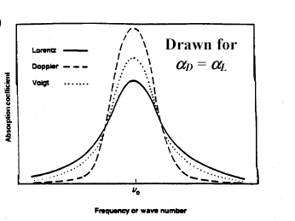
Voigt profile
Pressure and Doppler broadening cannot be considered separately in the low-pressure region (about 40 km above the earth's surface), so the so-called Voigt profile defined as follows is used to describe the spectral lines

Slide 12
Properties of Voigt profile
For high pressure, the Doppler broadening is narrow, so the Voigt profile is the same as the Lorenz profile.
For low pressure, the behaviour of the Voigt profile is more complicated and it is difficult to distinguish Doppler broadening from pressure broadening.

Slide 13
Absorption coefficient and transmission
The absorption coefficient (mass absorption coefficient) is defined by the position (in frequency space), the intensity of the spectral line (S) and its shape and is expressed by the formula
where S and f satisfy the relationships:
Monochromatic radiation transmission T_{ν} is defined as
where τ_{ν} is the optical thickness defined by the absorption coefficient

Slide 14
Notes
The unit of the absorption coefficient is [m²/kg] thus defined is and is therefore called the mass absorption coefficient, as opposed to the volume absorption coefficient, the unit of which is [m⁻¹].
The latter is the product of the absorption cross-sectional area and the concentration of the particles per unit volume.
Radiation transmittance defined above varies from zero do 1.
Transmission formula is only correct if the atmosphere is horizontally homogeneous or if the radiation propagates vertically upwards or downwards.

Slide 15
Optical depth (absorption optical depth)
where u is the optical path
When k_{ν} is constant along the direction of propagation
τ_{ν} depends in general on the frequency and the optical path

Slide 16
Absorption in the far-infrared
Terrestrial radiation interacts strongly with atmospheric gases and especially with water vapour and carbon dioxide and ozone.
Consequently, a significant proportion of the terrestrial radiation emitted by the earth's surface is absorbed in the atmosphere.
Only in the area of the so-called atmospheric window (8-12 μm) is there little absorption of radiation outside the area around 9.6 μ m, where the ozone absorption band occurs.
Radiation with wavelengths greater than 14 μm is completely absorbed in the atmosphere by the continuum spectrum of CO₂ and water vapour.

Slide 17
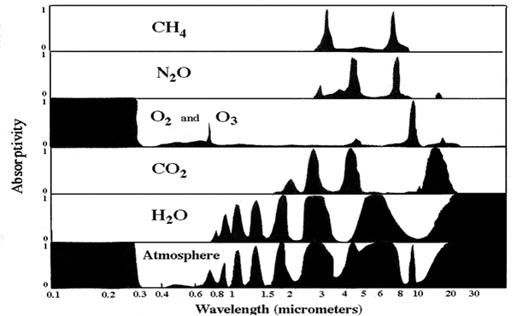
Absorption by main atmospheric gasses

Slide 19
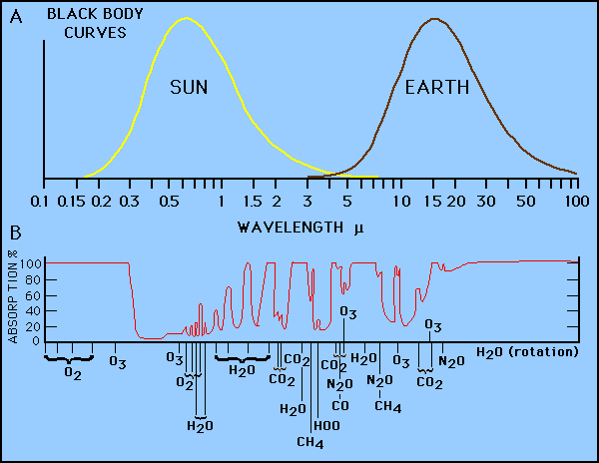
Gas absorption related to solar and infrared blackbody radiation

Slide 20
HITRAN database (http://www.cfa.harvard.edu/hitran/)
The absorption coefficients of the most important atmospheric gases are described in the HITRAN database.
The values of these coefficients are defined as a function of temperature, pressure and wavelength.
The database is continuously improved and new editions are published regularly.
The results of observed atmospheric and theoretically calculated absorption coefficients differ for some gases.
An example of this is water vapour, where the difference is probably due to the fact that the existence of water dimers present in the atmosphere was neglected in the numerical calculations.

Slide 21
What includes HITRAN?
Line-by-Line model data
Absorption cross section
Aerosol properties

Slide 22
What includes HITRAN?
The spectral line intensity [cm−1/(molecule⋅cm−2)cm−1/(molecule·cm−2)] at Tref=296K
https://hitran.org/docs/definitions-and-units/

Slide 23
Spontaneous emission
If a light source ('the atom') is in an excited state with energy E₂, it may spontaneously decay to a lower lying level (e.g., the ground state) with energy E₁, releasing the difference in energy between the two states as a photon. The photon will have energy hν.
If the number of light sources in the excited state at time t is given by N(t), the rate at which N decays is:
where A₂₁ is the rate of spontaneous emission. In the rate-equation A₂₁ is a proportionality constant for this particular transition in this particular light source. The constant is referred to as the Einstein A coefficient, and has units s⁻¹.
Solution

Slide 24
HITRAN software
The HITRAN Application Programming Interface (HAPI) [1] is a set of routines in Python which aims to provide remote access to functionality and data provided by HITRANonline.
https://github.com/hitranonline/hapi
MATLAB import data
https://www.mathworks.com/matlabcentral/fileexchange/48649-importhitran-par_file

