Slide 1
Radiative processes in the atmosphere
Krzysztof Markowicz
Institute of Geophysics, University of Warsaw
kmark@igf.fuw.edu.pl

Slide 2
DISORT method
The discrete ordinate method was developed by Chandrasekhar in 1950. It is now widely used in radiation codes requiring high precision. Let us consider for simplicity the case of isotropic scattering
Then the transfer equation takes the form
After applying the Gaussian formula we obtain

Slide 3
DISORT
The above equation describes 2n non-homogeneous first-order differential equations.
If we denote the general solution of the homogeneous equations is of the form
where k and g_{i} are constants. By substituting the solution into the homogeneous equation we have
The coefficient g_{i} can be determined from the equation
L is constant

Slide 4
After substitution into the equation for g_{i} , we obtain
This equation gives 2n solutions for the coefficients (n=1,2,...,n). Finally, the solution of the homogeneous equation takes the form
where L_{j} are constants. The special solution of the inhomogeneous equation has the simple form

Slide 5
By substituting into the initial equation we have
Finally
where the L_{j} constants are determined from the boundary conditions.
diffuse term direct term

Slide 6
Final consideration
To conclude our consideration of methods for solving the radiative transfer equation, let us generalise the discrete ordinate method to the case of anisotropic scattering. The radiance of the radiation can be written as a series of
The general solution of the homogeneous equation, as in the case of isotropic scattering, is of the form
where are the coefficients

Slide 7
The special solution of a homogeneous equation can be written in the form of
Finally
where i=-n,...,n.

Slide 8
Properties of the DISORT method (numerical code of the discrete ordinate method)
Applicable for an inhomogeneous atmosphere (plane-parallel approximation)
It is possible to task any number of layers in the atmosphere.
Each layer is characterised by the effective optical depth, the single-scatering albedo, and the asymmetry parameter or phase function.
It is possible to inflict an arbitrary phase function by specifying the expansion coefficients in Legendre polynomials.
The number of radiative fluxes is given by the user (the calculation time is proportional to the cube of the number of fluxes!).
The key problem is to obtain a solution for phase functions with strong forward scattering.
DISORT allows the radiance to be determined as a function of direction and position in the atmosphere not only at the boundaries of the layers, but also in the atmosphere.

Slide 9
Line-by-line model
The methods considered so far for solving the radiative transfer equation in the atmosphere have dealt with monochromatic radiation.
Solving the transfer equation for each spectral line is computationally very expensive and only used for calculations where high spectral resolution is required.
Models of this type is line-by-line model (e.i. LBLRITM, GENSPEC)
The latter was written in the MATLAB environment and allows the calculation of radiative transfer.
In addition to line-by-line models, band models and the distribution-k model are much more commonly used.
The former use different methods to calculate the effective transmission through the band.
In the simplest case for a homogeneous atmosphere, the effective transmission is

Slide 10
In what follows, we will omit the methods for calculating effective transmission for band models.
In the decomposition-k method, the entire spectrum is divided into N intervals in such a way that each interval contains a large number of absorption lines.
On the other hand, they are narrow enough to assume that the Planck function within such a band was constant.
We will consider for simplicity the case of a homogeneous atmosphere. In this method, the integration after the frequency of the complex dependence of the absorption coefficient is replaced by the integration of a much smoother function in the space of k.
Furthermore, a specific value of k is taken only once for the calculation, whereas there may be many within a specific band.
We introduce the density function f(k) according to the formula

Slide 11
Band model
where the interval is contained within the band under consideration. The normalisation of the density function is of the form
By g(k) we denote the cumulative distribution associated with the probability density function f(k)
gdzie g(0)=0 zaś g(∞)=1 oraz
dg(k)=f(k)dk.

Slide 12
From the definition of the cumulative distribution g(k), it follows that it is a monotonically smooth and non-decreasing function in the space k. Using this, we can write the transmission formula in the form of
Due to the smoothness of the function g(k), k(g), we can approximate the expression for transmission by the sum of a series of

Slide 13
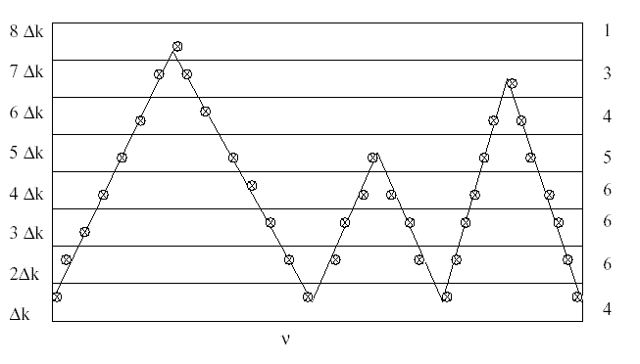
Example
Figure shows the frequency dependence of the absorption coefficient. We divide the range of variation of k into intervals (in this case eight intervals). Counting the number of points in the frequency domain that correspond to a given interval, we draw a histogram and successively plot the distribution, which is expressed by the formula
where N is the number of all points (N=35) and n(0,k) specifies the number of points for which the absorption coefficient is less than, or equal to, k.

Slide 14
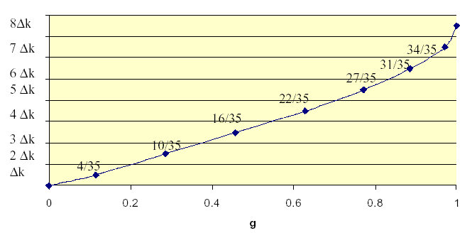
In the general case (for an inhomogeneous atmosphere), an analogous method called k-correlated distribution is used.

