Slide 1
Social Crisis & Migrations
Michał Grzela
MD Abid Hasan
Ifechi Chikezie
Beryl Okal

Slide 2
Overview:
Social crisis
  What is it?
  Is social crisis climate related?
IPCC Report - Global Warming of 1.5 Celsius
Climate change and land
Migrations

Slide 3
Social crisis

Slide 4
“Many members of a social system fail to receive expected conditions of life from the system.”
Len Barton

Slide 5
What is social crisis?
We can understand them as natural, collective, unavoidable, and necessary processes for the evolution of a social system in continuous adaptation and with increased complexity.
Situation in which we are not capable of finding the solutions for certain problems.
Processes in which the organization of the system is questioned, thus - due to the rise of adaptive pressures - it can lead to a change.

Slide 6
Types of social crisis incidents
Local: Death, suicide, health related issues, accidents, intruders, and acts of violence or crime within the local community.
Global: Natural disasters, terrorism, and death of a public figure.

Slide 7
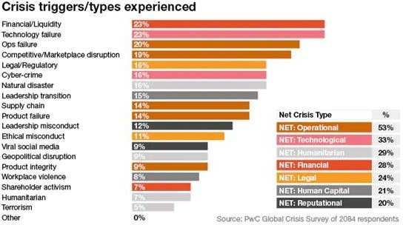
https://www.reputation.ca/the-definitive-guide-to-crisis-management-online-and-offline/

Slide 8
Examples of social crisis

Slide 9
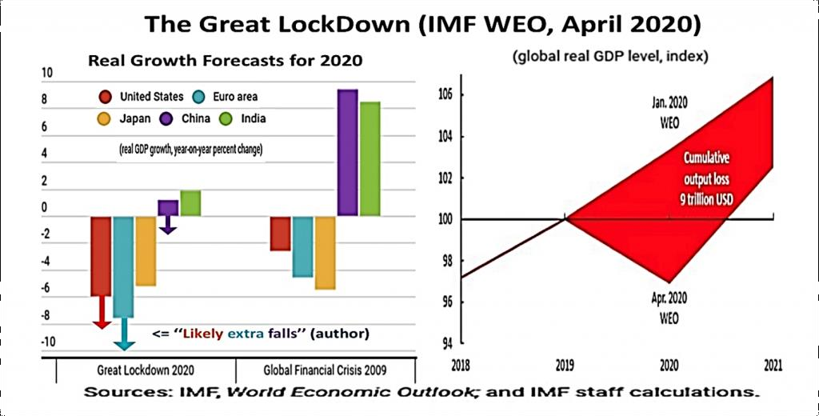
https://www.atlanticcouncil.org/blogs/new-atlanticist/can-we-compare-the-covid-19-and-2008-crises/

Slide 10
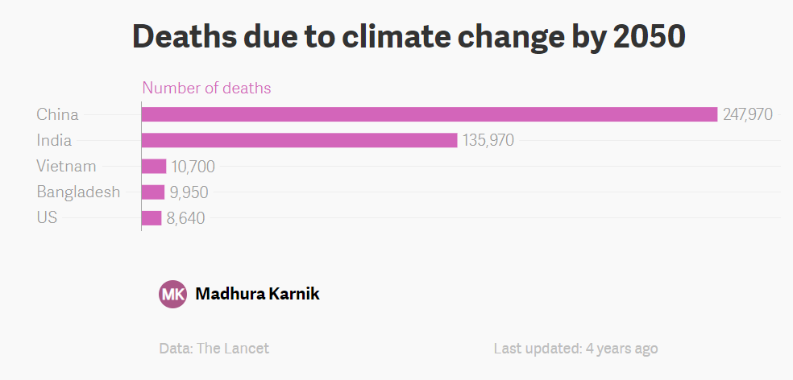
https://www.google.com/search?q=climate+change+threat+to+social+crisis&source=lnms&tbm=isch&sa=X&ved=2ahUKEwjKrNn4zp3uAhXywTgGHfeVAr8Q_AUoAnoECA8QBA&biw=1396&bih=605#imgrc=4WDwWgybrwmzqM

Slide 11
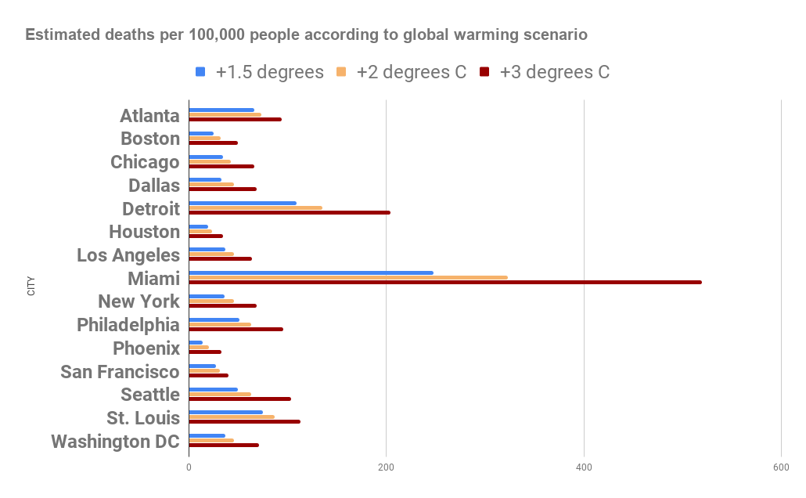
Heat-related deaths in these 15 U.S. cities
https://grist.org/article/heres-how-many-heat-deaths-15-cities-could-prevent-based-on-how-seriously-we-take-climate-change/

Slide 12
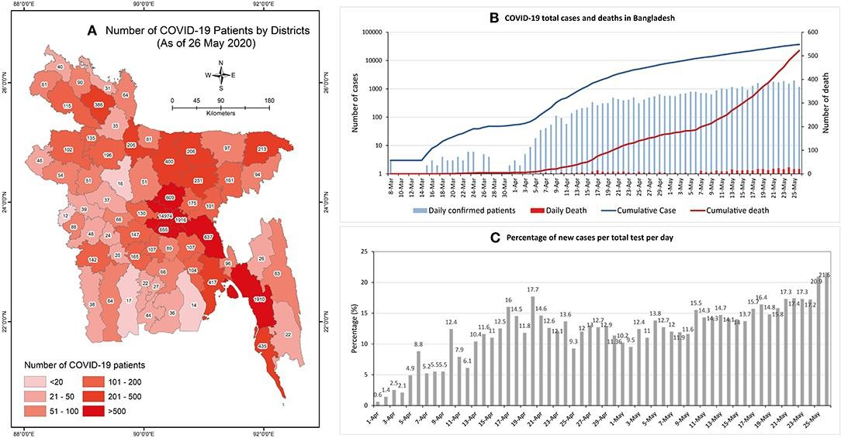
Psychosocial and Socio- Economic Crisis in Bangladesh Due to COVID- 19 Pandemic
Front. Public Health, 26 June 2020. https://doi.org/10.3389/fpubh.2020.00341

Slide 13
Why climate change needs to be considered a social crisis?

Slide 14
Climate change = Social crisis
IPCC report “Global Warming of 1.5 ºC”
  The latest scientific analysis gives us just twelve years to limit global warming to 1.5 degree Celsius above pre-industrial levels by 2100.
  No one will be safe but the poor, marginalized and disadvantaged will suffer the most
Climate change presents perhaps the most profound challenge ever to have confronted human, social, political, and economic systems.

Slide 15
Climate change = Social crisis
Shortly, we can say that due to the impact of climate change every branch of human life is affected
  Health
  Education
  Food Security
  Employment
  Migration
  Vulnerable population

Slide 16
Climate Change = Social Crisis
Poor and marginalized groups are raising their voices to call for more ambitious action on climate change, conflict, and other global issues. Climate change is more than an environmental crisis – it is a social crisis and compels us to address issues of inequality on many levels: between wealthy and poor countries; between rich and poor within countries; between men and women, and between generations.

Slide 17
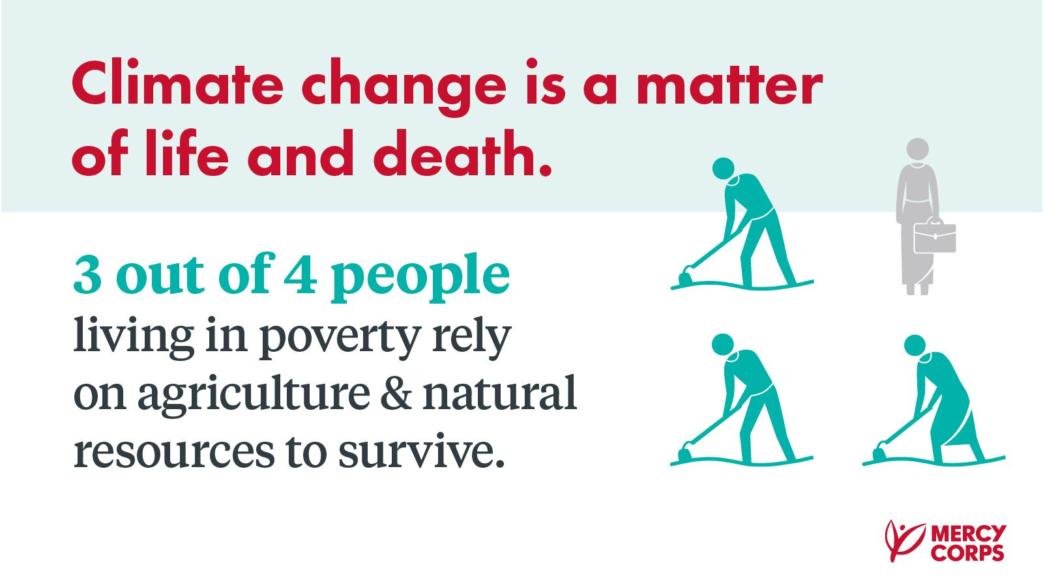
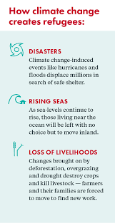
https://www.google.com/search?q=climate+change+threat+to+social+crisis&source=lnms&tbm=isch&sa=X&ved=2ahUKEwjKrNn4zp3uAhXywTgGHfeVAr8Q_AUoAnoECA8QBA&biw=1396&bih=605#imgrc=ZQebrfhIkASX5M
https://www.google.com/search?q=climate+change+threat+to+social+crisis&source=lnms&tbm=isch&sa=X&ved=2ahUKEwjKrNn4zp3uAhXywTgGHfeVAr8Q_AUoAnoECA8QBA&biw=1396&bih=605#imgrc=ZQebrfhIkASX5M&imgdii=iGofKCxb9OtO8M

Slide 18
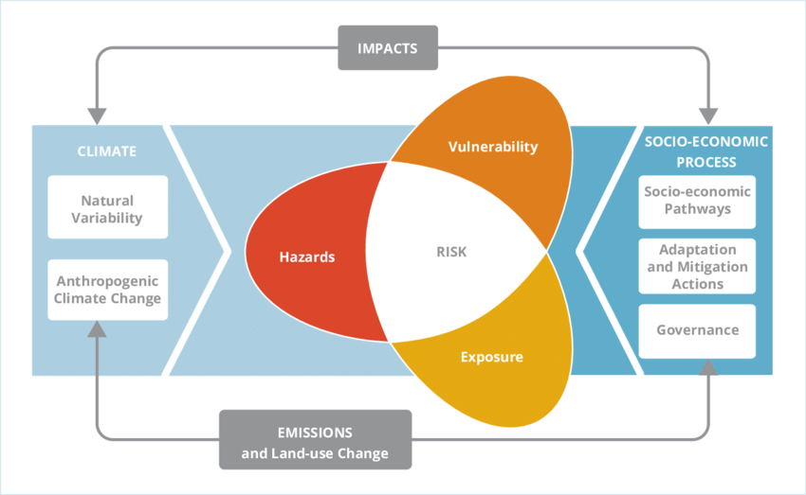
Impacts of climate change on societal prosperity:
The SREX and IPCC AR5 vulnerability assessment framework where the risk of climate-related impacts results from the interaction of the climate-related hazards with vulnerability and exposure of human and natural systems.
Risk and Vulnerability A HANDBOOK FOR SOUTHERN AFRICA - Scientific Figure on ResearchGate. Available from: https://www.researchgate.net/figure/The-SREX-and-
IPCC-AR5-vulnerability-assessment-framework-where-the-risk-of_fig5_326190916 [accessed 11 Jan, 2021]

Slide 19
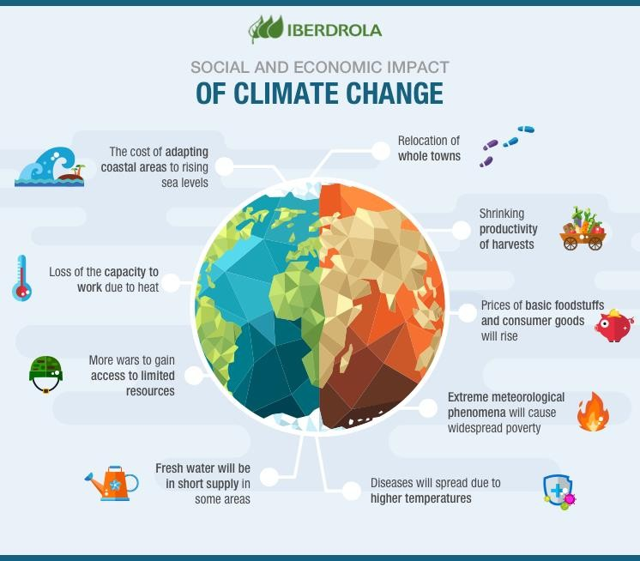
https://www.google.com/search?q=reasons+of+social+crisis&tbm=isch&ved=2ahUKEwiQqvDjuJTuAhXJYH0KHRMeAj0Q2cCegQIABAA&oq=reasons+of+social+crisis&gs_lcp=CgNpbWcQAzoICAAQCBAHEB5Qq8DWJa9A2DNvwNoAHAAeACAAbkBiAGJB5IBAzAuN5gBAKABAaoBC2d3cy13aXotaW1nwAEB&sclient=img&ei=A5D8X9CcKcnB9 QOTvIjoAw&bih=532&biw=1229#imgrc=gJpNKCD6gfNtuM

Slide 20
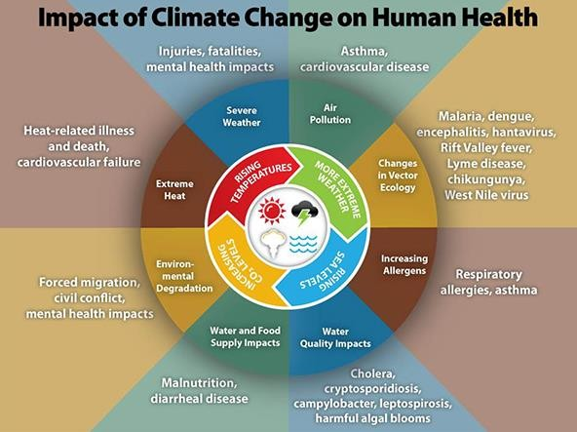
https://www.cdc.gov/climateandhealth/effects/default.htm

Slide 21
How we can deal with a social crisis?

Slide 22
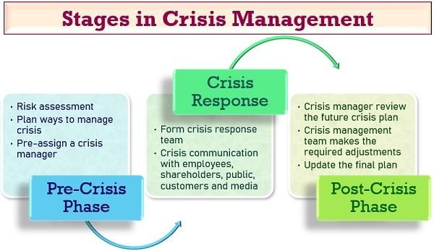
https://www.google.com/search?q=types+of+social+crisis&source=lnms&tbm=isch&sa=X&ved=2ahUKEwjYr_bQmpTuAhV97XMBHQEjCBwQ_AUoAXoECAIQAw&biw= 1229&bih=532#imgrc=ieojZd9gKzFf3M&imgdii=rsqGM0uhms74lM

Slide 23
Objectives of crisis management:
To end the crisis as soon as possible and to assure security.
To demonstrate commitment or expertise.
To control the flow of accurate information, for pacifying the situation.
To manage resources effectively.
Thrimurthulu, V. 2016. “Social Crisis and its Management.” Journal of Educational Research & Extension. Vol. 53, no. 03. http://www.srkvcoe.org/JERE/journaladmin/journals/Vol._53_Issue._38682.pdf

Slide 24
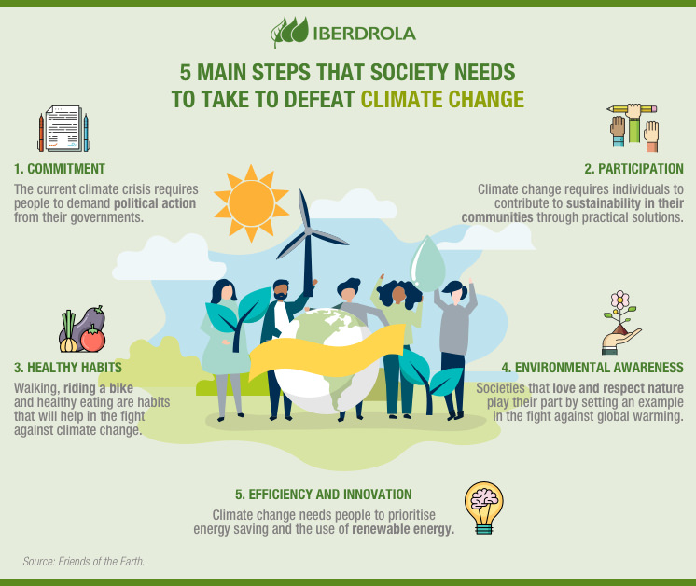
https://www.google.com/search?q=climate+change+threat+to+social+crisis&source=lnms&tbm=isch&sa=X&ved=2ahUKEwjKrNn4zp3uAhXywTgGHfeVAr8Q_AUoAnoECA8QBA&biw=1396&bih=605#imgrc=ER0SGOCz6S8LmM

Slide 25
Solution of the social problems:
Poverty: By providing education, skill training and job opportunities in a society. Increase the education budget. Provide them scholarship and opportunities, to get the best achievable education. To all the classes technical education must be given.
Unemployment: Providing job-oriented education, training to the people by Government.
Population growth: Awareness programme should be created about the family planning and its effect on population growth. Devices of family planning should be available free of cost to the poor and rural population.
Social problems: Various awareness programmes like; procession, street drama, advertisement of alcohol, tobacco, etc in media like; television, newspaper, radio, etc should be banned to solve social problems.

Slide 26
Number one priority
Unless we submit these to critical scrutiny, no change in coping with climate change can occur.
To divert the deadly course on which we have sent the Earth, we have to immediately take the actions that experts and activists called for decades ago. Their advice to us was, in a nutshell, to change how society functions and especially to stop deferring to the interests of industry and capital at the expense of humanity.
Problems will continue to manifest themselves - both as we try to prevent and as we try to adapt to the consequences of climate change - so human systems will have to learn how better to respond.

Slide 27
It is very likely that a solution to climate change does not exist. However, we must do our best!

Slide 28
SOCIAL CRISIS AND MIGRATIONS IPCC REPORT
GLOBAL WARMING OF 1.5 DEGREES CELSIUS

Slide 29
SUSTAINABLE DEVELOPMENT, POVERTY ERADICATION AND REDUCING INEQUALITIES
What are the Connections between Sustainable Development and Limiting Global Warming to 1.5°C above Pre-Industrial Levels?
Sustainable development seeks to meet the needs of people living today without compromising the needs of future generations, while balancing social, economic and environmental considerations. The 17 UN Sustainable Development Goals (SDGs) include targets for eradicating poverty; ensuring health, energy and food security; reducing inequality; protecting ecosystems; pursuing sustainable cities and economies; and a goal for climate action (SDG 13). Climate change affects the ability to achieve sustainable development goals, and limiting warming to 1.5°C will help meet some sustainable development targets. Pursuing sustainable development will influence emissions, impacts and vulnerabilities.

Slide 30
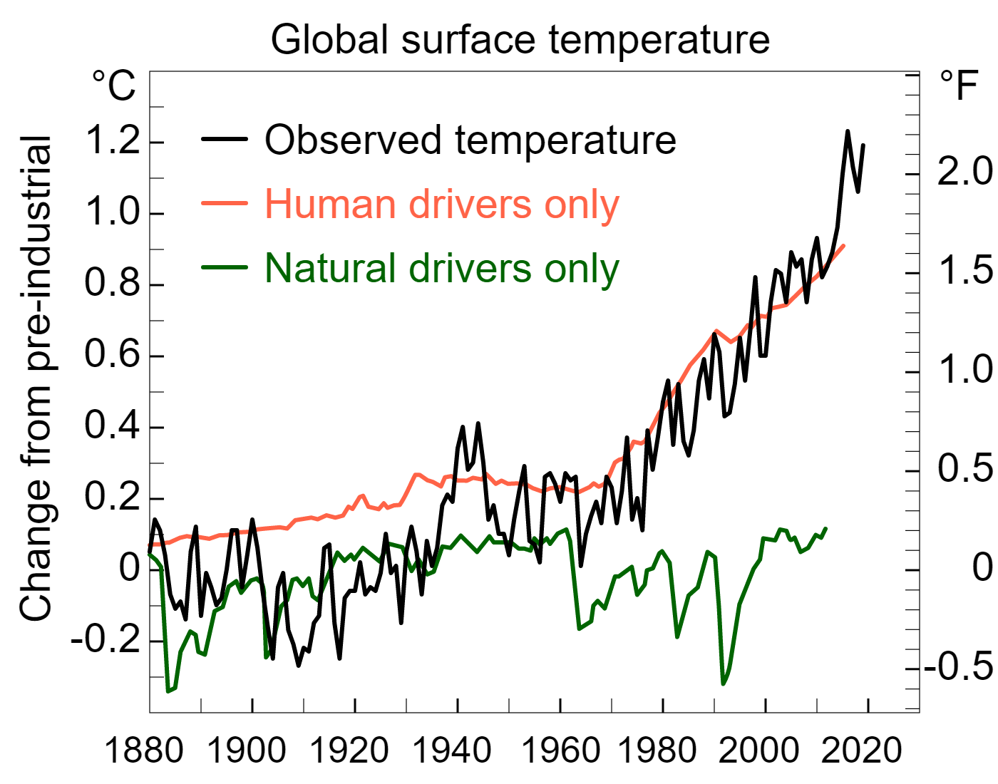
Responses to climate change in the form of adaptation and mitigation will also interact with sustainable development with positive effects, known as synergies, or negative effects, known as trade-offs. Responses to climate change can be planned to maximize synergies and limit tradeoffs with sustainable development.
Climate change and sustainable development are fundamentally connected. Previous IPCC reports found that climate change can undermine sustainable development, and that well-designed mitigation and adaptation responses can support poverty alleviation, food security, healthy ecosystems, equality and other dimensions of sustainable development. Limiting global warming to 1.5°C would require mitigation actions and adaptation measures to be taken at all levels. These adaptation and mitigation actions would include reducing emissions and increasing resilience through technology and infrastructure choices, as well as changing behaviour and policy.

Slide 31
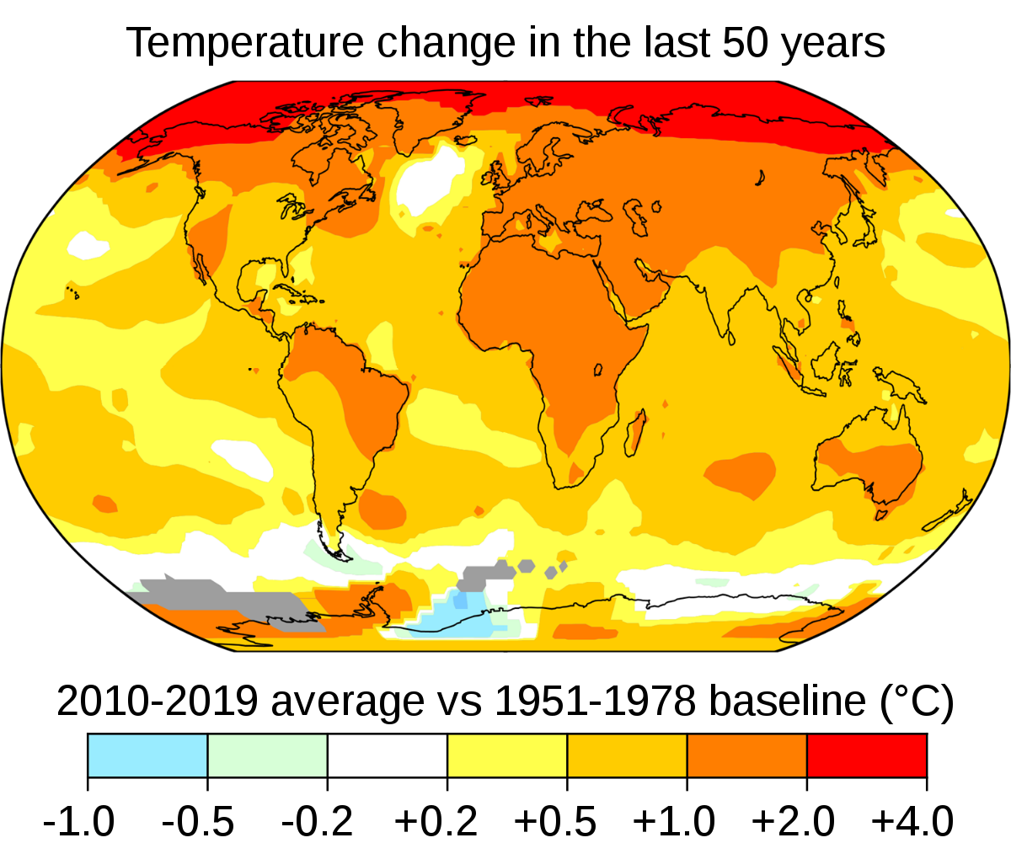
Average global temperatures from 2010 to 2019 compared to a baseline average from 1951 to 1978. Source: NASA.

Slide 32
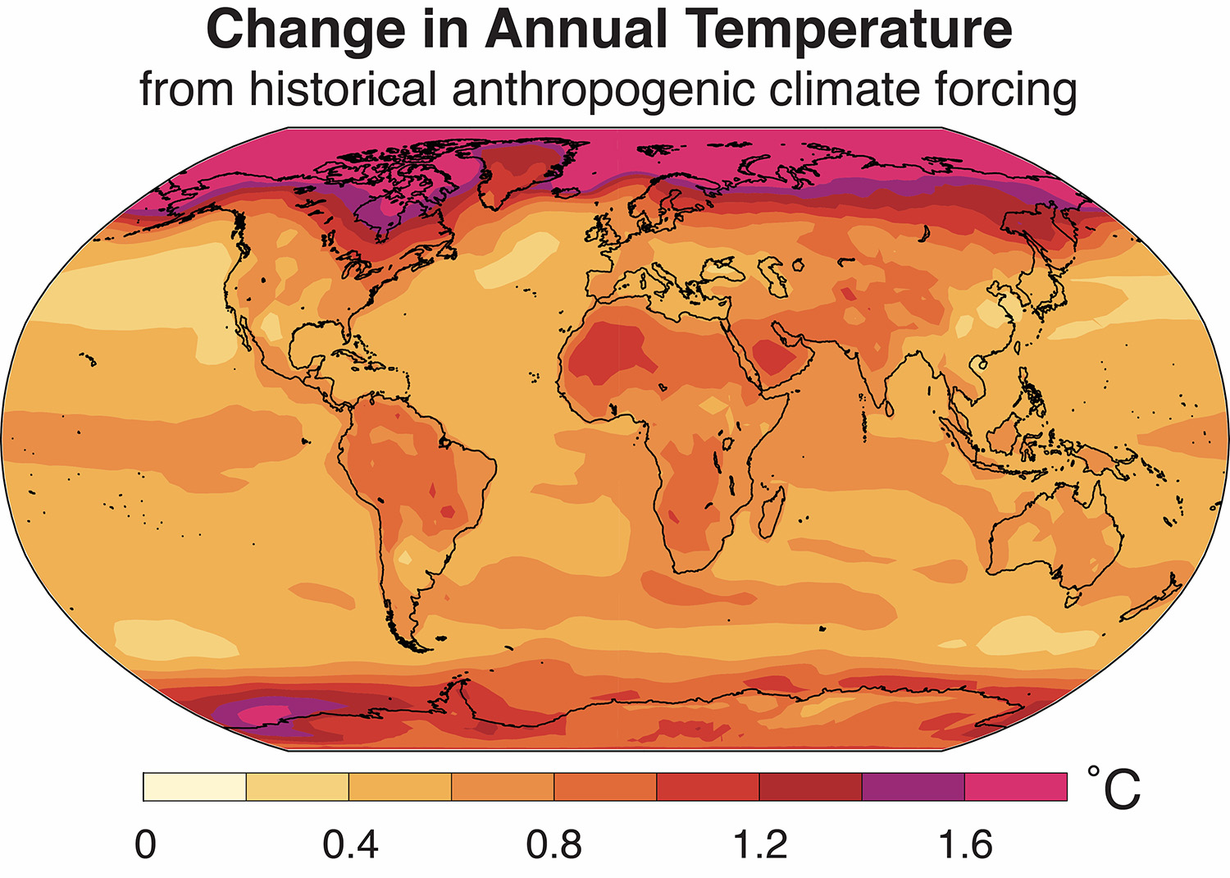
Poverty, Equality and Equity Implications of a 1.5°C Warmer World
Climate change could lead to significant impacts on extreme poverty by 2030 (Hallegatte et al., 2016; Hallegatte and Rozenberg, 2017). The AR5 concluded, with very high confidence, that climate change and climate variability worsen existing poverty and exacerbate inequalities, especially for those disadvantaged by gender, age, race, class, caste, indigeneity and (dis)ability (Olsson et al., 2014).
The understanding of regional impacts and risks of 1.5°C global warming and interactions with patterns of societal vulnerability and poverty remains limited. Yet identifying and addressing poverty and inequality is at the core of staying within a safe and just space for humanity (Raworth, 2017; Bathiany et al., 2018).
New Stanford study shows a warming planet worsens global economic inequalities →
Climate change is widening the world’s gap between the haves and have-nots, worsening economic inequality between rich and poor countries, according to a new analysis by Stanford scientists.
The difference between the economic output of the world’s cool wealthy nations and hot struggling nations is 25 percent larger today than it would have been without global warming, according to researchers Noah Diffenbaugh and Marshall Burke.
https://www.mercurynews.com/2019/04/22/how-climate-change-widens-gap-between-haves-and-have-nots/

Slide 33
Impacts and Risks of a 1.5°C Warmer World: Implications for Poverty and Livelihoods
This includes residual risks, limits to adaptation, and losses and damages, food and water security, health, decrease in crop production and quality, increase in crop pests and diseases, disruption of culture, and increased gender inequality ((Kaijser and Kronsell, 2014; Vinyeta et al., 2015; Carter et al., 2016; Hanna and
Oliva, 2016; Li et al., 2016).
Global heat stress is projected to increase in a 1.5°C warmer world, and by 2030, compared to 1961–1990, climate change could be responsible for additional annual deaths of 38,000 people from heat stress, particularly among the elderly, and 48,000 from diarrhoea, 60,000 from malaria, and 95,000 from childhood undernutrition (WHO, 2014). Each 1°C increase could reduce work productivity by 1 to 3% for people working outdoors or without air conditioning, typically the poorer segments of the workforce (Park et al., 2015).
Limiting warming to 1.5°C is expected to reduce the number of people exposed to hunger, water stress and disease in Africa (Clements, 2009). It is also expected to limit the number of poor people exposed to floods and droughts at higher degrees of warming, especially in African and Asian countries (Winsemius et al., 2018). Challenges for poor populations – relating to food and water security, clean energy access and environmental well-being – are projected to be less at 1.5°C, particularly for vulnerable people in Africa and Asia (Byers et al., 2018).
The overall projected socio-economic losses compared to the present day are less at 1.5°C (8% loss of gross domestic product per capita) compared to 2°C (13%), with lower-income countries projected
to experience greater losses, which may increase economic inequality between countries (Pretis et al., 2018).

Slide 34
A devastating heat wave swept across Europe in 2003, killing tens of thousands of people, scientists estimate. Many were elderly, with limited mobility, and some already suffered from chronic diseases. But climate change is making such extreme weather more common—and the effects will not be limited to the old and sick. Warming temperatures do not only threaten lives directly. They also cause billions of hours of lost labor, enhance conditions for the spread of infectious diseases and reduce crop yields, according to a recent report.
“It affects everyone around the world—every single person, every single population. No country is immune,” says Nick Watts, executive director of the Lancet Countdown and one of many co-authors of the report. “We've been seeing these impacts for some time now.”
There were 157 million more “heat wave exposure events” (one heat wave experienced by one person) in 2017 than in 2000. Compared with 1986 to 2005, each person was exposed to, on average, 1.4 more days of heat wave per year from 2000 to 2017. That may not seem like a lot, but as Watts notes, “someone who is 75 and suffers from kidney disease can probably survive three to four days of heat wave but not five or six.”
https://www.scientificamerican.com/article/climate-change-is-having-a-major-impact-on-global-health/

Slide 35
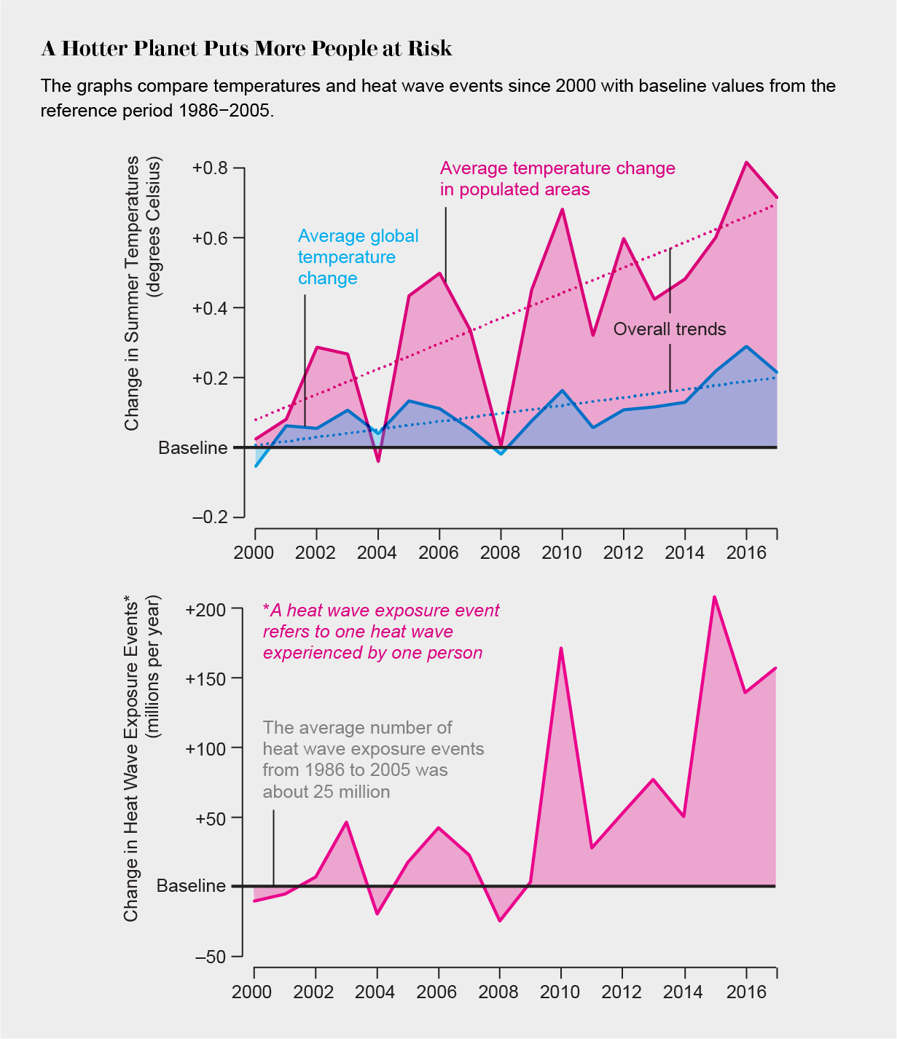
Credit: Amanada Montañez; Source: “The 2018 Report of the Lancet Countdown on Health and Climate Change: Shaping the Health of Nations for Centuries to Come,” by Nick Watts et al., in Lancet, Vol. 392; December 8, 2018

Slide 36
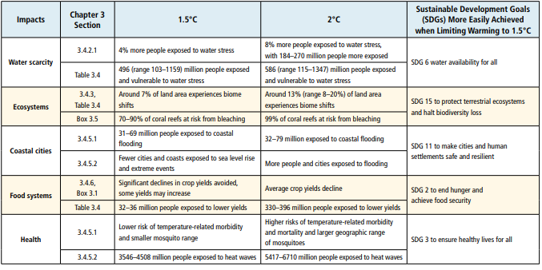
Risks from 1.5°C versus 2°C Global Warming and the Sustainable Development Goals: Sustainable development implications of avoided impacts between 1.5°C and 2°C global warming.

Slide 37
Synergies and trade-offs between mitigation options and SDGs. (Explanation to Slide 7)
Top three wheels are representing synergies and bottom three wheels show trade -offs.
Colours on the border of the wheels correspond to the SDGs listed above. Here SDG 13 climate action is at the centre because the figure shows if mitigation actions (climate action) in various sectors are taken then what do they interact with the 16 SDGs.
Vertically starting from the first left side pair of wheels correspond to synergies (Top) and tradeoffs (Bottom) of three mitigation actions undertaken in each of the energy demand sectors (Industry, Residential and Transport sectors). Middle pair of wheels vertically shows the synergies (Top) and tradeoffs (Bottom) with SDGs of the five mitigation actions taken in the energy supply sector. Right most pair, shows synergies (top) and tradeoffs (bottom) with SDGs of three types of mitigation actions in each of the sectors Agriculure, Forestry and Oceans.
Length of the coloured bars show the strength of the synergies or tradeoffs. Longer the bar higher is the strength. Shade of the color represent level of confidence based on evidence and agreement in the literature.
Darker the shade higher is the confidence and lighter the shade confidence level is lower.
White within wheels show no interaction between the corresponding mitigation action sand the SDG, Grey within the wheels show knowledge gap. Bottom panel shows various mitigation actions in each sector and corresponding symbols.

Slide 38
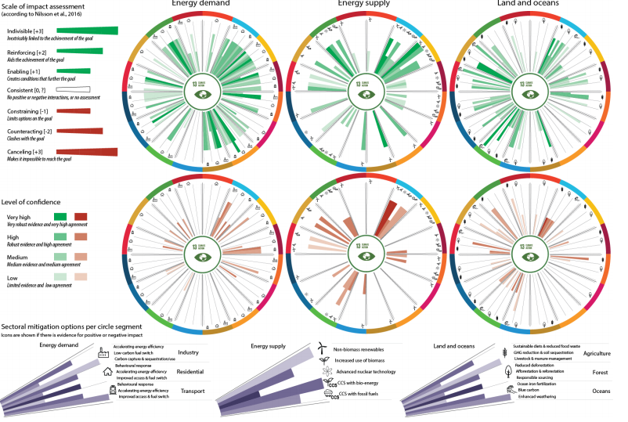

Slide 39
Sustainable Development Implications of 1.5°C and 2°C Mitigation Pathways
Air Pollution and Health: mitigation strategies that reduce GHGs or the use of fossil fuels typically also reduce emissions of pollutants, such as particulate matter (e.g., PM2.5 and PM10), black carbon (BC), sulphur dioxide (SO2 ), nitrogen oxides (NOx) and other harmful species (Clarke et al., 2014)
(Figure 5.3), causing adverse health and ecosystem effects at various scales (Kusumaningtyas and Aldrian, 2016).
Food Security and Hunger: 1.5°C’ goals often rely on the deployment of large-scale land-related measures, like afforestation and/or bioenergy supply (Popp et al., 2014; Rose et al., 2014; Creutzig et al., 2015) These land-related measures can compete with food production and hence raise food security concerns (P. Smith et al., 2014)
Water security: Transformations towards low emissions energy and agricultural systems can have major implications for freshwater demand as well as water pollution. The scaling up of renewables and energy efficiency as depicted by low emissions pathways would, in most instances, lower water demands for thermal energy supply facilities (‘water-for-energy’)
compared to fossil energy technologies, and thus reinforce targets related to water access and scarcity.

Slide 40
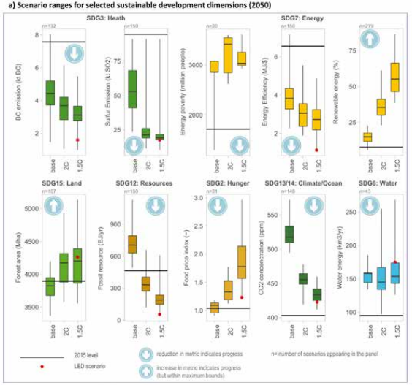

Slide 41
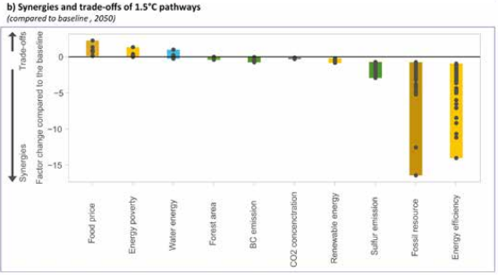

Slide 42
Sustainable development implications of mitigation actions in 1.5°C pathways. (Slide 9 and 10)
Panel (a) shows ranges for 1.5°C pathways for selected sustainable development dimensions compared to the ranges of 2°C pathways and baseline pathways. Depicts interquartile and the full range across the scenarios for Sustainable Development Goal (SDG) 2 (hunger), SDG 3 (health), SDG 6 (water), SDG 7 (energy), SDG 12 (resources), SDG 13/14 (climate/ocean) and SDG 15 (land). Progress towards achieving the SDGs is denoted by arrow symbols (increase or decrease of indicator).
Black horizontal lines show 2015 values for comparison. Note that sustainable development effects are estimated for the effect of mitigation and do not include benefits from avoided impacts (see Chapter 3, Section 3.5). Low energy demand (LED) denotes estimates from a pathway with extremely low energy demand reaching 1.5°C without bioenergy with carbon capture and storage (BECCS).
Panel (b) presents the resulting full range for synergies and trade-offs of 1.5°C pathways compared to the corresponding baseline scenarios.
The y-axis in panel (b) indicates the factor change in the 1.5°C pathway compared to the baseline. Note that the figure shows gross impacts of mitigation and does not include feedbacks due to avoided impacts. The realization of the side effects will critically depend on local circumstances and implementation practice. Trade-offs across many sustainable development dimensions can be reduced through complementary/ re-distributional measures.
The figure is not comprehensive and focuses on those sustainable development dimensions for which quantifications across models are available.
Sources: 1.5°C pathways database from Chapter 2 (Grubler et al., 2018; McCollum et al., 2018b).

Slide 43
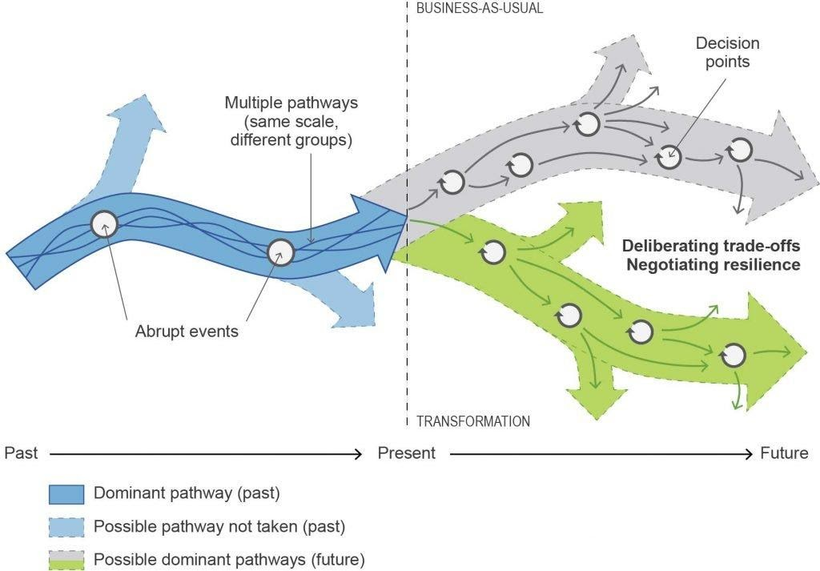
Climate Resilience Development Pathways
Pathways into the future, with path dependencies and iterative problem-solving and decision-making (after Fazey et al., 2016).

Slide 44
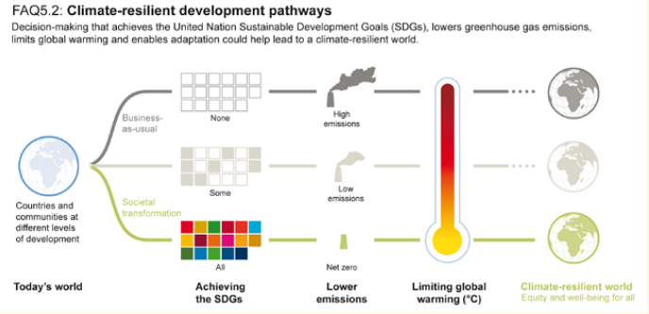
Climate-resilient development pathways (CRDPs) describe trajectories that pursue the dual goals of limiting warming to 1.5°C while strengthening sustainable development. Decision-making that achieves the SDGs, lowers greenhouse gas emissions and limits global warming could help lead to a climate-resilient world, within the context of enhancing adaptation.
They entail a mix of measures that lower emissions and reduce the impacts of climate change, while contributing to poverty eradication and reducing inequalities. Which pathways are possible and desirable will differ between and within regions and nations

Slide 45
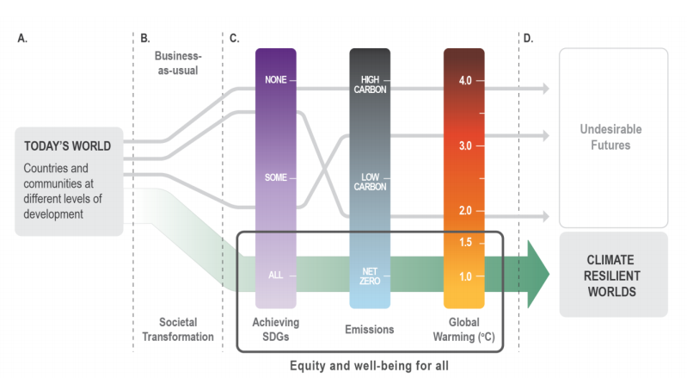
Climate-resilient development pathways (CRDPs) (green thick arrow) between our current world in which countries and communities exist at different levels of development, with various adaptation and mitigation measures available to them (A) and future worlds that are climate-resilient (bottom), undesirable (top), or somewhere in between (D). CRDPs emerge when aligned with societal transformation rather than business-as-usual policies and approaches (B). Pathways that achieve the SDGs by 2030 and beyond, strive for net zero emissions by mid- or later 21st century, and stay within the global 1.5°C warming target by the end of the 21st 9 century, while ensuring equity and well-being for all, are considered as CRDPs (C).

Slide 46
ONGOING SOCIAL CRISIS CAUSED BY CLIMATE CHANGE IN KENYA.
After months of unusually heavy rain, thousands of people in Kenya’s Great Rift Valley have evacuated due to intense flooding. Rising waters have inundated homes, businesses, farms, and even entire islands. The torrential rains have also caused two important lakes to swell, creating several issues for local wildlife and businesses
Both lakes play significant roles in sustaining local citizens, attracting tourists, and providing a home for many wildlife species. Lake Baringo provides irrigation and drinking water and is also home to Nile crocodiles. Rising waters at the lake have damaged businesses, schools, homes, and hotels, while bringing crocodiles and hippos dangerously close to people. Lake Bogoria is a World Heritage site and home to hundreds of bird species, including as many as one million flamingos at times. It also contains several geysers and hot springs that are popular with tourists; nearly 80 percent of these hot springs are now underwater.
Officials are particularly concerned that the freshwater Lake Baringo and alkaline Lake Bogoria could merge soon, which would cause cross-contamination and threaten wildlife even more. The two lakes were once 20 kilometers (13 miles) apart, but now sit 13 kilometers (8 miles) from one another. Neither lake has an outlet to allow excess water to flow out.
NASA Earth Observatory images by Lauren Dauphin, using Landsat data from the U.S. Geological Survey. Story by Kasha Patel.

Slide 47
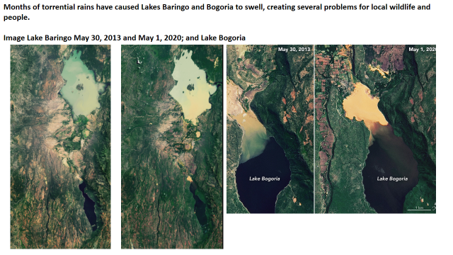

Slide 48
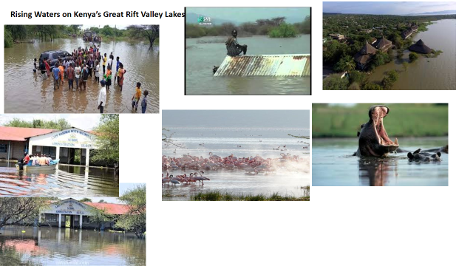

Slide 49
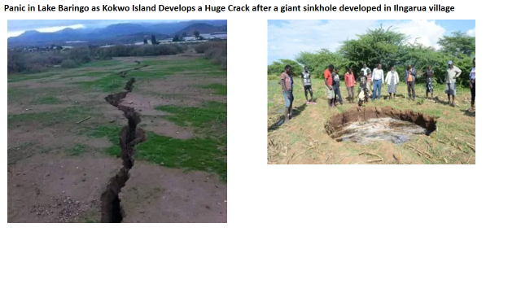

Slide 50
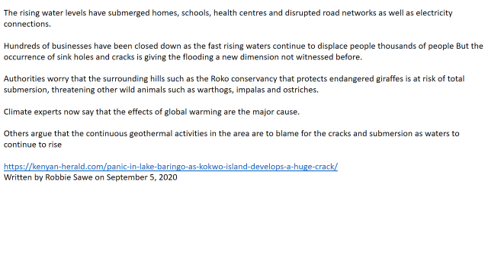

Slide 51
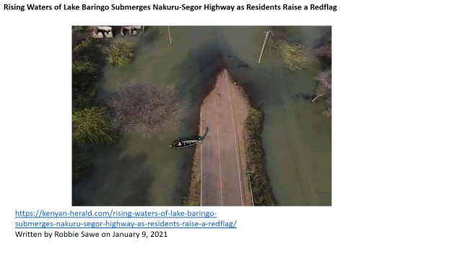

Slide 52
Development trajectories, sharing of efforts and cooperation
The potential for pursuing sustainable and climate-resilient development pathways towards a 1.5°C warmer world differs between and within nations, due to differential development achievements and trajectories, and opportunities and challenges.
There are clear differences between high-income countries where social achievements are high, albeit often with negative effects on the environment, and most developing nations where vulnerabilities to climate change are high and social support and life satisfaction are low, especially in the Least Developed Countries (LDCs) (Sachs et al., 2017; O’Neill et al., 2018).
Differential starting points for CRDPs between and within countries, including path dependencies (Figure 5.5), call for sensitivity to context (Klinsky and Winkler, 2018). For the developing world, limiting warming to 1.5°C also means potentially severely curtailed development prospects (Okereke and Coventry, 2016) and risks to human rights from both climate action and inaction to achieve this goal (Robinson and Shine, 2018) (Section 5.2).
Within-country development differences remain, despite efforts to ensure inclusive societies (Gupta and Arts, 2017; Gupta and Pouw, 2017). Cole et al. (2017), for instance, show how differences between provinces in South Africa constitute barriers to sustainable development trajectories and for operationalising nation-level SDGs, across various dimensions of social deprivation and environmental stress, reflecting historic disadvantages.

Slide 53
Climate change and land

Slide 54
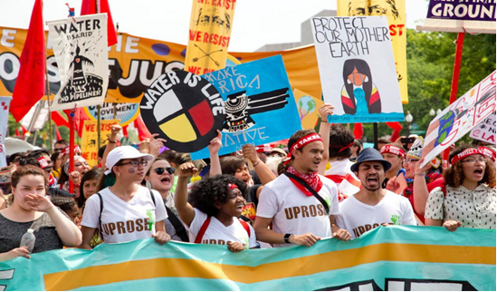
Climate Change and Land
Interlinkages between desertification, land degradation, food security and greenhouse gas fluxes: Synergies, trade-offs and integrated response options
Sustainable Development, Poverty Eradication and Reducing Inequalities

Slide 55
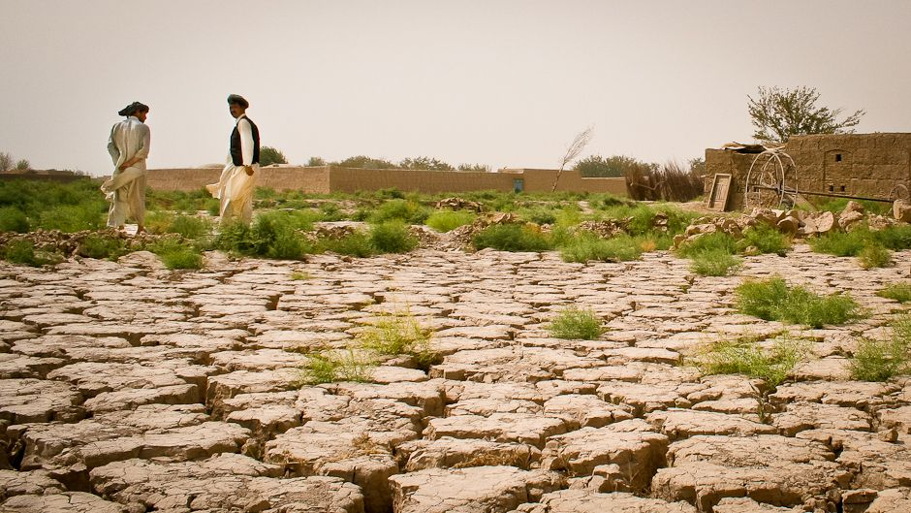
SPECIAL REPORT: SPECIAL REPORT ON CLIMATE CHANGE AND LAND
According to IPCC report, the land challenges faced today vary across regions; climate change will increase challenges in the future, while socio- economic development could either increase or decrease challenges.
Increases in biophysical impacts from climate change can worsen desertification, land degradation, and food insecurity. Additional pressures from socio- economic development could further exacerbate these challenges; however, the effects are scenario dependent. Scenarios with increases in income and reduced pressures on land can lead to reductions in food insecurity; however, all assessed scenarios result in increases in water demand and water scarcity.

Slide 56
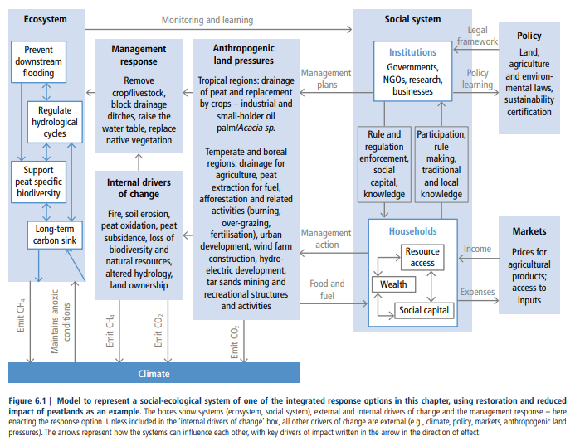
Interlinkages between desertification, land degradation, food security and greenhouse gas fluxes:
Synergies, trade-offs and integrated response options.
Figure 6.1:outlines the approach used in assessing the evidence for interactions between response options to deliver climate mitigation and adaptation, to prevent desertification and land degradation, and to enhance food security

Slide 57
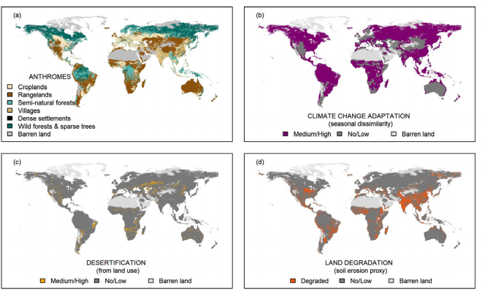
Figure 6.2 | Global distributions of land-use types and individual land-based challenges. (a) Land-use types (or anthromes, after Ellis and Ramankutty 2008);
(b) Climate change adaptation challenge (estimated from the dissimilarity between current and end-of-century climate scenarios, Netzel and Stepinski 2018);
(c) Desertification challenge
(d) Land degradation challenge (estimated from a soil erosion proxy, one indicator of land degradation; Borrelli et al. 2017);
(e) Food security challenge (estimated from chronic undernourishment, a component of food security, FAO 2017a); (f) biodiversity challenge (estimated from threatened biodiversity hotspots, a component of biodiversity, Mittermeier et al. 2011);
(g) Groundwater stress challenge (estimated from water over-abstraction, Gassert et al. 2014); (
h) Water quality challenge (estimated from critical nitrogen and phosphorus loads of water systems, Xie and Ringler 2017)

Slide 58
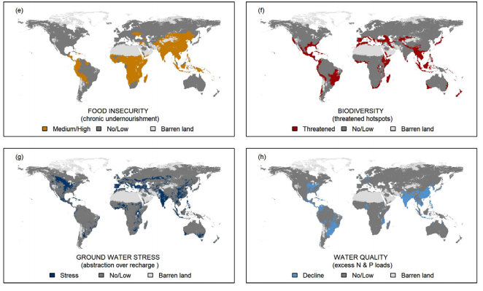
Continuation…………..Figure 6.2 | Global distributions of land use types and individual land-based challenges

Slide 59
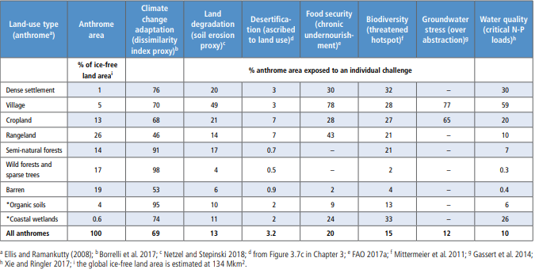
Figure 6.3: Global area of land-use types (or anthromes) and current percentage area exposure to individual (overlapping) land-based challenges.

Slide 60
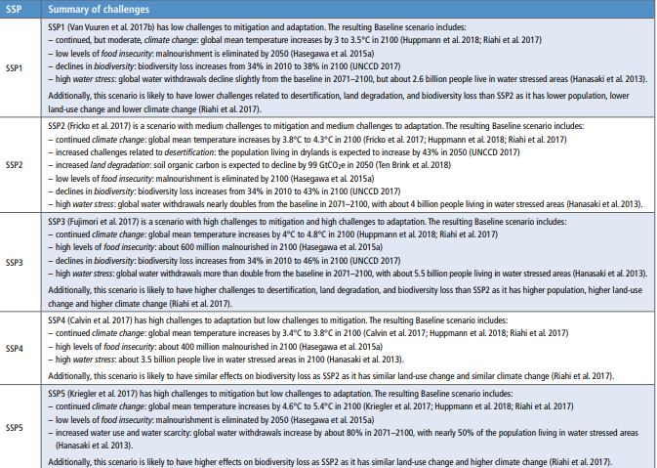
Figure A: SSP Baseline scenarios:
Assessment of future challenges to climate change, mitigation, adaptation, desertification, land degradation, food insecurity water stress, and biodiversity

Slide 61
Explanation to slide 5: Figure A
Mitigation: Challenges to mitigation depend on the underlying emissions and ‘mitigative capacity’, including technology availability, policy institutions, and financial resources (O’Neill et al. 2014). Challenges to mitigation are high in SSP3 and SSP5, medium in SSP2, and low in SSP1 and SSP4 (O’Neill et al. 2014, 2017; Riahi et al. 2017
Adaptation: Challenges to adaptation depend on climate risk and adaptive capacity, including technology availability, effectiveness of institutions, and financial resources (O’Neill et al. 2014). Challenges to adaptation are high in SSP3 and SSP4, medium in SSP2, and low in SSP1 and SSP5 (O’Neill et al. 2014, 2017; Riahi et al. 2017).
Desertification: The combination of climate and land-use changes can lead to decreases in soil cover in drylands (Chapter 3). Population living in drylands is expected to increase by 43% in the SSP2-Baseline, due to both population increases and an expansion of dryland area (UNCCD 2017).
Land degradation: Future changes in land use and climate have implications for land degradation, including impacts on soil erosion, vegetation, fire, and coastal erosion (Chapter 4; IPBES 2018). For example, soil organic carbon is expected to decline by 99 GtCO2e in 2050 in an SSP2-Baseline scenario, due to both land management and expansion in agricultural area (Ten Brink et al. 2018).
Biodiversity: Future species extinction rates vary from modest declines to 100-fold increases from 20th century rates, depending
on the species (e.g., plants, vertebrates, invertebrates, birds, fish, corals), the degree of land-use change, the level of climate change, and assumptions about migration (Pereira et al. 2010). Mean species abundance (MSA) is also estimated to decline in the future by 10–20% in 2050 (Van Vuuren et al. 2015; Pereira et al. 2010). Scenarios with greater cropland expansion lead to larger declines in MSA (UNCCD 2017) and species richness (Newbold et al. 2015).
Water stress: Changes in water supply (due to climate change) and water demand (due to socio-economic development) in the
future have implications for water stress. Water withdrawals for irrigation increase from about 2500 km3 yr–1 in 2005 to between 2900 and 9000 km3 yr–1 at the end of the century (Chaturvedi et al. 2013; Wada and Bierkens 2014; Hejazi et al. 2014a; Kim et al. 2016; Graham et al. 2018; Bonsch et al. 2015); total water withdrawals at the end of the century range from 5000 to 13,000 km3 yr–1 (Wada and Bierkens 2014; Hejazi et al. 2014a; Kim et al. 2016; Graham et al. 2018). The magnitude of change in both irrigation and total water withdrawals depend on population, income, and technology (Hejazi et al. 2014a; Graham et al. 2018). The combined effect of changes in water supply and water demand will lead to an increase of between 1 billion and 6 billion people living in waterstressed areas (Schlosser et al. 2014; Hanasaki et al. 2013; Hejazi et al. 2014b). Changes in water quality are not assessed here but could be important (Liu et al. 2017).

Slide 62
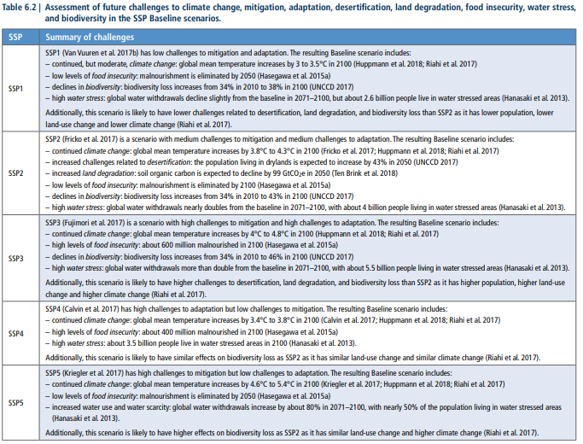
Scenarios with multiple challenges: Table 6.2 summarises the challenges across the five SSP Baseline scenarios.

Slide 63
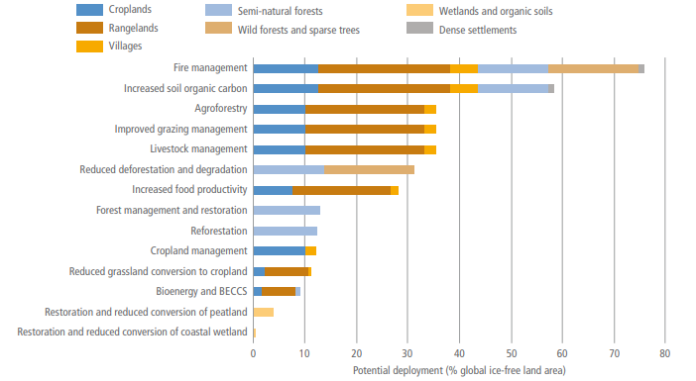
Opportunities for implementing integrated response options
Figure 6.6 shows the potential deployment area of land management responses across land-use types (or anthromes).

Slide 64
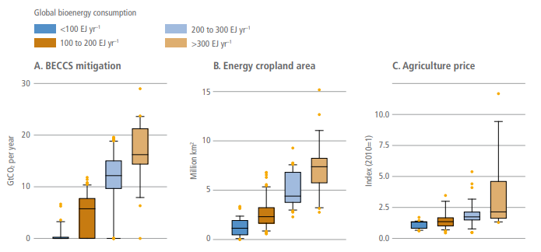
Figure 6.8 | Correlation between bioenergy use and other indicators.
Panel A shows global CO2 sequestration by BECCS in 2100.
Panel B shows global energy cropland area in 2100.
Panel C shows agricultural prices in 2100 indexed to 2010. Data are based on the amount of bioenergy used globally in 2100. All scenario data that include bioenergy consumption and the variable of interest are included in the figure; the resulting number of scenarios varies per panel, with 352 in panel A, 262 in panel B, and 172 in panel C.
The boxes represent the interquartile range (i.e., the middle 50% of all scenarios). The line in the middle of the box represents the median, and the ‘whiskers’ represent the 5 to 95% range of scenarios. Data is from an update of the Integrated Assessment Modelling Consortium (IAMC) Scenario Explorer developed for the SR15 (Huppmann et al. 2018; Rogelj et al. 2018b)

Slide 65
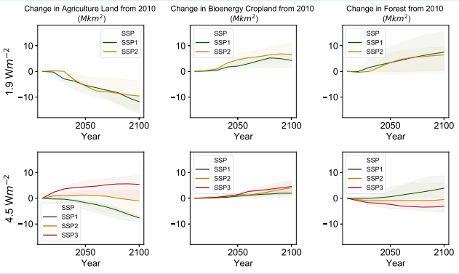
Land-use and land-cover change
In SSP1, sustainability in land management, agricultural intensification, production and consumption patterns result in reduced need
for agricultural land, despite increases in per capita food consumption. This land can instead be used for reforestation, afforestation
and bioenergy. In contrast, SSP3 has high population and strongly declining rates of crop yield growth over time, resulting in increased
agricultural land area. SSP2 falls somewhere in between, with societal as well as technological development following historical
patterns. Increased demand for land mitigation options such as bioenergy, reduced deforestation or afforestation decreases availability
of agricultural land for food, feed and fibre. In the climate policy scenarios consistent with the Paris Agreement, bioenergy/BECCS and
reforestation/afforestation play an important role in SSP1 and SSP2. The use of these options, and the impact on land, is larger in scenarios
that limit radiative forcing in 2100 to 1.9 W m–2 than in the 4.5 W m–2 scenarios. In SSP3, the expansion of land for agricultural
production implies that the use of land-related mitigation options is very limited, and the scenario is characterised by continued
deforestation.

Slide 66
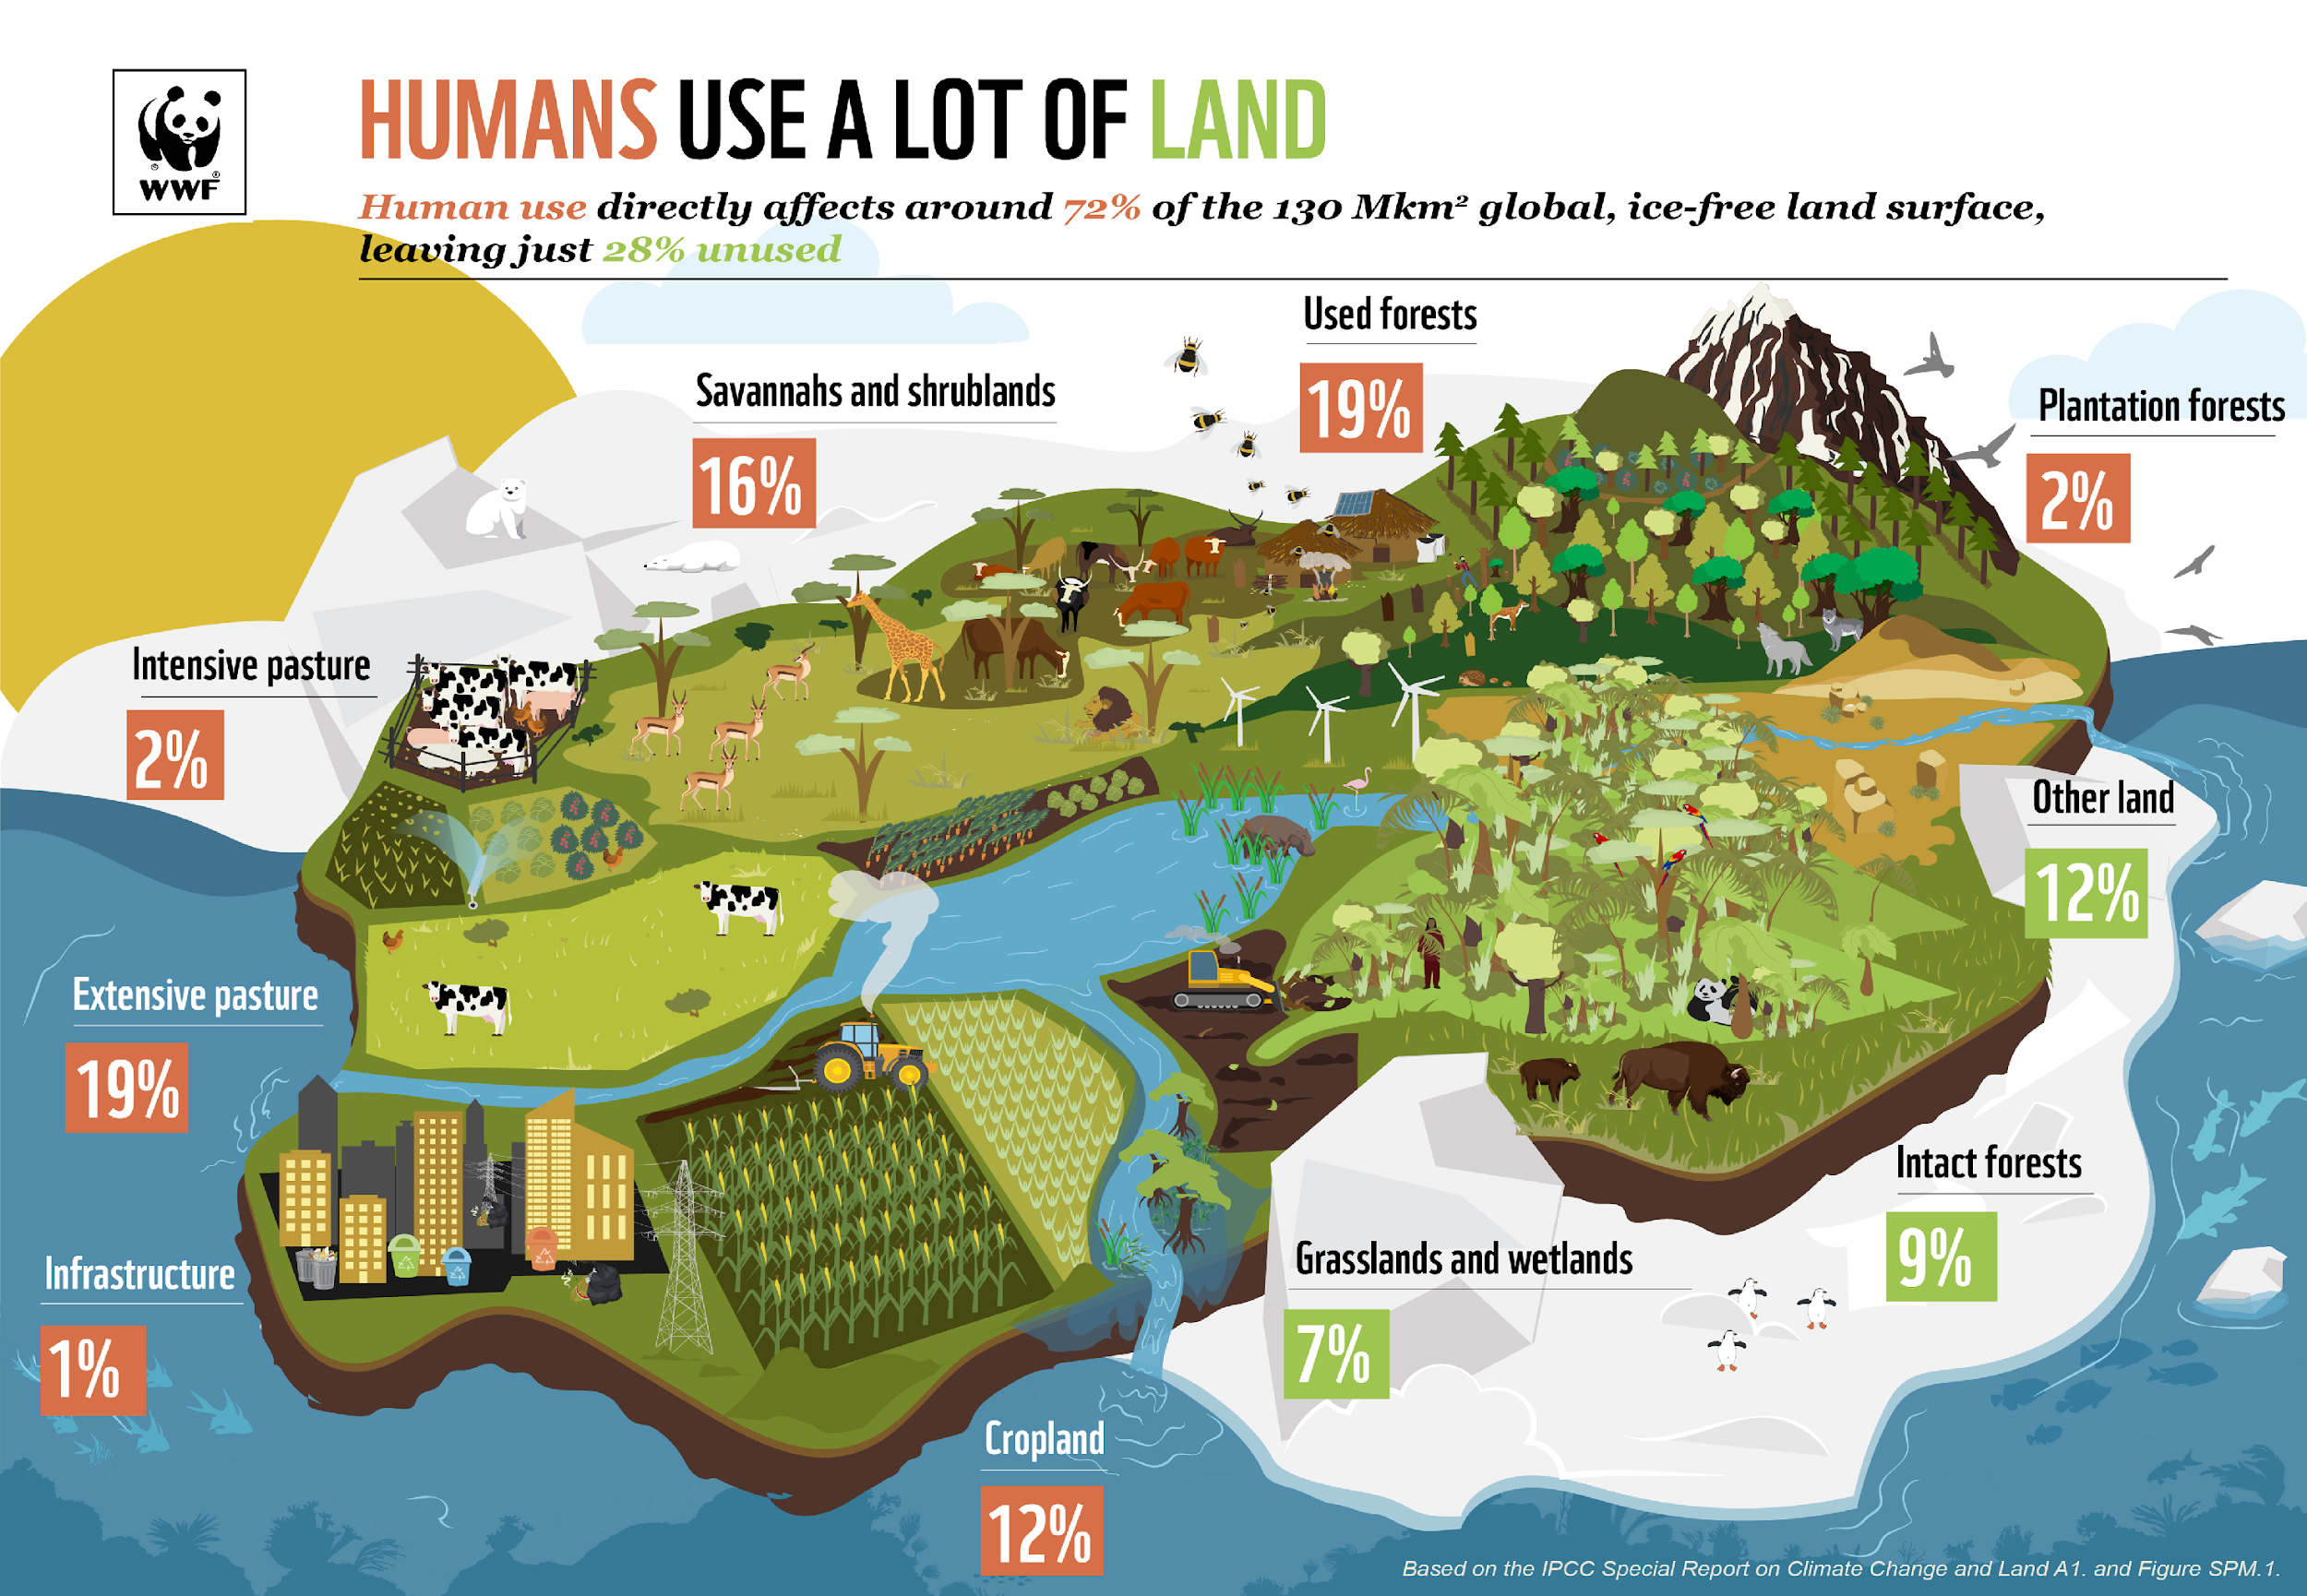
Land and climate interact with each other: The way we use land drives climate change and climate change adds stress to land systems and so worsens existing risks to people and nature. The food system is contributing around a quarter of global greenhouse gas emissions. With better land management, we can help tackle climate change and create a secure future for people and nature. https://wwf.panda.org/discover/our_focus/climate_and_energy_practice/ipcc_land/

Slide 67
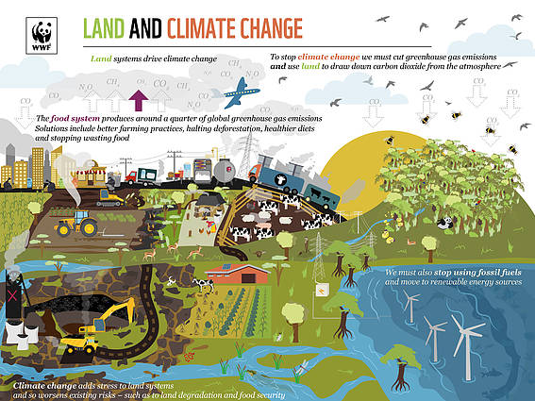
In conclusion, land degradation involves two interlocking, complex systems: the natural ecosystem and the human social system (Barrow, 1994). High population is not related to land degradation. Rather, it is what a population does to the land that determines the extent of degradation.
Land surface is an important part of the climate system. The interaction between land surface and the atmosphere involves multiple processes and feedbacks.
Land use and land cover changes influence carbon fluxes and GHG emissions which directly alter atmospheric composition and radiative forcing properties (Houghton 1995; Braswell et al. 1997.
According to IPCC (2003), established by WMO and UNEP, ecosystems are subject to many pressures (e.g., land-use change, resource demands, population changes); their extent and pattern of distribution is changing, and landscapes are becoming more fragmented. Climate change constitutes an additional pressure that could change or endanger ecosystems and the many goods and services they provide. Soil properties and processes including organic matter decomposition, leaching, and soil water regimes-will be influenced by temperature increase.
https://wwf.panda.org/discover/our_focus/climate_and_energy_practice/ipcc_land/

Slide 68
Migrations
In 1990, the Intergovernmental Panel on Climate Change (IPCC) noted that the greatest single impact of climate change could be on human migration —with millions of people displaced by shoreline erosion, coastal flooding and agricultural disruption.

Slide 69
How is climate change connected with migration
Media outlets, think tanks, researchers, and advocacy groups are increasingly raising the specter that climate change will cause mass migration via its spiraling impacts on agriculture, water resources, and infrastructure, particularly in the developing world. More than just speculation about the future, however, environmental migration is already here.

Slide 70
Long tradition
Climate variability hastened migration following the decline of the Western Roman Empire in 476 AD and drought was at work during the downfall of the Mayan Empire (660 to 1000 AD).
In the last century, the American Dust Bowl of the 1930s and the Sahelian droughts of the 1970s and 1980s drove many to migrate, respectively, to California and to regional urban centres in countries such as Burkina Faso, Mali, Mauritania, and Niger.

Slide 71
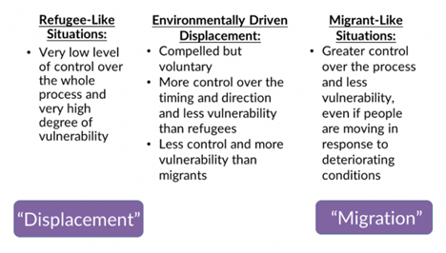
Types of mobility

Slide 72
Migrants or refugees? - New Zealand case
Small Island States such as Tuvalu are at the center of a heated debate on so-called climate refugees. In June 2014, New Zealand made headlines by granting residency to a Tuvaluan family claiming asylum based on climate change.
  Tuvalu lies only a few meters above sea level, and as several alarmists have warned, many low-lying islands could completely disappear within 30 to 50 years. Family was complaining about coastal erosion and difficulty with growing crops.

Slide 73
Migrants or refugees? - New Zealand case
New Zealand did not just grant asylum to the first “climate refugees”. The family were granted residence in New Zealand on humanitarian grounds. The impacts of climate change formed a large part of the case. However, in the end, the court granted the family residency because of the close family ties they had in New Zealand.
However, this case did not grant refugee status, so it has no bearing on how New Zealand deals with refugees in the future. It also has no effect on the Refugee Convention, which is international law

Slide 74
Migrants or refugees?
Victims of climate change are not recognized as refugees by the International Refugee Convention.
Given that the majority of people displaced by climate change will likely stay within their own borders, restricting the definition to those who cross international borders may seriously understate the extent of the problem. Second, the concept of a “refugee” tends to imply a right of return once the persecution that triggered the original flight has ceased
It’s hard to track climate migration. No data about climate migrants/refugees. They are not receiving any help from the community.

Slide 75
Migrants or refugees?
How then should we categorize these people? The International Organization for Migration (IOM) proposes the following definition, “Environmental migrants are persons or groups of persons, who, for compelling reasons of sudden or progressive changes in the environment that adversely affect their lives or living conditions, are obliged to leave their habitual homes, or chose to do so, either temporarily or permanently, and who move either within their country or abroad”.

Slide 76
Current-day problem
In 2016 alone, over 24 million people were displaced by unexpected climate-related disasters. It is commonly understood that there is a correlation between climate change and human mobility, however, the lack of evidence-based findings has hindered necessary changes to being made in this regard. It is extremely difficult to track migration caused by climate change; there are numerous other factors that could also contribute to migration, and some may even be in combination with climate change.

Slide 77
Drivers of migration
Environmental factors are more likely to operate through intermediate drivers
  economic
  social
  demographic
  political

Slide 78
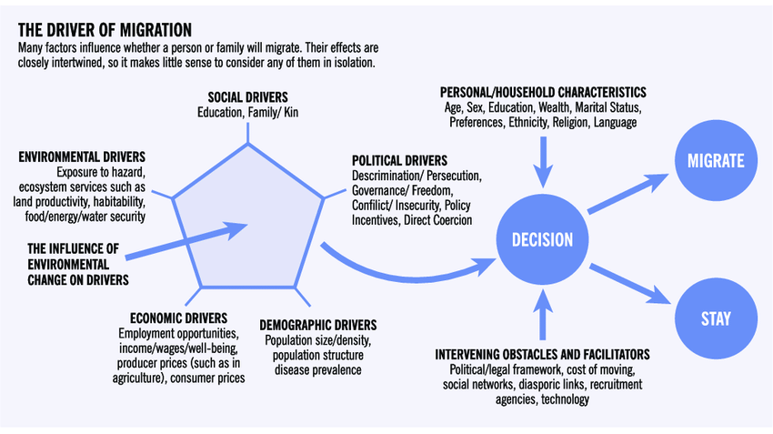

Slide 79
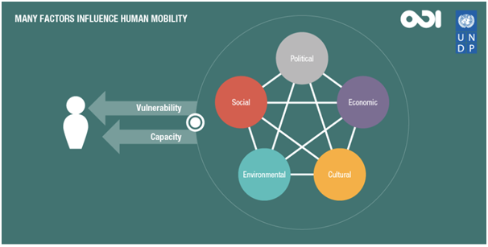

Slide 80
Climate processes and climate events - drivers of forced migration

Slide 81
Climate processes are slow onset changes such as sea-level rise, salinization of agricultural land, desertification, growing water scarcity and food insecurity. Sea level rise patently makes certain coastal areas and small island states uninhabitable.
Climate events, on the other hand, are sudden and dramatic hazards such as monsoon floods, glacial lake outburst floods, storms, hurricanes and typhoons. These force people off their land much more quickly and dramatically.

Slide 82
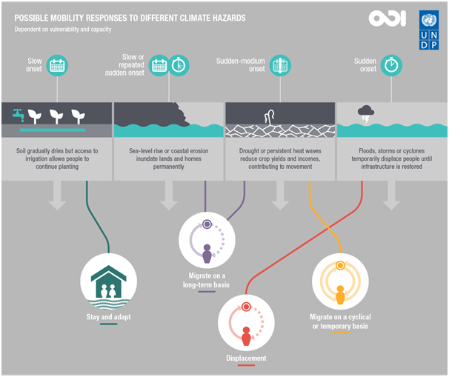

Slide 83
Can anybody migrate?
“Trapped populations”
  Meanwhile, at the high end of the income spectrum, people have fewer incentives to migrate and are more likely to be “moored” in place. Migration is more likely for those in the middle of the wealth and capabilities spectrum, as confirmed by the United Nations Development Program’s Scaling Fences report.

Slide 84
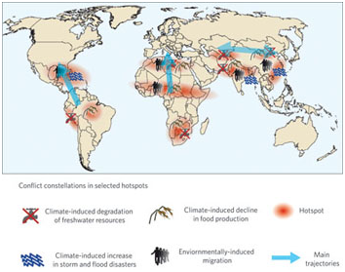
Who is under biggest threat of migration/dislocation?
The more society is vulnerable and has a lower capacity to adapt, the bigger the chance for migration of people
  Small islands
  Africa
  Developing countries

Slide 85
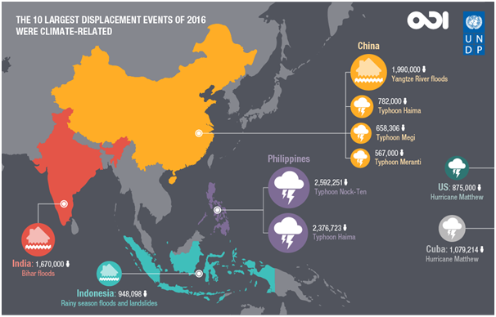

Slide 86
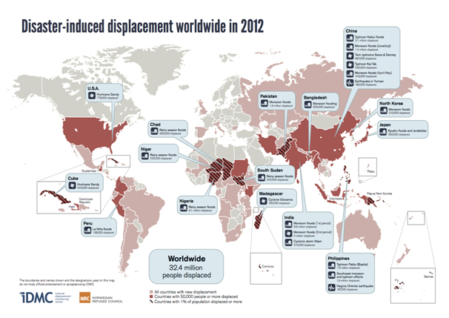

Slide 87
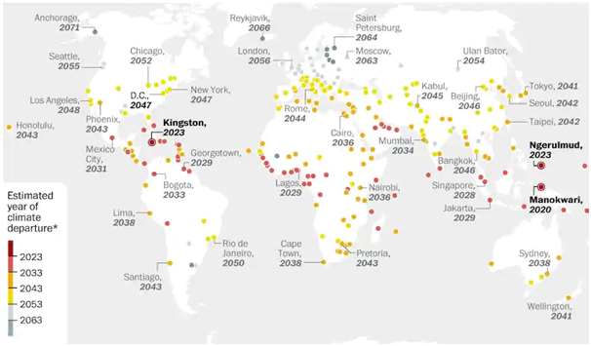

Slide 88
Destinations of climate migration

Slide 89
As with all migration, most climate migration and displacement will be internal, though even the relatively small international fraction could be sizeable given growing populations and the potential scale of climate impacts.

Slide 90
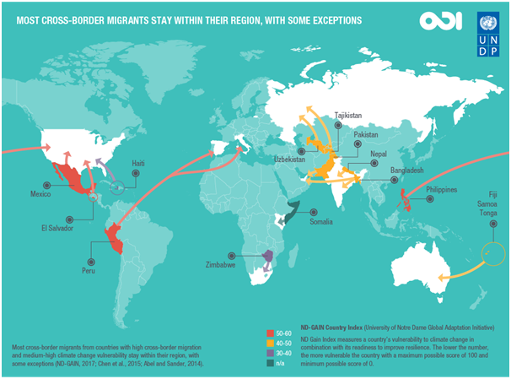

Slide 91
Two faces of climate migration

Slide 92
The phenomenon is regularly framed as a sign of failed adaptation, with migrants usually portrayed as passive victims. This narrative is often adopted by the media, politicians, and practitioners who frequently claim that anywhere from 300 million to 1.5 billion people could be forced to migrate by 2050 due to climate change.
Climate change factor (e.g. land degradation) can trigger a climate-migration conflict with natural resources on the line.
Migration and mobility are adaptation strategies in all regions of the world that experience climate variability. Expanding opportunities for mobility can reduce vulnerability to climate change and enhance human security.
Resilience - instead of merely serving as an escape route, migration can be a way for households to proactively guard against increasing effects of climate change on local environments and livelihoods.

Slide 93
Benefits of migration
○ Social and financial remittances.
○ Migration can massively contribute to resilience of society.
○ Migration is not a failure, it can be a part of adaptation.
○ Instead of merely serving as an escape route, migration can be a way for households to proactively guard against increasing effects of climate change on local environments and livelihoods.

Slide 94


Slide 95
Projections in regard to climate change and migrations

Slide 96

Projections - examples

Slide 97
Problem with projections
Evolution is not linear - we must be prepared for different outcomes
Professor Myers himself admits that his estimate, although calculated from the best available data, required some “heroic extrapolations”. Not that any criticism is implied; the simple fact is that nobody really knows with any certainty what climate change will mean for human population distribution. Current estimates range between 25 million and 1 billion people by 2050.

Slide 98
Disaster-induced displacement

Slide 99
Since 2008, an average of 26.4 million people per year have been displaced from their homes by disasters brought on by natural hazards. This is the equivalent to one person being displaced every second. The number and scale of huge disasters creates significant fluctuation from year to year in the total number of people displaced, while the trend over decades is on the rise. With climate change on the rise, such challenges will become more pressing in many world regions.

Slide 100

A report from the United Nations Office for Disaster Risk Reduction (UNISDR) has revealed that over the last twenty years, the overwhelming majority (90%) of disasters have been caused by floods, storms, heatwaves and other weather-related events. In total, 6,457 weather-related disasters were recorded worldwide by EM-DAT, the foremost international database of such events.

Slide 101


Slide 102
With all available scenarios predicting accelerating climate change impacting growing populations and more people living on marginal land, forced climate migration is certain to increase. The important questions are; by how much? and with what implications for development?
According to the International Organization for Migration, the impact of climate change as a driver of future forced migration depends on several factors which includes:
• The quantity of future greenhouse gas emissions
• The rate of future population growth and distribution
• The meteorological evolution of climate change
• The effectiveness of local and national adaptation strategies

Slide 103
Migration scenarios
In the past 10 years, many of the major national, European and international actors concerned with migration have developed their own sets of migration scenarios. While every scenario study considers a host of migration-relevant drivers and their interconnections, the ones considered to be more impactful on migration but also highly uncertain, as mentioned previously, are chosen to serve as cornerstones of their respective scenario frameworks and are called “scenario dimensions.” They include;
International governance, that is, the degree of international cooperation between countries.
The degree of future economic convergence between world regions
The severity and speed of environmental change
The impact of public opinion on migration policy.

Slide 104


Slide 105
IPCC Emission scenarios
The IPCC has devised a series of scenarios, called the Emission Scenarios of the IPCC Special Report on Emission Scenarios (or SRES for short), which set-out a range of different future emissions scenarios varied according to demographic, technological and economic developments. There are six basic “plots''; each of which contain individual scenarios with common themes. The six families of scenarios discussed in the IPCC's Third Assessment Report (TAR) and Fourth Assessment Report (AR4) are A1FI, A1B, A1T, A2, B1, and B2. They can be said to range from the good to bad to ugly.

Slide 106


Slide 107
Forced migration hinders development in at least four ways;
-Increasing pressure on urban infrastructure and services
-Undermining economic growth
-Increasing the risk of conflict and
-Leading to worse health, educational and social indicators among migrants themselves

Slide 108


Slide 109
In conclusion, what impact climate change migration ultimately has on development depends, of course, on which of the above scenarios play out: it is clear that 200 million people displaced by climate change would be much more detrimental to development than 10 million. There is also a large difference in development outcomes between those displaced by long-term climate processes (sea level rise) and short-term climate events (storms). Aggregated figures for forced climate migration mask this distinction.

Slide 110
How to fight with the impact of climate change on migration?

Slide 111
We are not thinking of migration as a consequence of climate change.
Society is ill-prepared.

Slide 112


Slide 113


Slide 114


Slide 115
References
https://www.ipcc.ch/report/srccl/
https://www.ipcc.ch/sr15
https://www.scientificamerican.com/article/climate-change-is-having-a-major-impact-on global-health/
Barrow CJ (1994) Land degradation. Development and breakdown of terrestrial environments.
Cambridge University Press, New York, NY, USA)
Braswell BH, Schimel DS, Linder E, Moore B III (1997) The response of global terrestrial ecosystems to interannual temperature variability. Science 278:870-872.
Ioras, F, Bandra, I, Kemo, C (2014). Introduction to Climate Change and Land Degradation. UK :Buckingamshire New University
https://dialnet,unirioja,es/descarga/articulo/4997441.pdf
IPCC (2003) Climate Change 2001: Impacts, Adaptation and Vulnerability. Contribution of Working Group II to the Third Assessment. Published for the Intergovernmental Panel on Climate
Change, Cambridge University Press, Cambridge, UK

Slide 116
References
Alex de Sherbinin, Impacts of Climate Change as Drivers of Migration, Migration Policy Institute, 2020
Report - What has the IPCC actually said about migration and climate change, 2014
Francesco Basetti, Environmental Migrants: Up to 1 Billion by 2050, Climate Foresight, 2019
Rick Noack, Has the era of the ‘climate change refugee’ begun?, The Washington Post, 2014
Patrick Sakdapolrak and Harald Sterly, Building Climate Resilience through Migration in Thailand, Migration Policy Instiute, 2020
Svenja Enge, Thinking Migration Policy Differently at the 2017 Bonn Intersessional, Transre, 2018
Raphael Nawrotzki, Do social networks help facilitate climate-related migration?, Transre, 2018
Social Crises: Signatures of Complexity in a Fast-Growing Economy, Hindawi - Complexity, 2017
E.L. Quarantelli, Russell R. Dynes, Response to social crisis and disaster, Annual Reviews Inc., 1977
Anna Durnova, Dagmar Rychnovska, The Climate Crisis is a Social Crisis, ihc.ac.at, 2018
https://www.iom.int/global-compact-migration
https://www.worldbank.org/en/topic/social-dimensions-of-climate-change
https://news.un.org/en/story/2019/07/1043551
https://ec.europa.eu/clima/policies/adaptation/how/social_e

Slide 117
Thank you for your attention!

