Slide 1
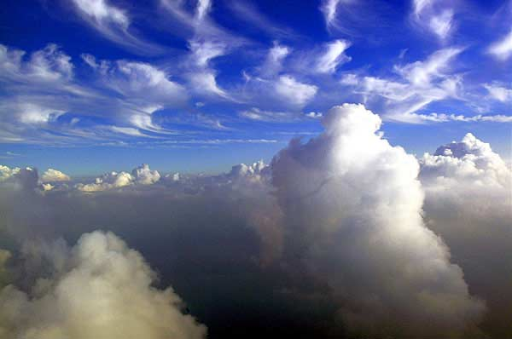



Double moment microphysics schemes for Numerical Weather Prediction models: why and how?
F. Chosson
M.K. Yau

Slide 2
“For microphysics, the main question for forecast models
is whether to go to double-moment schemes
that predict number concentrations[…]
This would make sense in forecast systems […],
which are likely to be developed more in the future.”
Third International Workshop on Next-Generation NWP Model, 2010.
Hong, S. Y. and J. Dudhia, 2012: Next-Generation Numerical Weather Prediction: Bridging
Parameterization, Explicit Clouds, and Large Eddies. Bull. Amer. Meteor. Soc.

Slide 3
Clouds in NWP models: a bulk approach
A bulk scheme: use of a probability distribution function (PDF)
of cloud particles
number concentration
N(D)
M_{n}= ∫ D^{n} N(D) dD
Diameter
D
Prognostic equations of the moments M_{n} of the PDF of each hydrometeor species
M₀ → total concentration
M₁ → characteristic size
M₂ → sedimentation
fall speed, extinction
M₃ → mass mixing ratio
M₃/M₂ → effective diameter
M₅ → precipitation flux
M₆ → radar reflectivity

Slide 4
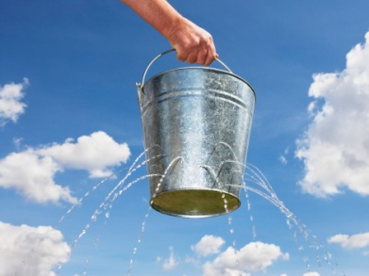
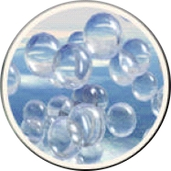
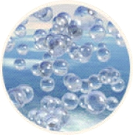


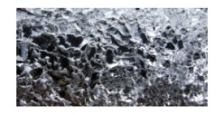


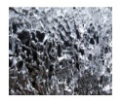

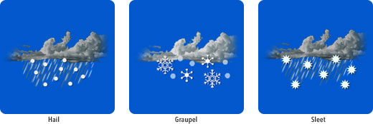

Bulk microphysics schemes
Available in single, double or triple moment mode for various number of hydrometeor species
Simple Moment
Double Moment
Triple Moment
à Simple Moment
à Double Moment
à Triple Moment
M₃
+
M₀
+
M₆
Q_{x}
+
N_{x}
+
Z_{x}
M₃
+
M₀
Q_{x}
+
N_{x}
M₃
Q_{x}
Complexity, number of equations, advected fields and numerical cost
Q_{c}
Q_{i}
Q_{r}
Q_{s}
Q_{tot}
Q_{h}
Q_{g}
Hydrometeor classes

Slide 5
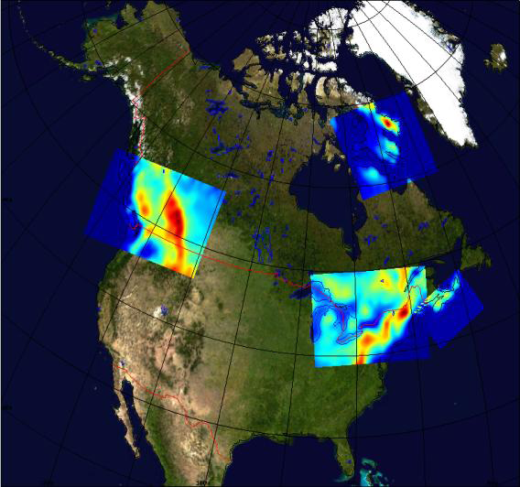
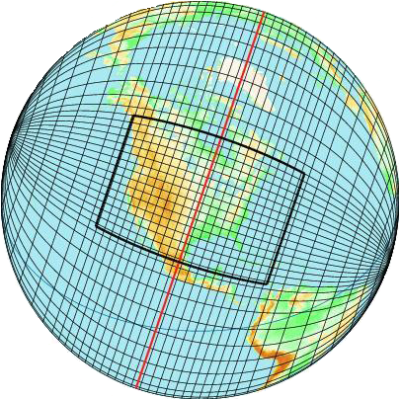
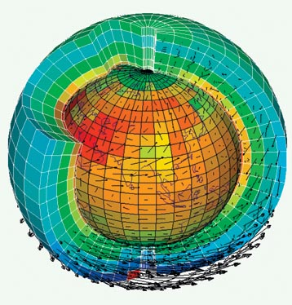
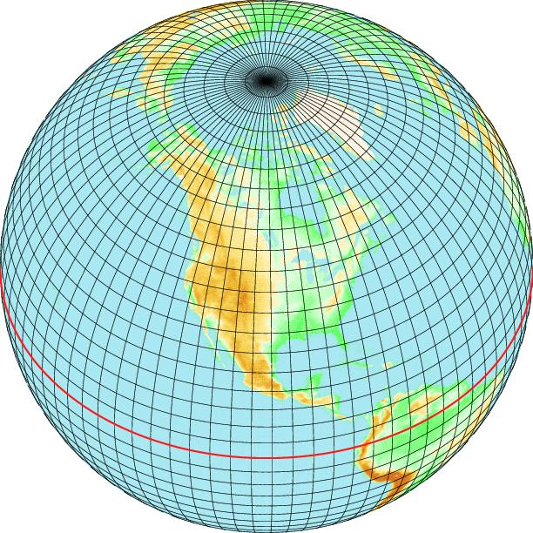
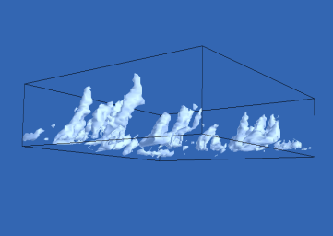
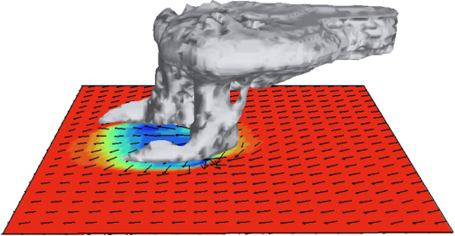
Clouds in NWP models: a scale dependence
Simple
Double
Simple
Triple
LAM-2.5km
LAM-REG
CLIMAT
GLOBAL
CRM
15km
LES
CRM
GCM
100m
500m
1km
2.5km
4km
10km
30km
100km
Challenge: Which microphysical scheme?

Slide 6
Defining the microphysics scheme of the future.
Consistence with small scales:
a lesson from Cloud Resolving Models
microphysical processes representation implied within
convective phenomena, squall line and intense
precipitation periods impose a sufficient number of
hydrometeors classes (categories):
liquid phase: cloud water Qc
rain Qr
solid phase: “ice” category Qi
“snow” category Qs
graupel and/or hail Qg / Qh
Nb Classes ≥5
Double moment schemes better than single moment
conceptually and by comparison with the observations.
(e.g. Lim and Hong, 2009; Morrison et al., 2009; Milbrandt et al., 2009?)
Double Moment

Slide 7
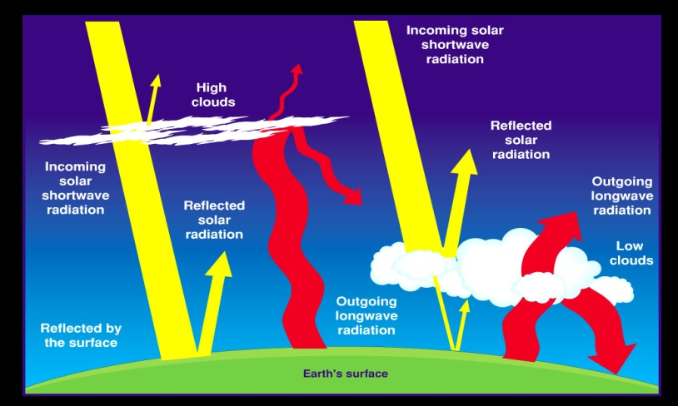
Defining the microphysics scheme of the future.
Consistence with the radiative transfer:
Microphysical
parameters
Optical
parameters
Radiative
Transfer
Double Moment
τω
g
Q_{x}
N_{x}
Shape
Q_{x}
R_{eff}
LUT
Nb Classes ice phase≥2

Slide 8
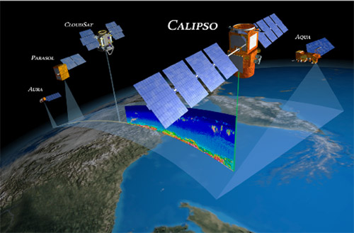
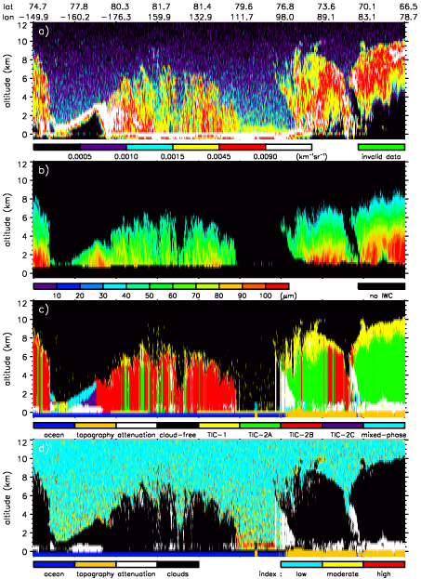
Defining the microphysics scheme of the future.
Consistance with the observations:
A-train, E-train, GPM, ground radar
and lidar, precipitation gauges...
To be able to compare/to validate and to correct at more and more compatibles scales…
Retrieval of Q_{x} and R_{eff} (N_{x})
Grenier et al., 2009
Double (Triple) Moment
Retrieval of the hydrometeor class (cloud masks)
Retrieval of the precipitation profiles
Nb Classes ≥5

Slide 9
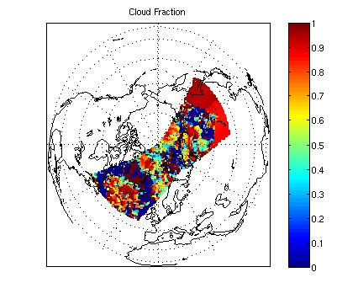
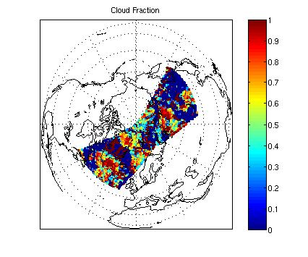
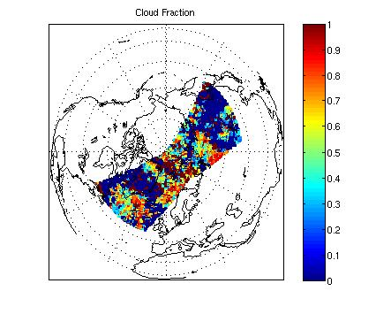
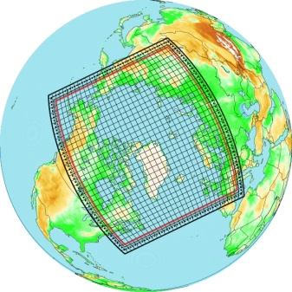

Defining the microphysics scheme of the future.
Consistence with the observations:
simulating remotely observables
parameters and retrieval schemes
physical
parameter
physical
parameter
physical
Parameter
Double (Triple) Moment
Retrieval
Hypothesis
Retrieval
Hypothesis
Nb Classes suffisant
Model
simul. Obs.
Hypothesis
Hypothesis
Radiances
Radiances

Slide 10
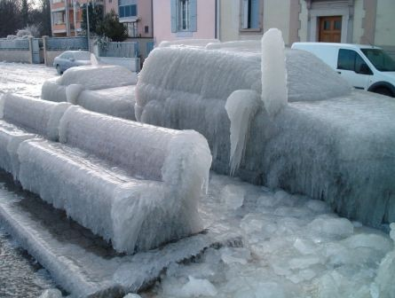
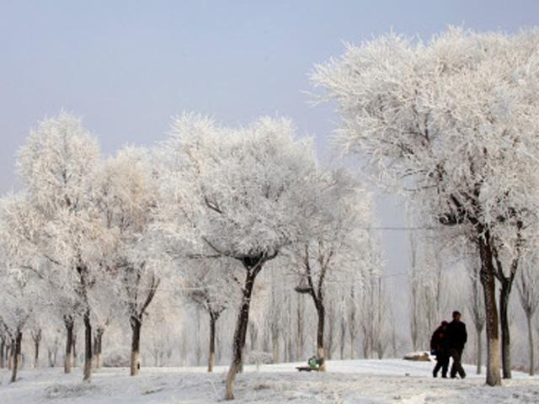
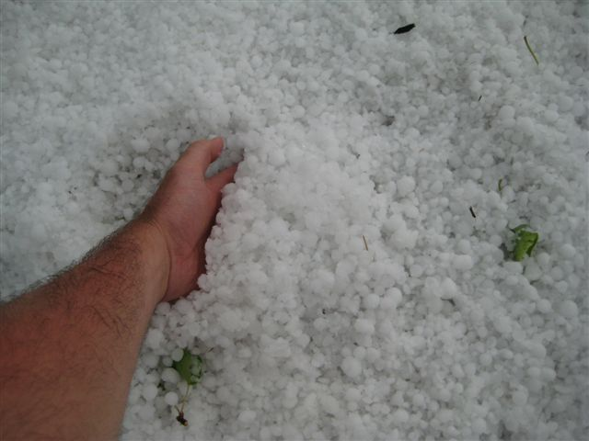
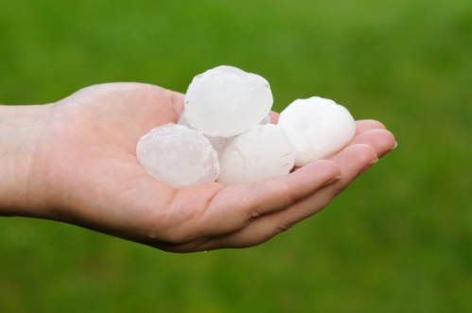
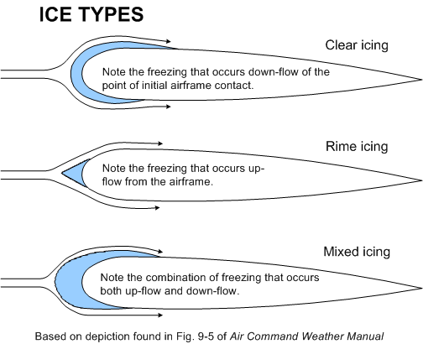
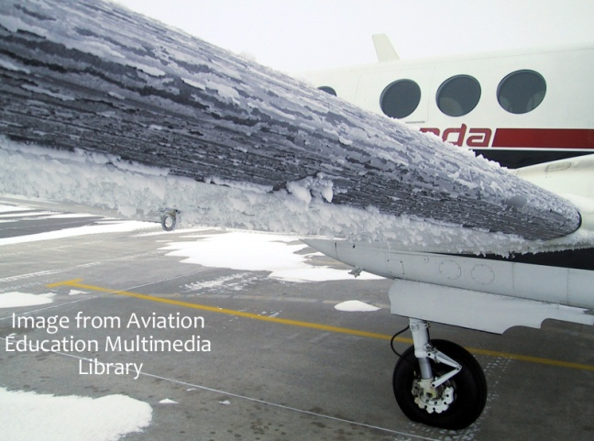
Defining the microphysics scheme of the future.
Consistency with prediction of
weather-related threats.
Making it more feasible?
Icing severity
Double Moment
size of graupel / hail particles?
hail, droplets, rain drops, drizzle

Slide 11
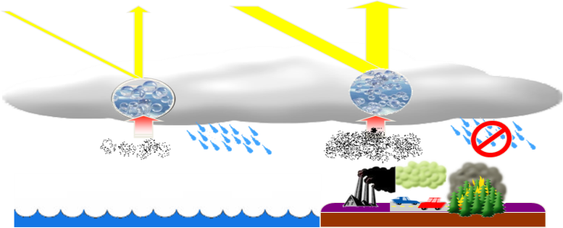
Defining the microphysics scheme of the future.
Consistence with present and futur
developpements:
Implementation of aerosol modules within air
quality models, and why not NWP models themselves
Double Moment
Taking into account in-cloud heterogeneous chemistry
Classes neige pluie
Climate mode: possibility to test some hypothesis
about aerosol indirect effects.
(e.g. dehydratation-greenhouse feedback in Arctic,
Blanchet and Girard, 1994)

Slide 12
THE microphysics scheme of the future.
LAM-2.5km
LAM-REG
CLIMAT
GLOBAL
CRM
15km
LES
CRM
GCM
100m
500m
1km
2.5km
4km
10km
30km
100km
Challenge: Which microphysical scheme?
Double Moment

Slide 13
THE microphysics scheme of the future.
Double
Toward bigger scales
LAM-2.5km
LAM-REG
GLOBAL
CRM
15km
LES
CRM
GCM
100m
500m
1km
2.5km
4km
10km
30km
100km

Slide 14
THE microphysics scheme of the future.
Double
Toward bigger scales
LAM-2.5km
LAM-REG
GLOBAL
CRM
Toward smaller scales
15km
LES
CRM
GCM
100m
500m
1km
2.5km
4km
10km
30km
100km

Slide 15
THE microphysics scheme of the future.
Double
Toward bigger scales
LAM-2.5km
LAM-2.5km
LAM-REG
LAM-REG
GLOBAL
CRM
Toward smaller scales
15km
LES
CRM
GCM
100m
500m
1km
2.5km
4km
10km
30km
100km
PROBLEM NUMBER 1: Spatial resolution
to be solved!
PROBLEM NUMBER 2: Temporal resolution

Slide 16
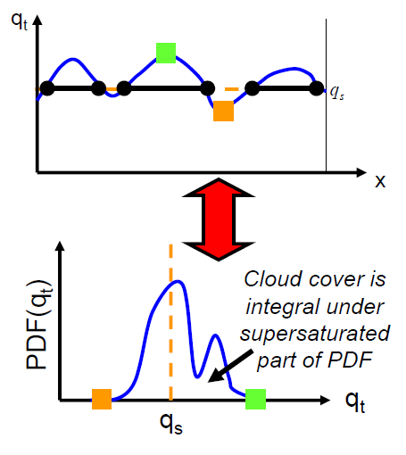
PROBLEM NUMBER 1: Spatial resolution
Subgrid Cloud fraction scheme
Tompkins,
2005
motto:
keep it simple!

Slide 17

PROBLEM NUMBER 1: Spatial resolution
Subgrid Cloud fraction scheme
PDF width
Simple PDF of total water content
LeTreut and Li (1991)
ALLOWS DIAGNOSTIC OF:
in-cloud
water vapor
“cloud”
fraction
clear-sky
water vapor

Slide 18
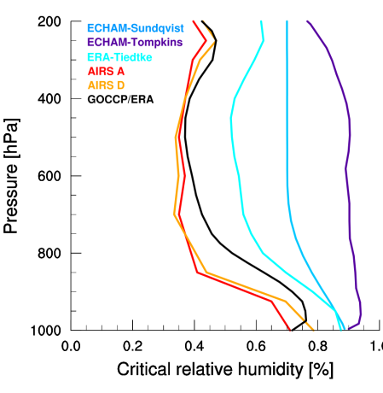
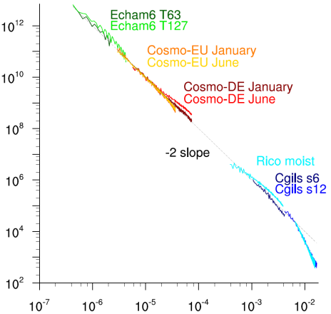
PROBLEM NUMBER 1: Spatial resolution
Subgrid Cloud fraction scheme
the PDF width is adapted to the spatial resolution!
resol:
25 km
resolution:
1.8°
Variability ∆q_{t}
from
J. Quaas
JGR,
2012
Spatial scale (m)
PDF width
1 km

Slide 19
PROBLEM NUMBER 1: Spatial resolution
Subgrid Cloud fraction scheme
subgrid cloud
fraction
In-cloud
microphysical process
CLOUDY CLASSES: Pristine Ice
Snow
Cloud droplets

Slide 20
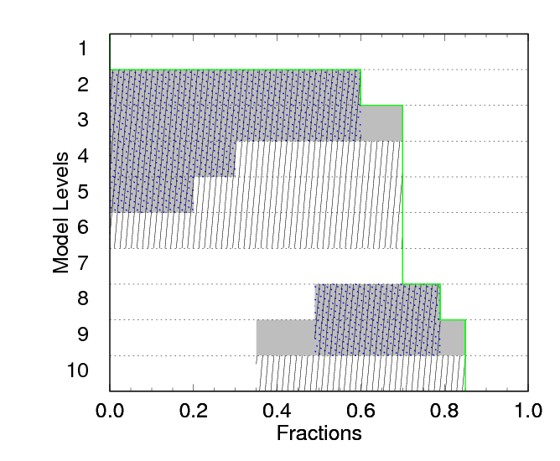
PROBLEM NUMBER 1: Spatial resolution
Precipitation Fraction
motto:
keep it simple!
fraction concerned
by precipitation?
subgrid cloud fraction
clear-sky precipitation
fraction
Maximum-random overlap
Precipitation
comes from clouds above
in-cloud
precipitation
fraction

Slide 21
PROBLEM NUMBER 1: Spatial resolution
Precipitation Fraction
Special for you
fraction concerned
by precipitation?
subgrid cloud fraction
Precipitation production within a fraction of the cloud fraction
Special tunable parameter!
increase your precip for free!
clear-sky precipitation
fraction
in-cloud
precipitation
fraction

Slide 22

PROBLEM NUMBER 1: Spatial resolution
Precipitation Fraction
subgrid precip.
fraction
Precipitation
microphysical process
PRECIP. CLASSES: Rain
Graupel
Hail

Slide 23
PROBLEM NUMBER 1: Spatial resolution
Precipitation and cloud fraction overlaps
cloud-precip interaction
microphysical process
OVERLAP OF PRECIPITATION
AND CLOUD FRACTIONS

Slide 24

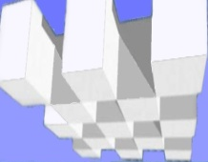
PROBLEM NUMBER 1: Spatial resolution
Intercomparison
Sundqvist et al.
(1989)
Milbrandt and Yau
(2005) original
Milbrandt and Yau
(2005) + SCPF
f(T)
1 moment
1 hydrometeor
class
diagnostic
precipitation
2 moments
6 hydrometeor
classes
prognostic
precipitation
+ Subgrid Cloud and
Precipitation Fraction
Scheme

Slide 25
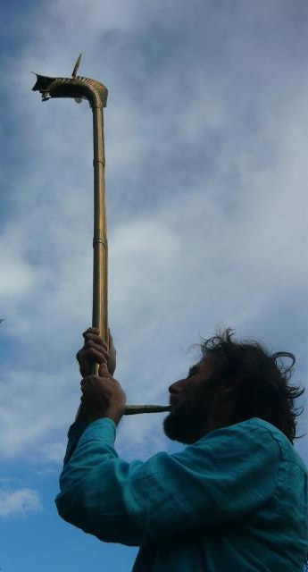
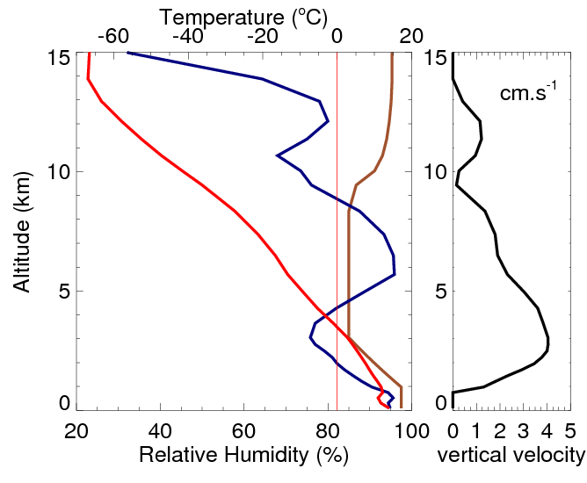
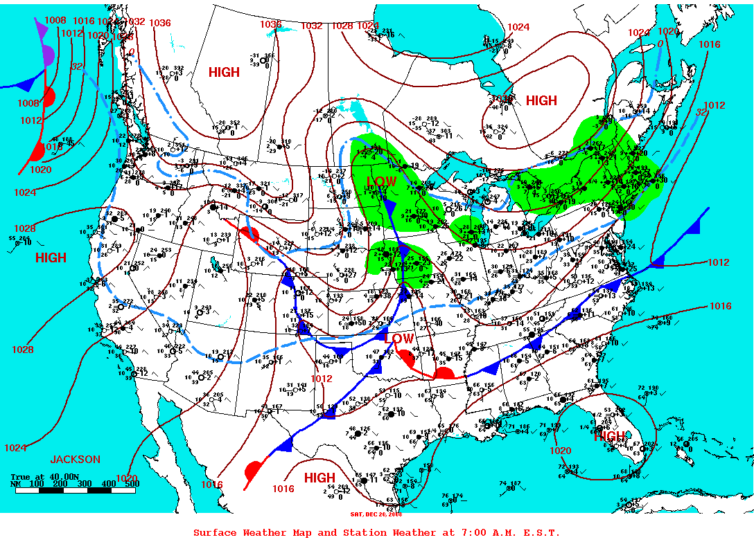
PROBLEM NUMBER 1: Spatial resolution
Test with a 1D kinematic model
GEM
RHcrit
U₀₀
experimental
1D kinematic model
winter cold front
representative profile
North American Regional
Reanalysis
(∆x = 30km ouput 3h)

Slide 26
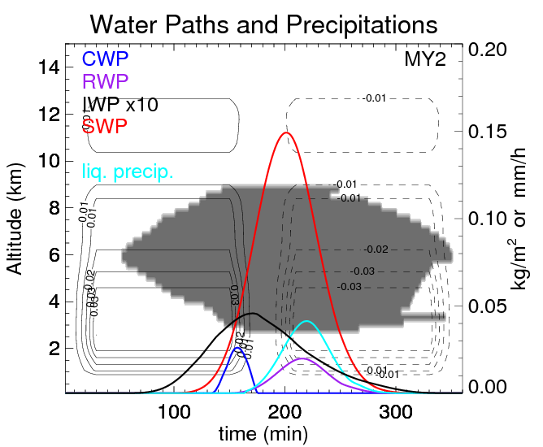
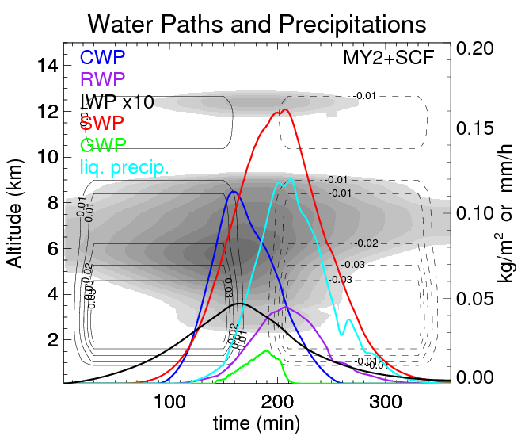
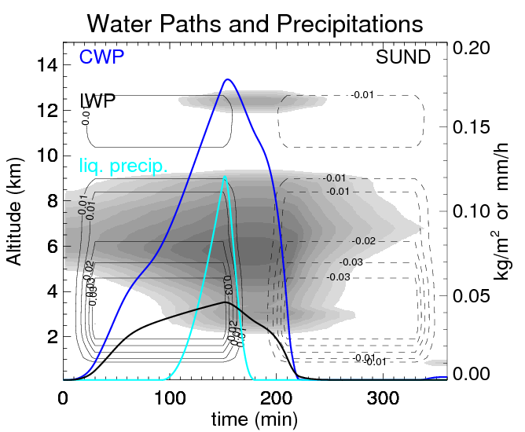
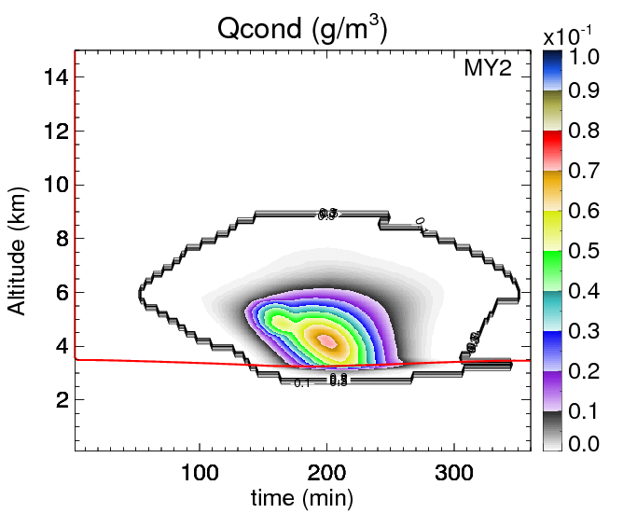
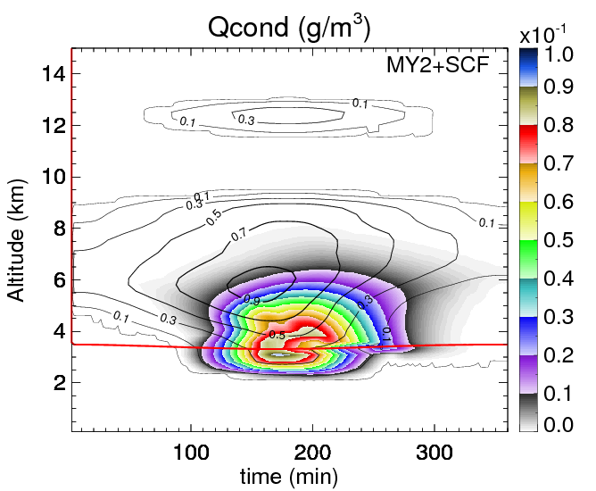
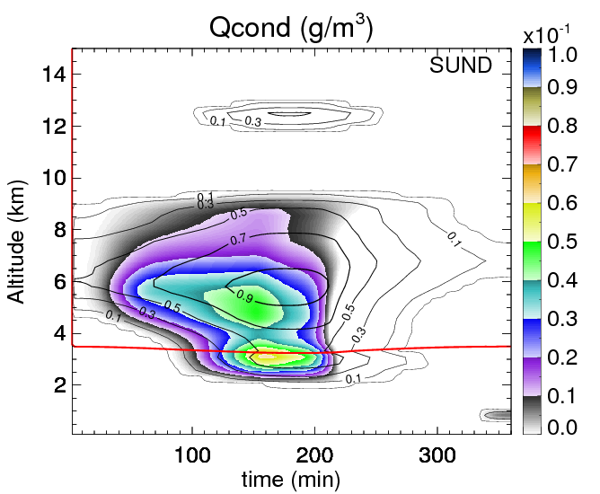
PROBLEM NUMBER 1: Spatial resolution
1D kinematic intercomparison
Milbrandt & Yau original
M&Y with SCPF
Sundqvist
+
+

Slide 27
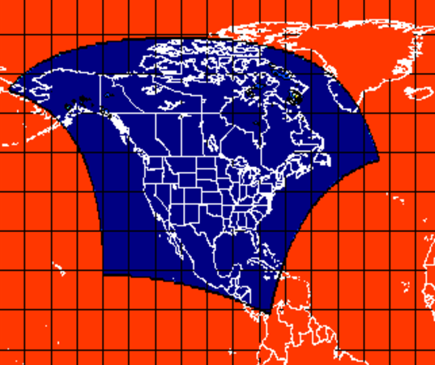
PROBLEM NUMBER 1: Spatial resolution
3D GEM-LAM model intercomparison
Sundqvist et al.
(1989)
Milbrandt and Yau
(2005)
Milbrandt and Yau
(2005)
f(T)
20 Dec. 2008
Simulation 36h
comparing only
the last 24h
(spin-up)
GEM-LAM
regional
∆x = 15 km
∆t = 450 sec

Slide 28
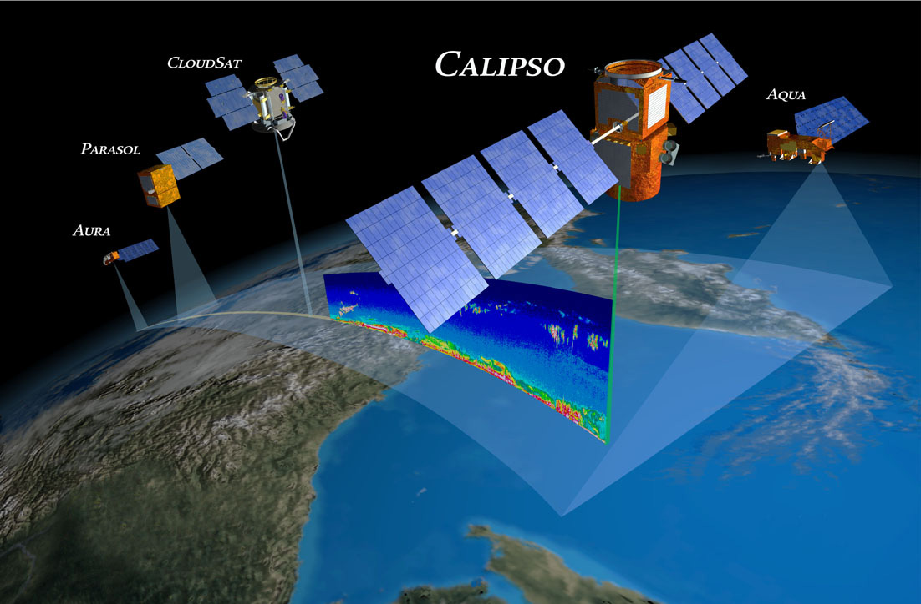
PROBLEM NUMBER 1: Spatial resolution
+ Observations CloudSat/Calipso
Calipso + CloudSat
=
LiDAR + RaDAR + Modis (IR)
=
DARDAR CLOUD products
(J. Delanoe, R. Hogan, 2008, 2010)
vertical profile of cloud mask,
IWC, effective radius,
extinction, optical thickness, ...
horizontal resolution = 1.1 km
vertical resolution = 60 m

Slide 29
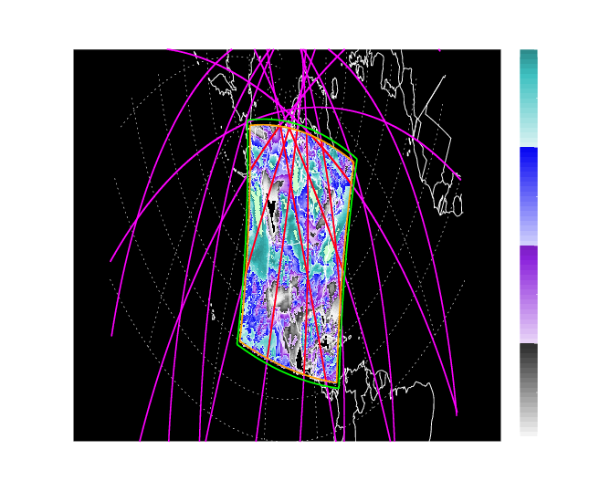
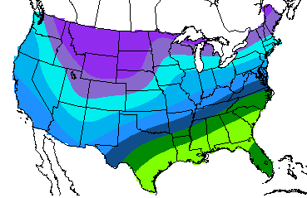
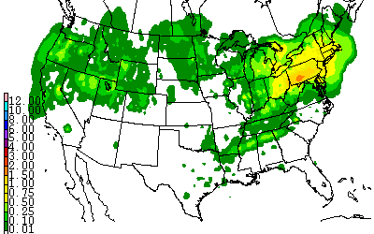
PROBLEM NUMBER 1: Spatial resolution
Intercomparaison case study December 20th 2008
Daily Mean Non-Convective Cloud Cover (NARR)
100%
Meteo
75%
50%
Temperature
25%
Precipitation

Slide 30
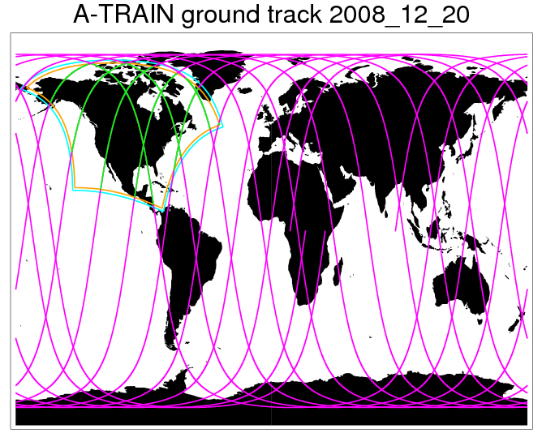
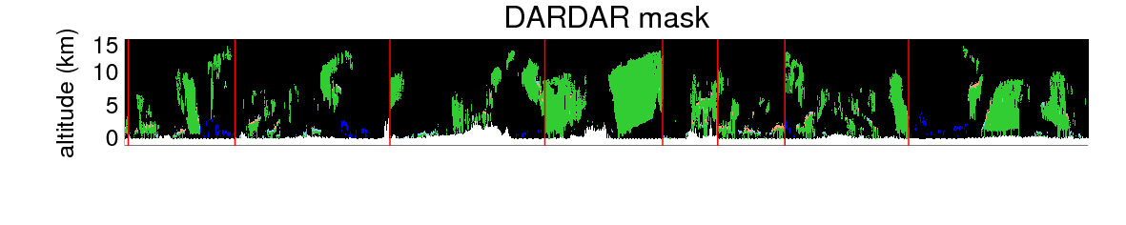
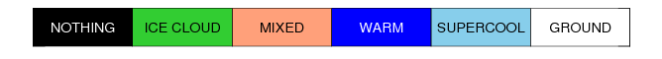
Intercomparaison
6
8
5
9
3
2
7
4
2
3
4
5
6
7
8
9
Chaque profil DARDAR de chaque traversée est comparé au profil
des simulations GEM le plus proche en temps et en lieu.

Slide 31
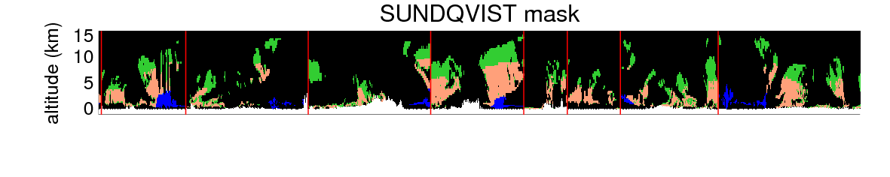


DARDAR
Sundqvist
2
3
4
5
6
7
8
9
M&Y+SCPF
M&Y

Slide 32





DARDAR
Sundqvist
M&Y+SCF
M&Y
0.0
0.125
0.25
0.375
0.5
0.625
0.75
0.875
1.0
IWC (g/m3)

Slide 33



6
8
along tracks
mean IWC
(g/m3)
5
9
3
2
7
4
Intercomparison
Cloud Fraction
in-cloud mean IWC
(g/m3)

Slide 34


THE microphysics scheme of the future.
Double
Toward bigger scales
LAM-2.5km
LAM-2.5km
LAM-REG
LAM-REG
GLOBAL
CRM
Toward smaller scales
15km
LES
CRM
GCM
100m
500m
1km
2.5km
4km
10km
30km
100km
SCPF
PROBLEM NUMBER 1: Spatial resolution
PROBLEM NUMBER 2: Temporal resolution

Slide 35




PROBLEM NUMBER 2: temporal resolution
Test with POLAR-GEM
LAM Arctic Basin ∆x=15km
SUND ∆t=450s
MY2 450s

Slide 36

PROBLEM NUMBER 2: temporal resolution
Test with POLAR-GEM
LAM Arctic Basin ∆x=15km
SUND ∆t=450s
SUND ∆t=60s
MY2 ∆t=60s
MY2 ∆t=450s

Slide 37
PROBLEM NUMBER 2: temporal resolution
Microphysical sub-time step
Equation to solve for each microphysical variable q
for each model time-step ∆t, for each model tile:
3 steps+updates
sedimentation
flux
problem: computed
sequentially, no interaction

Slide 38



PROBLEM NUMBER 2: temporal resolution
Microphysical sub-time step
long time step issue concerns
interactions between particles during sedimentation
therefore concerns mainly precipitations
seeder-feeder effect
Reality:
collection process
during sedimentation
Milbrandt and Yau
prognostic precip.
+ separated sedimentation
Sundqvist
diagnostic precip.
t
∆t
∆t>t
collection
no
collection
collection
OK
Prognostic precipitation + separate sedimentation requires small time step, requires courant number = 1, but in large scale model, time steps are large too...
The trick simply consists in iterate over the whole microphysics scheme (M&Y) within each atmospheric model time step, in order to simulate a series of small time step.

Slide 39
PROBLEM NUMBER 2: temporal resolution
Microphysical sub-time step
Equation to solve for each microphysical variable q,
for each model time-step ∆t, for each model tile:
(discretized form)
Each model time step ∆t is divided in n microphysics
sub-time step ∆t_{i} such as : ∆t = n∆t_{i}
It has been chosen ∆t_{i} ≈60s as a good compromise cost/precision.

Slide 40

PROBLEM NUMBER 2: temporal resolution
Test with POLAR-GEM
LAM Arctic Basin ∆x=15km
SUND 450s
SUND 60s
MY2 60s
MY2 450s sub-time step at 60s
MY2 450s

Slide 41

Numerical cost!
PROBLEM NUMBER 2: temporal resolution
The problem that resists
∆x = 15km
∆x= 15km
Sundqvist
reference
Milbrandt
& Yau
Other avenues?
x 1.2
x 2.3 !
Can’t afford !
∆t = 450 sec
∆t = 450 sec
dt_{micro}=60 sec

Slide 42

Cost-efficient sedimentation scheme?
PROBLEM NUMBER 2: temporal resolution
numerical
scheme
evolution of
ECMWF IFS vertical
resolution...
Eulerian
sedimentation
Courant number
is terminal
fall velocity
60 levels
91 levels
(137 since 2013)
Only one solution: sub-stepping
the sedimentation part!
The combination of the
highest terminal fall velocity,
the finest model level and the
long model time step will determine
the number of sedimentation
sub-steps to use on the whole column!
Can’t afford !

Slide 43


Cost-efficient sedimentation scheme?
PROBLEM NUMBER 2: temporal resolution
numerical
scheme
Lagrangian
Box-Lagrangian
(Teruyuki Kato, 1995,
J. Meteor. Soc. Japan)
Theoretically no CFL criteria
but practically so diffusive
that it limits C to about 2-3
knowing that Lagrangian
treatment is heavier
result is always
more expensive than
Eulerian sedimentation.

Slide 44

Bad news never come alone!
PROBLEM NUMBER 2: temporal resolution
The Excessive Size Sorting!
Mass q_{x} and concentration N_{x} have different fall velocities V_{q} > V_{N}
(they are proportional and the proportion p depends on the
assumed shape of the size distribution).
V_{N}
V_{q}
t
t+∆t
The goal is to mimic size sorting: bigger particles falls faster

Slide 45

Bad news never come alone!
PROBLEM NUMBER 2: temporal resolution
The Excessive Size Sorting!
Milbrandt and
McTaggart-Cowan,
2010, J.A.S.
V_{N}
V_{q}
N
Q
rain drops
D
t
t+∆t

Slide 46


Bad news never come alone!
PROBLEM NUMBER 2: temporal resolution
The Excessive Size Sorting!
Milbrandt and
McTaggart-Cowan,
2010, J.A.S.
V_{N}
V_{q}
N
Q
D
t
t+∆t
N
Q
D

Slide 47
Bad news never come alone!
PROBLEM NUMBER 2: temporal resolution
The Excessive Size Sorting!
Solutions:
rain drop spontaneous break-up?
yes, but... how about ice particles?
Limiting mean mass diameter?
yes, but... that implies inventing new particles

Slide 48
Bad news never come alone!
PROBLEM NUMBER 2: temporal resolution
The Excessive Size Sorting!
We will never avoid:
ghost particles removing at cloud top
overall loss of column particles number
mass without number = evaporation at leading edge of precip
overall loss of column total condensate mass
Courant number that increases during sub-stepping
Eulerian sedimentation can become unstable!
V_{N}
V_{q}
t
t+∆t
Size sorting is one of the main benefit from the use of double moment schemes
it’s also causing its doom at large time step...

Slide 49








1D model comparison: sedimentation only of a collection of graupel particles
c
dt=10s
dt=30s
dt=60s
dt=90s
dt=2min
dt=3min
dt=4min
dt=8min
Eulerian
sedimentat.
scheme
DgMax=6mm
Initial CFL condition
fullfilled!

Slide 50








1D model comparison: sedimentation only of a collection of graupel particles
c
dt=10s
dt=30s
dt=60s
dt=90s
dt=2min
dt=3min
dt=4min
dt=8min
Box-Lagrangian
sedimentat.
scheme
DgMax=6mm
Initial CFL condition
fullfilled!

Slide 51




Cost-efficient sedimentation scheme!
PROBLEM NUMBER 2: temporal resolution
We have a Solution for You!

Slide 52
Cost-efficient sedimentation scheme
PROBLEM NUMBER 2: temporal resolution
mass flux:
Budget
equation
(no advec.)
sink tendencies
Layer j-1
source tendencies
Assumption: sº/s^{i} terms and fluxes constant during ∆t
Layer j
Upstream
forward
scheme
Layer j+1
Remains
at the end
of time-step
condensate flux falling below layer j :
Line1
minus
Line2
bounded between 0 (no negative sedim.)
and total available condensate
after source/sink terms
known
(after advection)
known
known -- computed using (q⁻ + F_{j-1} )
... And similarly for number concentration N
Still have to determine proportions P₁ P₂ P₃ ...

Slide 53

Cost-efficient sedimentation scheme
PROBLEM NUMBER 2: temporal resolution
Layer j
∆z
P₁=
V∆t
∆z
V∆t
Probabilities (proportions)
and sedimentation fluxes
are aware of the Courant
number. So must be source
sink terms. Sedimentation
fluxes take into account
source/sink terms :
full interaction!

Slide 54
Cost-efficient sedimentation scheme
PROBLEM NUMBER 2: temporal resolution
Avoiding excessive size sorting
t
t+∆t
Lets fix a maximum mean mass diameter so that D ≤ D_{max} (from obs., tunable).
It follows that there is a maximum terminal fall velocity
It follows that both moment outgoing sedimentation fluxes are related and bounded:

Slide 55
Cost-efficient sedimentation scheme
PROBLEM NUMBER 2: temporal resolution
Avoiding excessive size sorting
t
t+∆t
Lets fix a maximum mean mass diameter so that D ≤ D_{max} (from obs., tunable).
It follows that there is a maximum terminal fall velocity
It follows that both moment outgoing sedimentation fluxes are related and bounded:
Lets fix a minimum mean particle diameter id est D > D_{min} .
It follows that there is a minimum terminal fall velocity
It follows that outgoing mass sedimentation flux is bounded so that the remaining
particles (if any, constrained by F_{N}) are always bigger than this minimum.

Slide 56





1D model comparison: sedimentation only of a collection of graupel particles
dt=10s
DgMin=none
dt=10s
DgMax=6mm
Box-Lagrangian
or Eulerian
sedimentat.
scheme
including
Dgmax
dt=10s
DgMax=6mm
DgMin=200μm
DgMax=6mm
New
sedimentat.
scheme

Slide 57






1D model comparison: sedimentation only of a collection of graupel particles
dt=10s
DgMin=none
dt=10s
DgMax=50mm
Box-Lagrangian
or Eulerian
sedimentat.
scheme
including
Dgmax
dt=10s
DgMax=50mm
DgMin=200μm
New
sedimentat.
scheme

Slide 58







1D model comparison: sedimentation only of a collection of graupel particles
c
dt=10s
dt=30s
dt=60s
dt=90s
dt=2min
dt=3min
dt=4min
dt=8min
New
sedimentat.
scheme
DgMax=6mm
DgMin=200μm

Slide 59






New
sedimentat.
scheme
Box-Lagrangian
sedimentat.
scheme
Eulerian
sedimentat.
scheme
dt=8min
dt=8min
dt=8min

Slide 60

1D kinematic model comparison: full microphysics + Subgrid Cloud Fraction

Slide 61

c
1D kinematic model
Weak and slow Up
and downdraft.
With subgrid cloud fraction.
New Sedimentation
Scheme

Slide 62

c
1D kinematic model
Weak and slow Up
and downdraft.
With subgrid cloud fraction.
Eulerian
Sedimentation
Scheme

Slide 63

c
1D kinematic model
Weak and slow Up
and downdraft.
With subgrid cloud fraction.
Box-Lagrangian
Sedimentation
Scheme

Slide 64

High performance, low cost!
Cheap!
Special
price!

Slide 65


Adapting multi-moments microphysics models across all resolutions
15km
LES
CRM
GCM
100m
500m
1km
2.5km
4km
10km
30km
100km
Two-fold issue
Spatial resolution ∆x :
Subgrid Cloud and
Precipitation Fraction
Temporal resolution ∆t :
Sedimentation related
issue

Slide 66
Cost-efficient sedimentation scheme
Conclusions:
Advantage 1: much lighter scheme that mimics Eulerian/Lagrangian schemes at short ∆t.
Advantage 2: much faster scheme.
Advantage 3: able to get rid of excessive size sorting, at any time step.
Advantage 4: theoretically able to take into account source/sink terms and sedimentation
at the same time.
Advantage 5: stable (able to avoid loss of precipitations that was the problem
for long time steps).
Disappointment 1: results are not time-step independent
Disappointment 2: at large time step, staggering (diffusion) of precipitation close to
“diagnostic precipitation” schemes effect (limit of the continuous fluxes and source/sink
terms assumption).
Disappointment 3: up to now, at large time step, source/sink terms do not take into
account sedimentation in a satisfying way.
→ Possibility to mix our microphysical sub-stepping approach with the
new sedimentation at lower cost.

Slide 67
Double moment microphysics schemes for Numerical Weather Prediction models: why and how?
Will you buy it?

Slide 68

1D model comparison: sedimentation only of a collection of graupel particles
New
sedimentat.
scheme
Box-Lagrangian
or Eulerian
sedimentat.
scheme
New
sedimentat.
scheme
dt=10s
DgMin=200μm
DgMin=none
DgMin=25μm
c
dt=10s
DgMax=6mm
DgMax=6mm
DgMax=6mm
dt=10s

Slide 69
Subgrid Cloud fraction scheme
Avoid too high cloud fraction of high altitude clouds:
Correction for Cirrus Ice Clouds
>90% of q_{s,w}
q_{s,i}
q_{s,w}
Kärcher and Lohmann, 2002
homogeneous freezing of
supercooled aerosols
(ECMWF approach)

Slide 70
Link to aerosols: activation schemes
Cloud Condensation Nuclei (CCN) activation at cloud base:
function of supersaturation,
vertical velocity, concentration
of CCN, physico-chemical
properties of aerosols (2 kinds)
Cohard and Pinty,
2000:
Predict the number concentration of cloud droplets.
Two kinds of aerosol type:
“polluted” (hydronium sulfate) and “pristine marine” (sea salt).

Slide 71
Link to aerosols: activation schemes
Ice Nuclei activation in pure ice clouds:
Presently used:
Meyers et al.,
1992:
function of supersat.
w.r.t. ice
Predict the number concentration of small ice particles through
primary ice nucleation.
New:
DeMott et al.,
2010:
based on 9 studies and field campaigns.
Focus on mix-phase clouds above sat. w.r.t.
liquid. Increases notably mix-phase clouds.
is the number concentration of giant IN of diameter larger than 0.5 microns

