Slide 1


Workshop on Eulerian vs. Lagrangian methods for cloud microphysics

Slide 2
Aerosol processing by clouds – development of a multifaced object-oriented numerical simulation framework
Project funded by National Science Center
2013-2016

Slide 3
GOAL
A novel and effective tool for studying aerosol-cloud interactions.
Coupling of:
a detailed particle-based microphysics (the Super-Droplet method)
a state-of-the art fluid dynamics (EULAG’s MPDATA-based anelastic framework)
an open-source tool engineering
using modern programming techniques

Slide 4
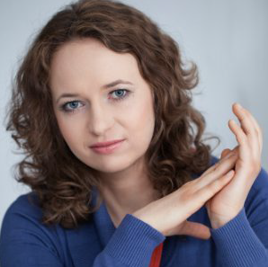
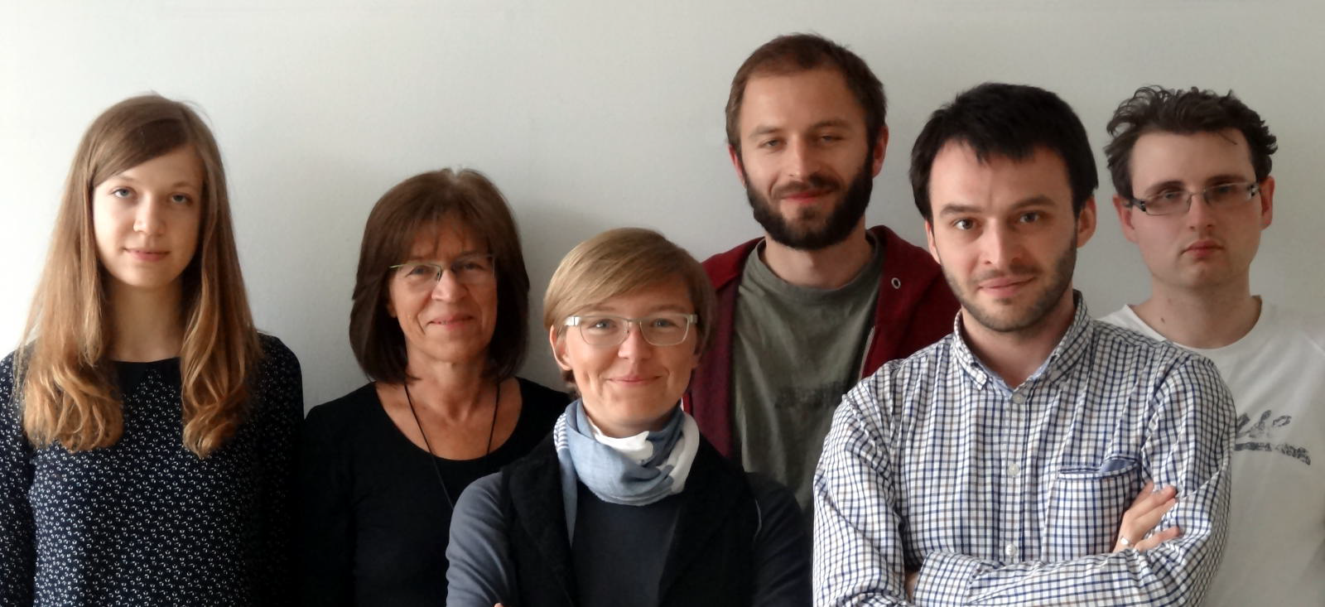
Dorota
JARECKA
Piotr
DZIEKAN
Maciek
WARUSZEWSKI
Hanna
PAWLOWSKA
Anna ZIMNIAK
Anna JARUGA
Sylwester ARABAS

Slide 5
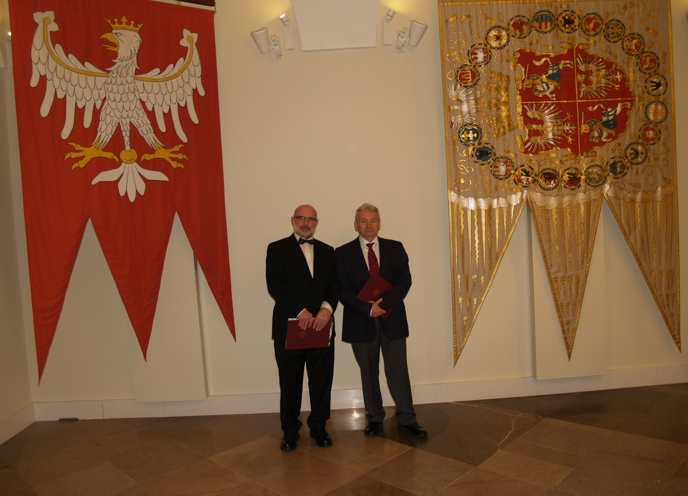
Wojciech GRABOWSKI, NCAR
Piotr SMOLARKIEWICZ, ECMWF

Slide 6
….The discussion panel
aimed at bringing together a group of experts
on Lagrangian particle-based modelling for aerosol-cloud research will be organized……

