Slide 1



Lagrangian/Eulerian equivalence for
forward-in-time differencing for fluids
Piotr Smolarkiewicz
“The good Christian should beware of mathematicians, and all those who make
empty prophecies. The danger already exists that the mathematicians have
made a covenant with the devil to darken the spirit and to confine man in
the bonds of Hell’’ (St. Augustine, De Genesi ad Litteram, Book II, xviii, 37).

Slide 2
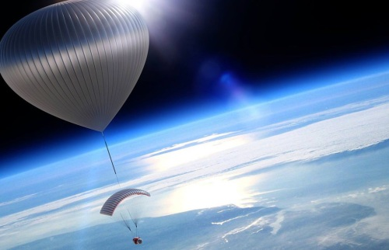
Two reference frames
Eulerian ⬅ ➔ Lagrangian
The laws for fluid flow --- conservation of mass, Newton’s 2nd law, conservation of energy, and 2nd principle of thermodynamics --- are independent on reference frames ➔ the two descriptions must be equivalent; somehow.

Slide 3

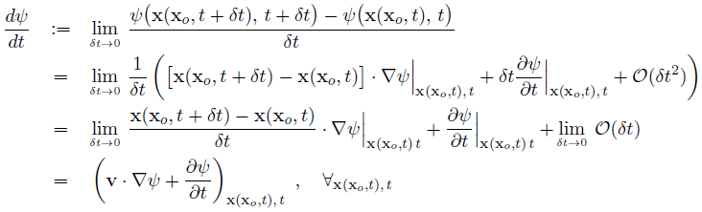

Fundamentals:
physics (re measurement)
math (re Taylor series)
physics (relating observations
in the two reference frames)

Slide 4

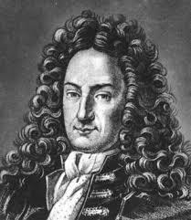

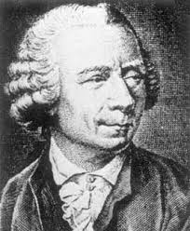

More math:
parcel’s volume evolution;
0 < J < ∞, for the flow to
be topologically realizable
flow divergence, definition
flow Jacobian
Euler expansion formula,
and the rest is easy ➔

Slide 5




… and the rest is easy, cnt:
mass continuity
key tools for deriving conservation laws

Slide 6
Solutions (numerical, forward-in-time)
Eulerian
Lagrangian (semi)
EUlerian/LAGrangian congruence

Slide 7
Motivation for Lagrangian integrals

Slide 8
Motivation for Eulerian integrals
forward-in-time temporal discretization:
Second order Taylor expansion about t=nδt
Compensating first error term on the rhs is a responsibility of an FT advection scheme (e.g. MPDATA). The second error term depends on the implementation of an FT scheme

Slide 9
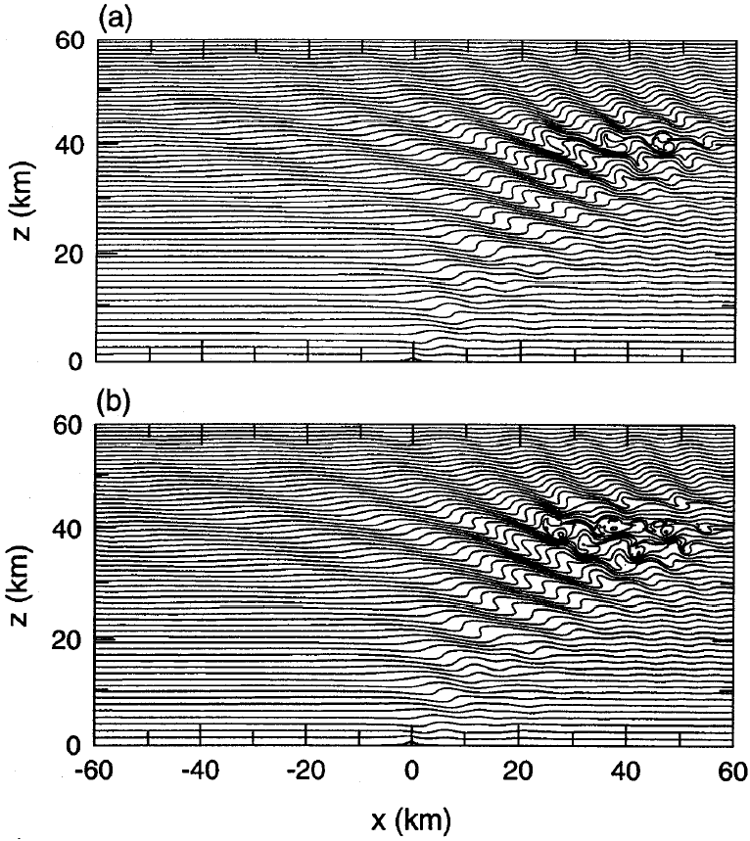
Example: stratospheric gravity wave; the same setup for SL (top) and EU (bottom)

Slide 10
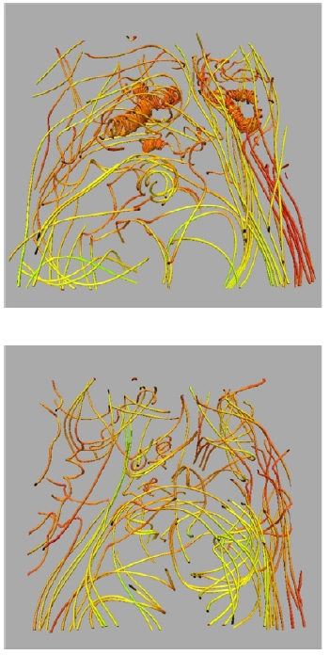

Relative merits:
Stability vs realizability : ; CFL
controls stability & realizability of Eulerian solutions, and Lipschitz
condition controls relizability of semi Lagrangian solutions
It is easy to assure compatibility of Eulerian solutions for specific
variables with the mass continuity. For semi-Lagrangian
schemes compatibility with mass continuity leads to
Monge-Ampere nonlinear elliptic problem, whose solvability is
controlled by the Lipschitz condition; (Cosette et al. 2014, JCP).
Regardless: semi-Lagrangian schemes enable large time step integrations and, thus, offer a practical option for applications where intermittent loss of accuracy is acceptable (e.g., NWP)

Slide 11
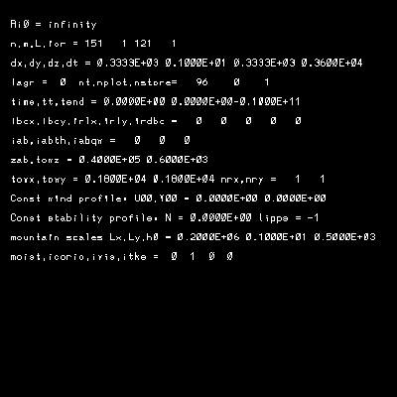
Boundary-adaptive mappings
3D potential flow past undulating boundaries
Sem-Lagrangian option; Courant number ~5.
mappings
Vorticity errors in potential-flow simulation

Slide 12
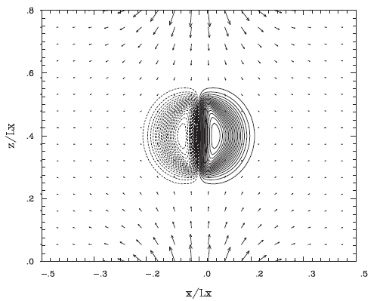
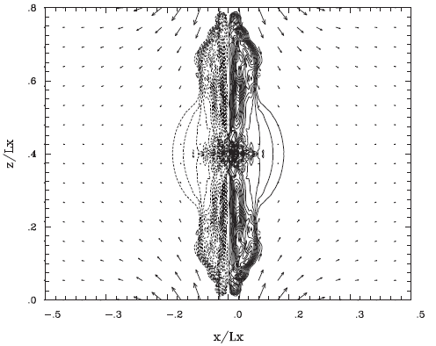
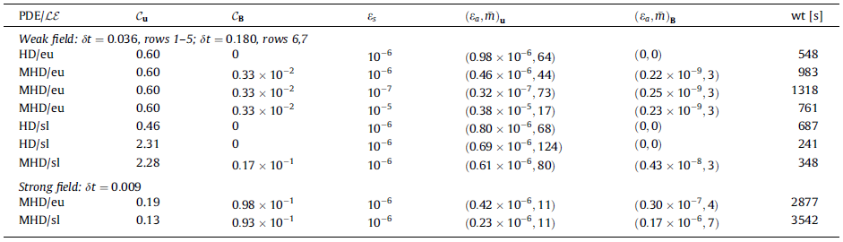

Slide 13
Remarks:
The availability of compatible flux-form Eulerian and Lagrangian options in a fluid model, is practical, convenient and enabling.
The issue is not one versus the other, but how to use complementarily both of them, working in concert to assure the most effective computational solutions to complex physical problems.
The research leading to these results has received funding from the European Research Council under the European Union’s Seventh Framework Programme (FP7/2012/ERC Grant agreement no. 320375)

