Slide 1
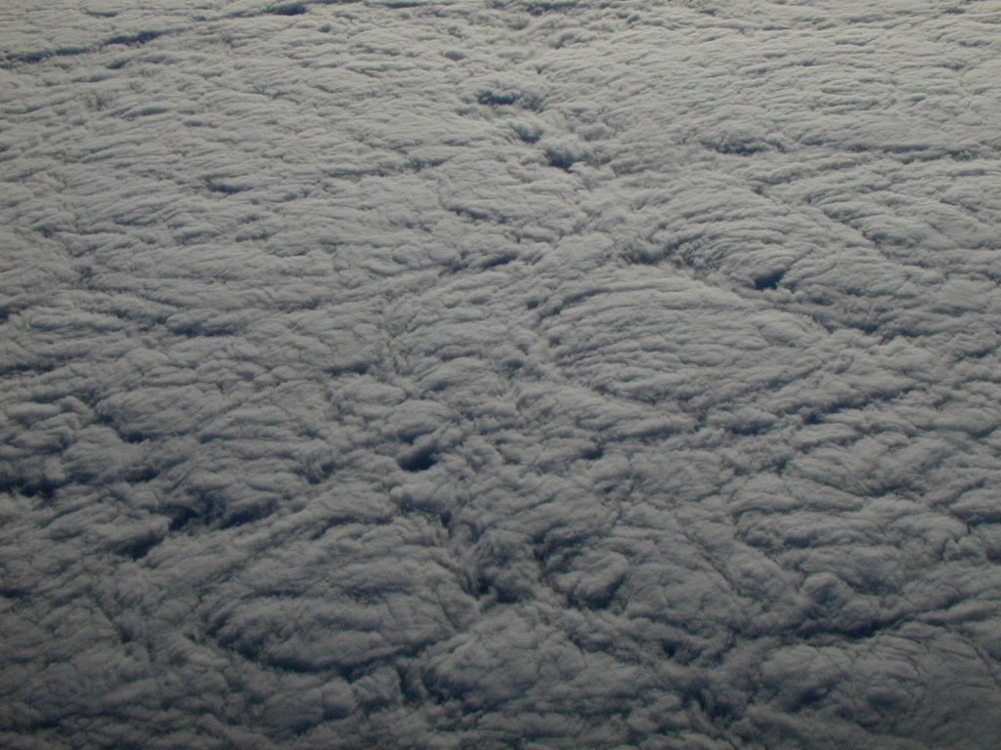


How observations shall be used to constrain numerical models of the Earth System
Workshop on Eulerian vs. Lagrangian methods for cloud microphysics
Warsaw 20-22 April 2015
J. L. Brenguier, Météo-France CNRS CNRM/GAME
Warsaw 20-22 April 2015

Slide 2
Why not just observing !
MCA
RAT
06
08
12
14
18
22
Correlation does not necessarily mean causal relationship !
Time is a crucial ingredient to establish causal relationships.
“Do MCA changes precede RAT changes or the contrary ?”
The second ingredient is a set of hypothesized mechanisms by which a physical phenomenon might impact another one. These mechanisms constitute a model.
The third ingredient is the susceptibility of the effect to the presumed cause compared to its susceptibility to other controlling factors. The former rather being much higher than the later !
J. L. Brenguier, Météo-France CNRS CNRM/GAME
Warsaw 20-22 April 2015

Slide 3
Strategy for Observations
Lets assume the above mentioned conditions are fulfilled and a model is available.
How to define a strategy for observations considering that the atmosphere can hardly be simulated in the lab !
That means the phenomenon cannot be reproduced many times changing the values of the presumed cause, all other controlling factors being frozen.
The atmosphere is a tightly coupled system of systems with multiple non-linear interactions and feedbacks.
One can only observe a (long) series of diverse system states, preferably covering its full domain of evolution.
The strategy is commonly referred to as a
“Closure Experiment”
J. L. Brenguier, Météo-France CNRS CNRM/GAME
Warsaw 20-22 April 2015

Slide 4
The ACE2 Cloudy Column
Experiment
Subject : The Aerosol Indirect Effect
Hypothesis : Hygroscopic aerosol particles have an impact on clouds, hence on climate (assumed to be a cooling effect counteracting green-house gases warming effect).
Sub-hypothesis : Hygroscopic aerosol particles have an impact on cloud radiative properties and precipitation formation.
J. L. Brenguier, Météo-France CNRS CNRM/GAME
Warsaw 20-22 April 2015

Slide 5
Radiative forcings and feedbacks
Aerosol particles
turbulence
Convective cluster
Droplets &
drops
convection
Synoptic perturbation
10³km
nm
mm
m
km
aerosol
With its nucleating properties, CCN and IN, the aerosol can impact cloud microphysical properties
Do cloud microphysical changes have an impact on
global scale cloud radiative properties ?
J. L. Brenguier, Météo-France CNRS CNRM/GAME
Warsaw 20-22 April 2015

Slide 6
The ACE2 Cloudy Column
Experiment
Multispectral
radiances
Spatial and size distribution of droplets
VALIDATION
Cloud
microphysical
model
Radiative
transfer
model
top
VALIDATION
VALIDATION
Droplet
growth
model
Spatial and size distribution of precipitation
base
Nact
VALIDATION
Aerosol size distribution & chemical composition
w
CCN
activation
model
océan
Turbulent fluxes
J. L. Brenguier, Météo-France CNRS CNRM/GAME
Warsaw 20-22 April 2015

Slide 7
Key Requirement in a Closure Experiment
Control Variable
The Control Variable measurements shall be fully independent of the Input Variable measurements !
VALIDATION
Input Variable
J. L. Brenguier, Météo-France CNRS CNRM/GAME
Warsaw 20-22 April 2015

Slide 8
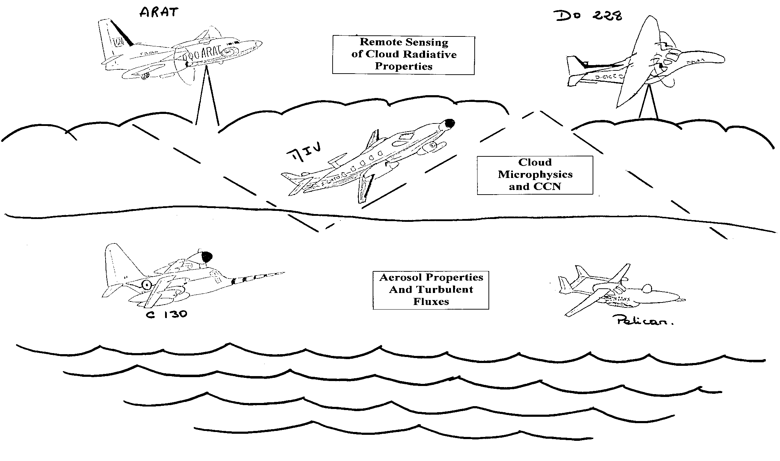
ACE-2 Field Campaign June-July 1997
J. L. Brenguier, Météo-France CNRS CNRM/GAME
Warsaw 20-22 April 2015

Slide 9
CN to CCN
Physical Process
Model or
Parameterization
Kölher
Theory
Measured
Input
Variables
Physico-
Chemical
Properties of
Aerosols
Predicted
Output
Variables
Predicted
CCN
Activation
Spectrum
COMPARISON
Measured
Output
Variables
Aerosol particles
Synoptic perturbation
Measured
CCN
Activation
Spectrum
convection
Convective cluster
Droplets & drops
turbulence
10³km
nm
mm
m
km
aerosol
J. L. Brenguier, Météo-France CNRS CNRM/GAME
Warsaw 20-22 April 2015

Slide 10
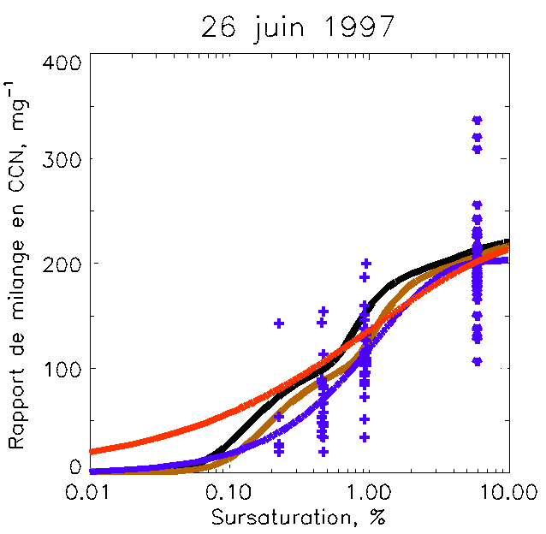
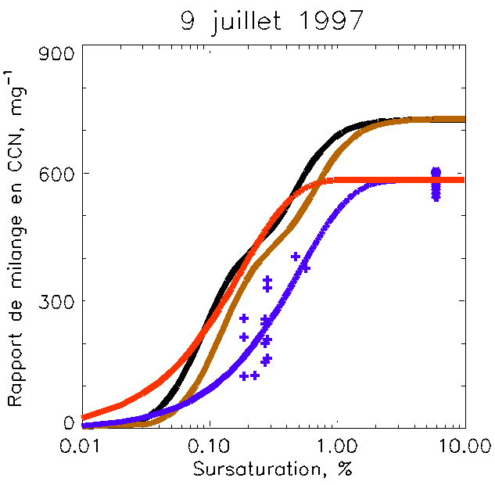
CCN concentration predicted from measured aerosol
against measured CCN concentration
+ CCN
 CN
J. L. Brenguier, Météo-France CNRS CNRM/GAME
Warsaw 20-22 April 2015

Slide 11
The ACE2 Cloudy Column
Experiment
Multispectral
radiances
Spatial and size distribution of droplets
VALIDATION
Cloud
microphysical
model
Radiative
transfer
model
top
VALIDATION
VALIDATION
Droplet
growth
model
Spatial and size distribution of precipitation
base
Nact
VALIDATION
Aerosol size distribution & chemical composition
w
CCN
activation
model
océan
Turbulent fluxes
J. L. Brenguier, Météo-France CNRS CNRM/GAME
Warsaw 20-22 April 2015

Slide 12
CCN Activation at Cloud Base
Aerosols
Properties
CCN
Activation
Model
Predicted
Nact
Vertical
velocity
@cloud base
COMPARISON
Aerosol particles
Synoptic perturbation
Measured
Nact
convection
Convective cluster
Droplets & drops
turbulence
10³km
nm
mm
m
km
aerosol
J. L. Brenguier, Météo-France CNRS CNRM/GAME
Warsaw 20-22 April 2015

Slide 13
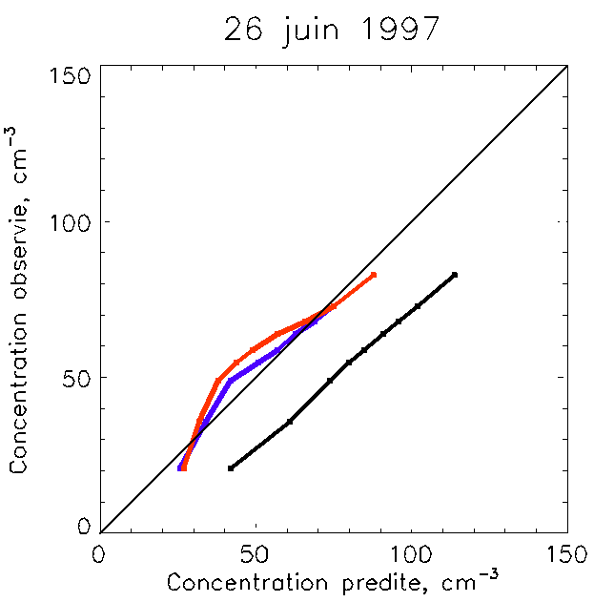
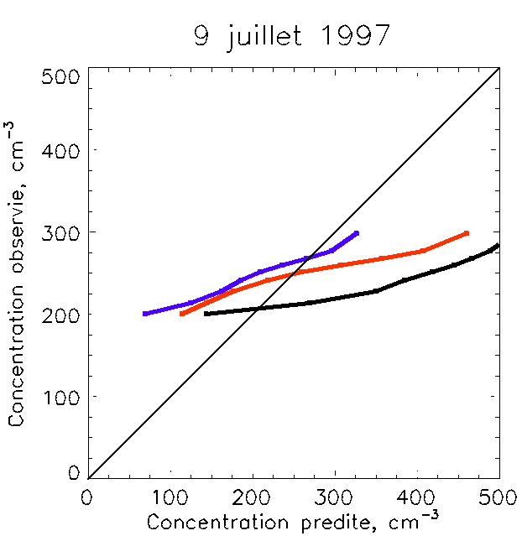
Activation closure
Droplet concentration predicted for the 10% percentiles of the measured w frequency distribution
against the 10% percentiles of the measured droplet concentration frequency distribution
measured concentration
measured concentration
predicted concentration
predicted concentration
J. L. Brenguier, Météo-France CNRS CNRM/GAME
Warsaw 20-22 April 2015

Slide 14
The ACE2 Cloudy Column
Experiment
Multispectral
radiances
Spatial and size distribution of droplets
VALIDATION
Cloud
microphysical
model
Radiative
transfer
model
top
VALIDATION
VALIDATION
Droplet
growth
model
Spatial and size distribution of precipitation
base
Nact
VALIDATION
Aerosol size distribution & chemical composition
w
CCN
activation
model
océan
Turbulent fluxes
J. L. Brenguier, Météo-France CNRS CNRM/GAME
Warsaw 20-22 April 2015

Slide 15
Cloud
Microphysical model
Predicted
Droplet
Spectrum
versus
Height
Nact
COMPARISON
Measured
Droplet
Spectrum
versus
Height
Aerosol particles
Synoptic perturbation
convection
Convective cluster
Droplets & drops
turbulence
10³km
nm
mm
m
km
aerosol
J. L. Brenguier, Météo-France CNRS CNRM/GAME
Warsaw 20-22 April 2015

Slide 16
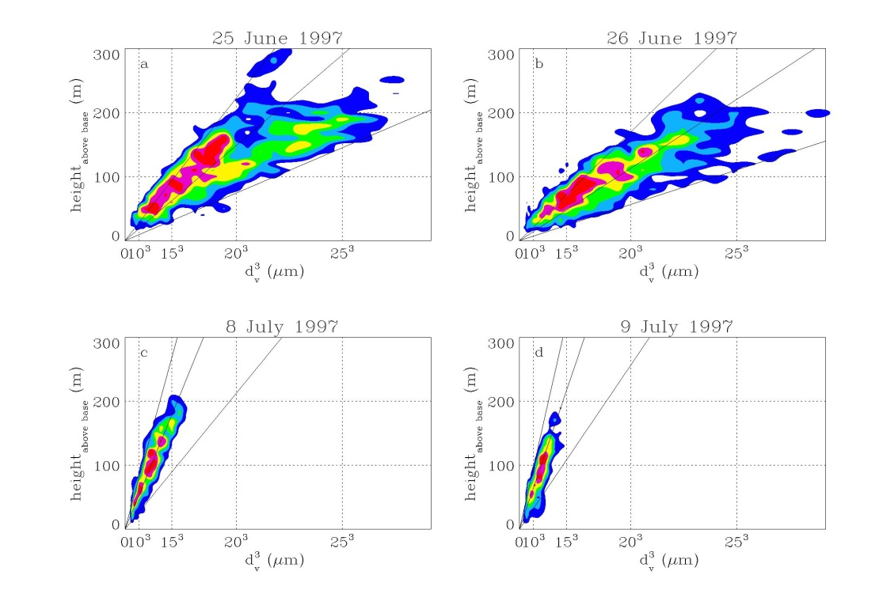

Droplets size distributions
Characterization of Cloud Microphysics (Pawlowska et al.)
Spatial Distribution and Vertical Stratification
based on M-IV Profiles through the Cloud Layer (ascent or descent),
from 15 to 35 profiles per flight
Droplet Mean Volume Diameter versus Height above Cloud Base
N=75
51
134
114
cm⁻³
208
256
178
134
J. L. Brenguier, Météo-France CNRS CNRM/GAME
Warsaw 20-22 April 2015

Slide 17
The ACE2 Cloudy Column
Experiment
Multispectral
radiances
Spatial and size distribution of droplets
VALIDATION
Cloud
microphysical
model
Radiative
transfer
model
top
VALIDATION
VALIDATION
Droplet
growth
model
Spatial and size distribution of precipitation
base
Nact
VALIDATION
Aerosol size distribution & chemical composition
w
CCN
activation
model
océan
Turbulent fluxes
J. L. Brenguier, Météo-France CNRS CNRM/GAME
Warsaw 20-22 April 2015

Slide 18
Cloud radiative transfer
Inverse radiative
transfer model
Measured
VIS and NIR
radiances
Retrieved
Nact & H
COMPARISON
Aerosol particles
Synoptic perturbation
Measured
Nact & H
convection
Convective cluster
Droplets & drops
turbulence
10³km
nm
mm
m
km
aerosol
J. L. Brenguier, Météo-France CNRS CNRM/GAME
Warsaw 20-22 April 2015

Slide 19
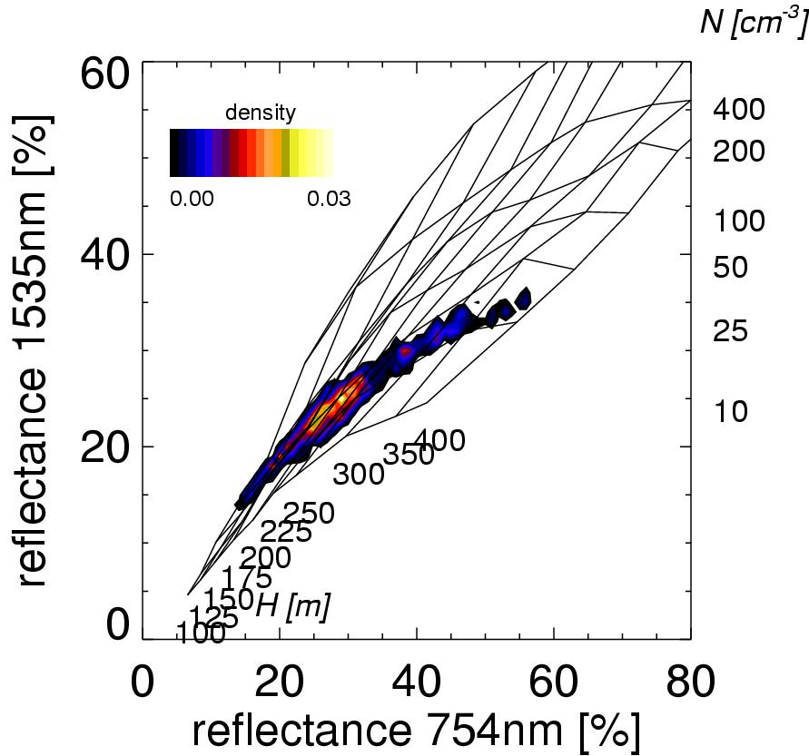
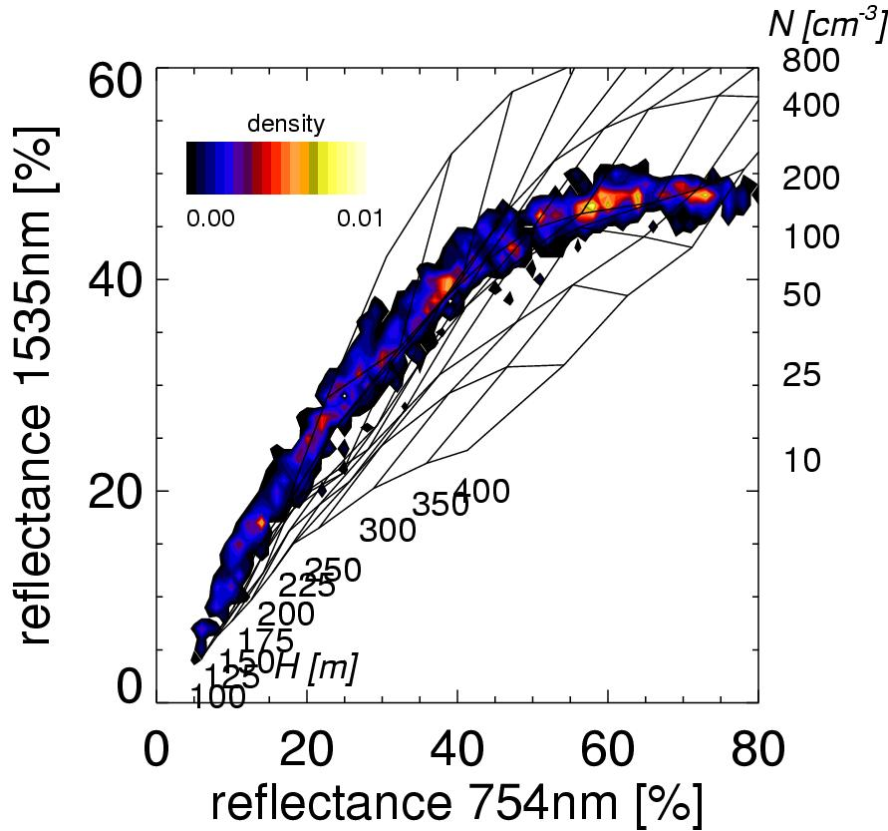
Cloud radiative transfer
J. L. Brenguier, Météo-France CNRS CNRM/GAME
Warsaw 20-22 April 2015

Slide 20
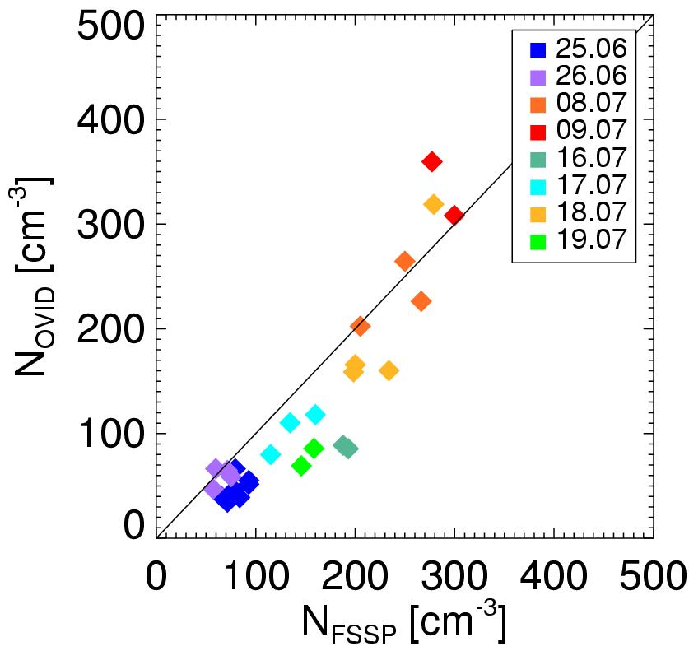
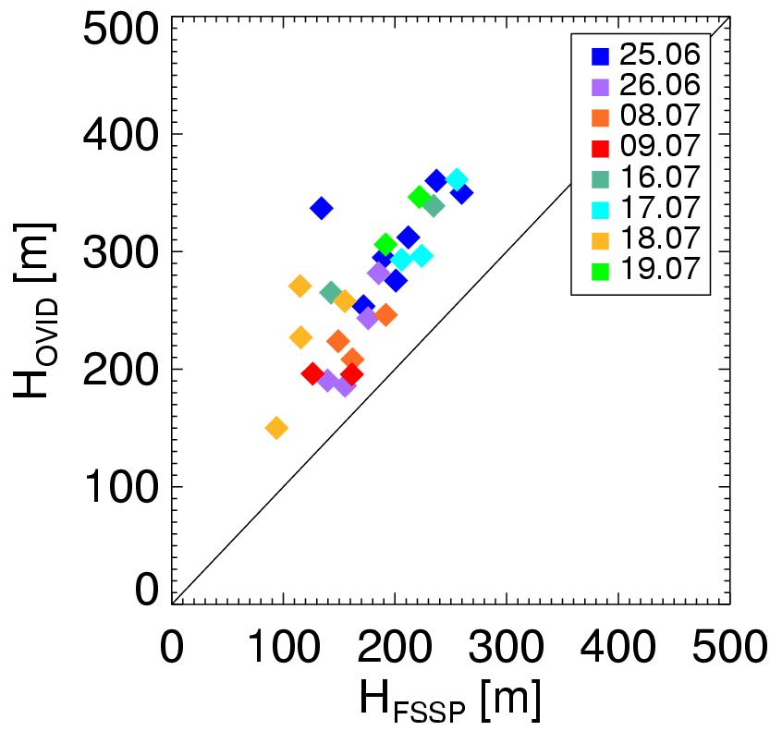
Radiative transfer
Comparison between observed and derived
droplet number concentration and cloud geometrical thickness
J. L. Brenguier, Météo-France CNRS CNRM/GAME
Warsaw 20-22 April 2015

Slide 21
The ACE2 Cloudy Column
Experiment
Multispectral
radiances
Spatial and size distribution of droplets
VALIDATION
Cloud
microphysical
model
Radiative
transfer
model
top
VALIDATION
VALIDATION
Droplet
growth
model
Spatial and size distribution of precipitation
base
Nact
VALIDATION
Aerosol size distribution & chemical composition
w
CCN
activation
model
océan
Turbulent fluxes
J. L. Brenguier, Météo-France CNRS CNRM/GAME
Warsaw 20-22 April 2015

Slide 22
Cloud
Precipitation
Parameterization
H
&
Nact
Parameterized
Precipitation
Rate
COMPARISON
Measured
Precipitation
Rate
Aerosol particles
Synoptic perturbation
convection
Convective cluster
Droplets & drops
turbulence
10³km
nm
mm
m
km
aerosol
J. L. Brenguier, Météo-France CNRS CNRM/GAME
Warsaw 20-22 April 2015

Slide 23
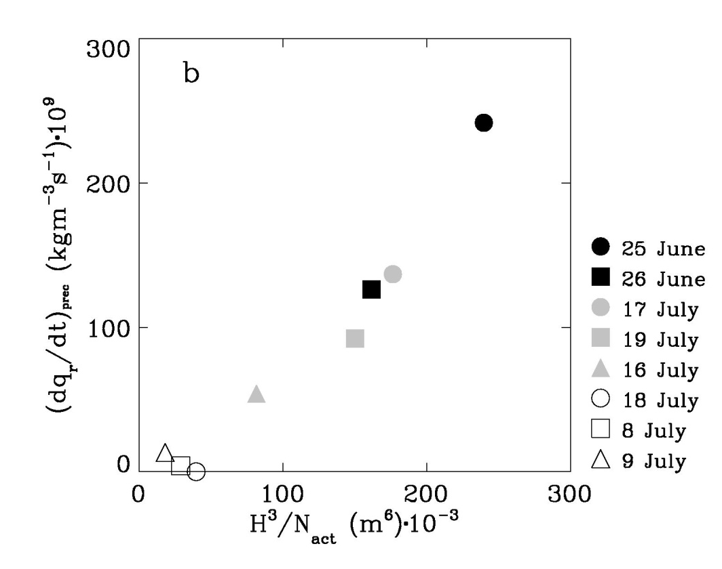
The ACE2 Cloudy Column
Experiment
Pawlowska & Brenguier JGR 2003
Reduction rate of cloud water by precipitation
as a power law of H and N_{act}
J. L. Brenguier, Météo-France CNRS CNRM/GAME
Warsaw 20-22 April 2015

Slide 24
The ACE2 Cloudy Column
Experiment
Subject : The Aerosol Indirect Effect
Next challenge to move from the cloud system scale to the global scale
Hypothesis : Hygroscopic aerosol particles have an impact on clouds, hence on climate (assumed to be a cooling effect counteracting green-house gases warming effect).
Aerosol particles
Aerosol particles
Synoptic perturbation
Synoptic perturbation
Sub-hypothesis : Hygroscopic aerosol particles have an impact on cloud radiative properties and precipitation formation.
Partly verified, although some discrepancies still exist between predictions and observations
convection
convection
Convective cluster
Droplets & drops
Convective cluster
Droplets & drops
turbulence
turbulence
10³km
m
10³km
nm
mm
m
km
nm
mm
km
aerosol
aerosol
J. L. Brenguier, Météo-France CNRS CNRM/GAME
Warsaw 20-22 April 2015

Slide 25
What do we already know ?
CCN Concentration  ⇒ CDNC 
⇒ Droplet Sizes  (cst LWP)
(II) Droplet Sizes  ⇒ COT  (cst LWP)
(III) Droplet Sizes  ⇒ PR  (cst LWP)
What is missing ?
(IV) Impacts on Cloud Extend and Life Time
(Varying LWP or 2nd Aerosol Indirect Effect)
CRF= f(M, A, MA)
J. L. Brenguier, Météo-France CNRS CNRM/GAME
Warsaw 20-22 April 2015

Slide 26
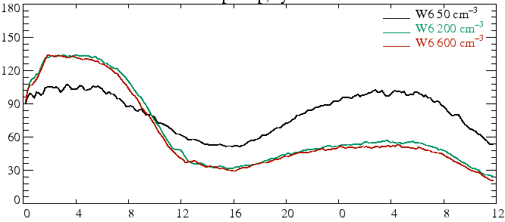
LES Studies
Changing cloud optical properties and precipitation efficiency is likely to impact cloud extend and life time
N_{ccn}= 50, 200, 600 cm⁻³
Sandu et al., JAS, 2008
Pawlowska and Brenguier, 2003
N_{c} = 40, 120, 220 cm⁻³
LWP (g/m²)
N_{c}
LWP
N_{c}
LWP
0 HL 12 HL 0 HL 12 HL
J. L. Brenguier, Météo-France CNRS CNRM/GAME
Warsaw 20-22 April 2015

Slide 27
What is missing ?
10³km
nm
mm
m
km
Resolved clouds
Parameterized
aerosol
The third ingredient is the susceptibility of the effect to the presumed cause compared to its susceptibility to other controlling factors. The former rather being much higher than the later !
J. L. Brenguier, Météo-France CNRS CNRM/GAME
Warsaw 20-22 April 2015

Slide 28
Null Hypothesis :
Aerosols have no impact on Clouds
Cloud controlling factors are the heat and moisture (relative humidity)
Heat and moisture are scalar tracers of the general circulation
The aerosol is also a scalar tracer of the general circulation (although with slightly different diffusivity)
Within the framework of the null hypothesis, satellite observations must exhibit noticeable correlations between heat, moisture and the aerosol
J. L. Brenguier, Météo-France CNRS CNRM/GAME
Warsaw 20-22 April 2015

Slide 29
Cloud Susceptibility to Meteorology versus Aerosol
FIRE 14-15 July 2009 case study θ = 287 K, q_{t} = 10 g/kg
z_{t}=600 m, z_{b}=200 m, H=400 m, W=220 gm⁻², dz_{b}/dq_{t}=150 m/gkg⁻¹
A CDNC doubling is balanced by a decrease of the cloud thickness of ΔH=H/5=80 m, i.e. Δq_{t}=-0.5 g/kg, equivalent ΔT=0.8 K.
(Δq_{t}=-0.12 g/kg or ΔT=0.2 K for a 100 m thick cloud layer).
J. L. Brenguier, Météo-France CNRS CNRM/GAME
Warsaw 20-22 April 2015

Slide 30
Cloud Susceptibility to Meteorology versus Aerosol
In MBL clouds, the susceptibility to the meteorology is two orders of magnitude greater than to the aerosols.
Assuming we observe a pristine and a polluted cloud system, and detect different trends in LWP, it is difficult to attribute these differences to the aerosols because the small differences in meteorological forcings that could also explain the LWP changes are not measurable !
Statistical approaches are necessary to filter out the variability of the meteorology (same methodology as in weather modification assessments)
J. L. Brenguier, Météo-France CNRS CNRM/GAME
Warsaw 20-22 April 2015

Slide 31
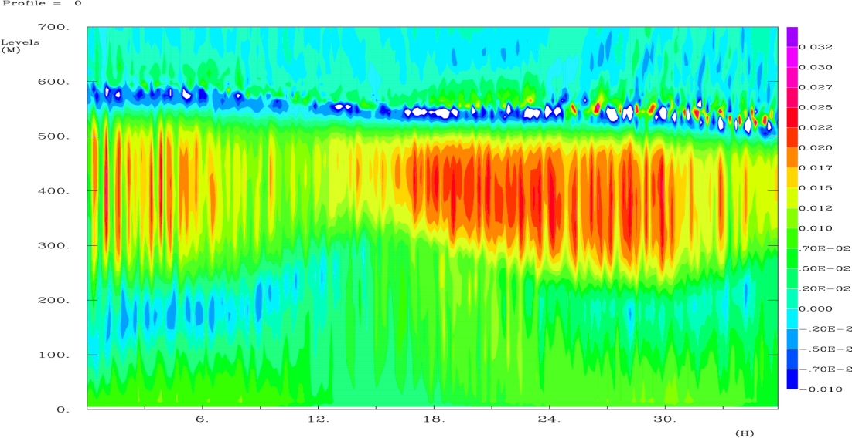
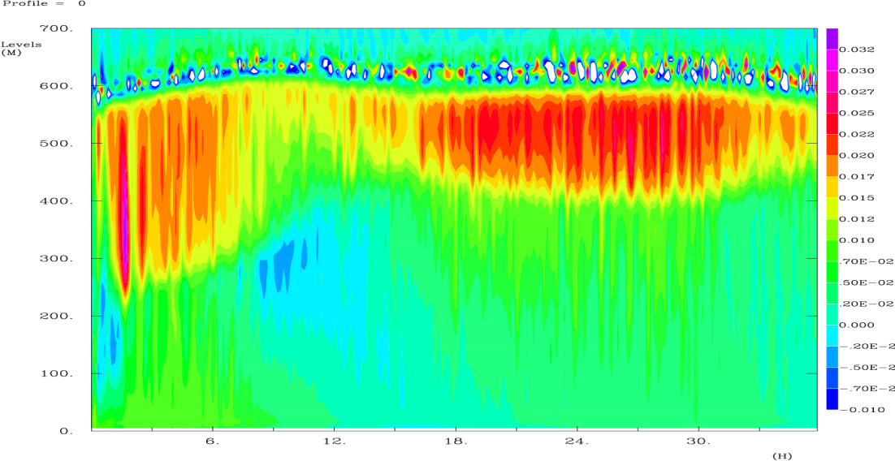
Mechanisms of the Interactions
Meteorological forcings are not measurable with the accuracy required to disentangle aerosol from meteorological impacts, BUT
The mechanisms by which aerosols are supposed to impact cloud dynamics in LES have specific measurable signatures.
Increased CCN concentration results in :
More adiabatic LWC vertical profile
Higher vertical velocity variance at cloud top
More coupling at night and more decoupling during the day
700 m
700 m
Precipitating
Buoyancy flux
Non-precipitating
J. L. Brenguier, Météo-France CNRS CNRM/GAME
Warsaw 20-22 April 2015
0
0
0 HL 12 HL 0 HL 12 HL
0 HL 12 HL 0 HL 12 HL

Slide 32
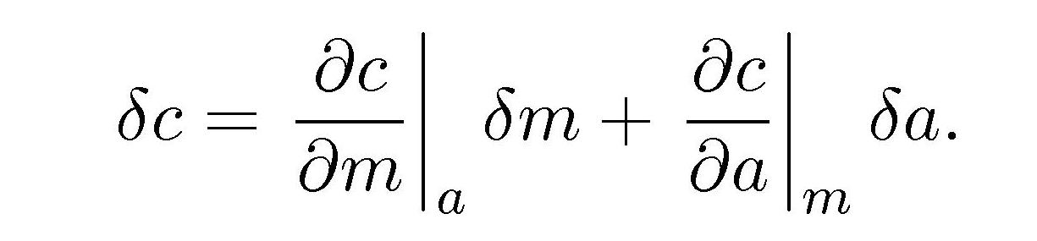
Observational Strategy
I.: Case Study approach: Look at cloud systems with different aerosols and the « same » meteorology:
0
Likewise, the fact that two air-masses have differing aerosol properties is an indicator of their differing meteorological origins and trajectories. Most of the aerosol sources are also sources of heat and moisture.
J. L. Brenguier, Météo-France CNRS CNRM/GAME
Warsaw 20-22 April 2015

Slide 33
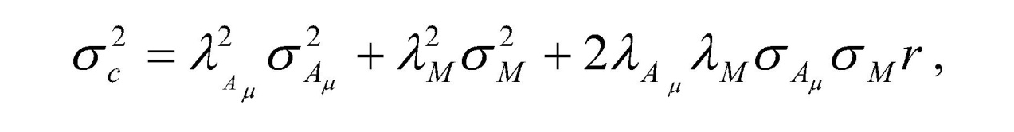
Observational Strategy
II. Statistical approach : examine a large sample of cases with significant aerosol variability and a reduced meteorological one. Same methodology as for weather modification experiments
0
50 years of weather modification experiments have not been sufficient to detect noticeable effects because λ_{M} >> λ _{A}
Not only do we need to reduce the meteorological variability and its impact on clouds, but also to understand to what extent the meteorological variability covaries with the aerosol variability.
J. L. Brenguier, Météo-France CNRS CNRM/GAME
Warsaw 20-22 April 2015

Slide 34
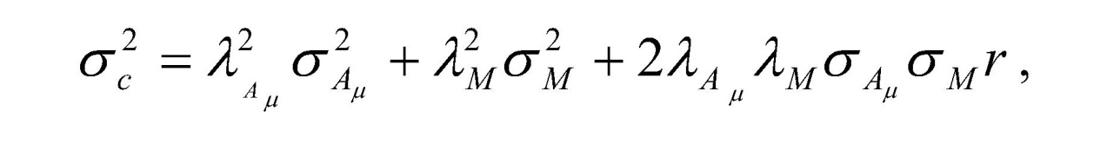
Observational Strategy
II : Statistical approach : Select situations where aerosol and meteorology vary independently (week-end effect, sugar cane burning)
0
Is there any aerosol source, that has no signature in term of heat and moisture, considering that λ_{M} >> λ_{A} ?
Where to look ? Close to or far from the source ?
J. L. Brenguier, Météo-France CNRS CNRM/GAME
Warsaw 20-22 April 2015

Slide 35
Observational Strategy
0
Close to the source, the heat and moisture signature is likely to be too large
Far from the source, can we expect that the heat and moisture signature vanishes, while the aerosol signature is still noticeable. Heat, moisture and aerosols are, however, all scalar tracers of the air mass, hence their dilution time scales are similar.
Moreover, far from the source, correlations have time to develop, that have nothing to do with the aerosol microphysical effect, i.e. cloud and precipitation impacts on aerosols and aerosol direct effects on the airmass
J. L. Brenguier, Météo-France CNRS CNRM/GAME
Warsaw 20-22 April 2015

Slide 36
Observational Strategy
IV. : System Dynamics approach: select situations where aerosol properties are specified and look at the short term meteorological response of the cloud system to the diurnal cycle.
∝cos(2πt/24)
The diurnal cycle provides the opportunity of a meteorological forcing that is well characterized and reproducible
J. L. Brenguier, Météo-France CNRS CNRM/GAME
Warsaw 20-22 April 2015

Slide 37
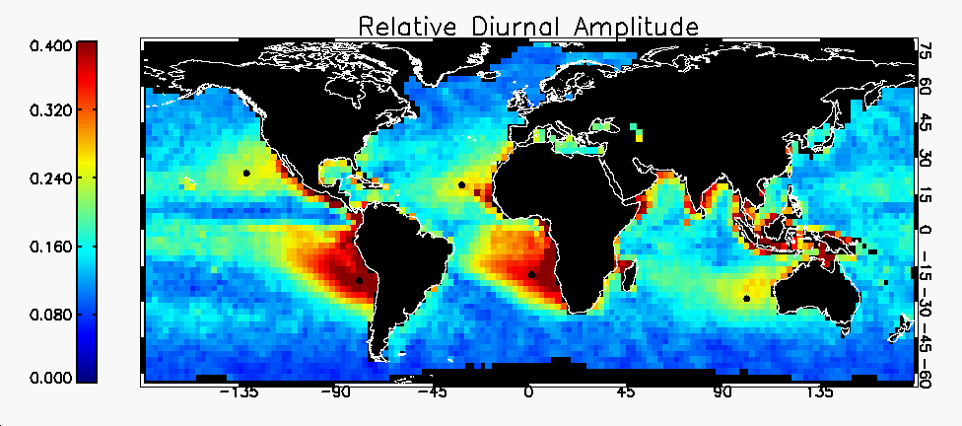
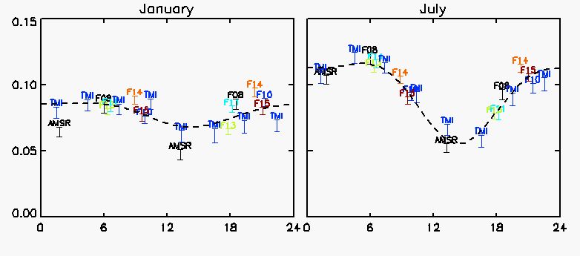
O’Dell, Wentz, and Bennartz, J Climate, 2008
Liquid Water Path [kg/m²]
J. L. Brenguier, Météo-France CNRS CNRM/GAME
Warsaw 20-22 April 2015
Local Time [hours]

Slide 38
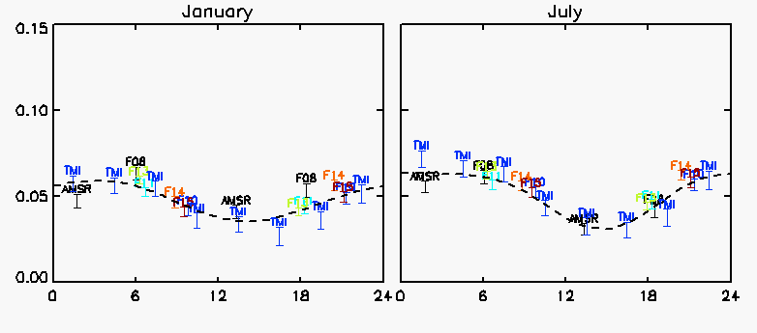
Liquid Water Path [kg/m²]
J. L. Brenguier, Météo-France CNRS CNRM/GAME
Warsaw 20-22 April 2015
Local Time [hours]

Slide 39
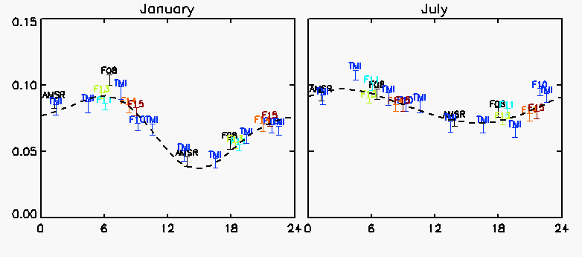
Liquid Water Path [kg/m²]
J. L. Brenguier, Météo-France CNRS CNRM/GAME
Warsaw 20-22 April 2015
Local Time [hours]

Slide 40
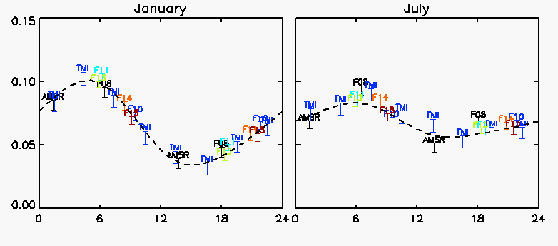
Liquid Water Path [kg/m²]
J. L. Brenguier, Météo-France CNRS CNRM/GAME
Warsaw 20-22 April 2015
Local Time [hours]

Slide 41

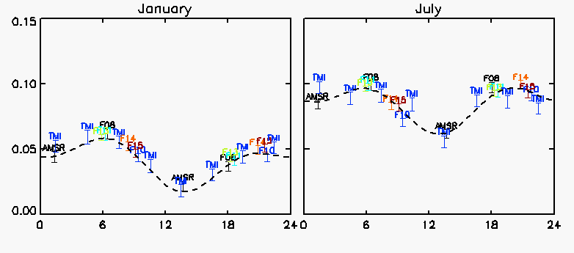
Liquid Water Path [kg/m²]
J. L. Brenguier, Météo-France CNRS CNRM/GAME
Warsaw 20-22 April 2015
Local Time [hours]

Slide 42
Summary
The detection of an aerosol impact on clouds is difficult because of the high susceptibility of clouds to meteorology (heat and moisture) compared to their susceptibility to aerosols
One alternative is to examine the diurnal cycle of cloud properties and its dependence on the aerosol, with the expectation, supported by LES, that the susceptibility of the diurnal cycle to the aerosol is comparable to its susceptibility to changes in meteorological forcings
J. L. Brenguier, Météo-France CNRS CNRM/GAME
Warsaw 20-22 April 2015

Slide 43
CONCLUSIONS
It is not feasible from satellite or any other measurement system to quantify the contribution of the meteorology to cloud macrophysical properties with the accuracy required to detect aerosol impacts.
Numerical simulations suggest that aerosols impacts on the cloud diurnal cycle might be detectable
A promising option is to use geostationary satellite data to characterize the diurnal cycle of the cloud systems and how it is modulated by the aerosol microphysical impacts.
Observations only are unlikely to solve the problem, but they are crucial for validating LES used to develop new parameterizations of the aerosol/cloud dynamics interactions in GCMs
J. L. Brenguier, Météo-France CNRS CNRM/GAME
Warsaw 20-22 April 2015

Slide 44

J. L. Brenguier, Météo-France CNRS CNRM/GAME
Warsaw 20-22 April 2015

