Slide 1


Comparing droplet activation parameterisations against adiabatic parcel models using a novel inverse modelling framework
Daniel Partridge*, Ricardo Morales and Philip Stier
*dan.partridge@aces.su.se
Warsaw: April 20th 2015: Eulerian vs. Lagrangian methods for cloud microphysics

Slide 2

Solving cloud droplet activation in a GCM
Cloud droplet activation is a key process for the indirect effect since it is the direct microphysical aerosol-cloud link.
Parameterising cloud droplet activation
Mechanistic approach: Solve an algebraic equation (instead of ODE's).
Based on 1D adiabatic cloud parcel model framework:
t
SS_{max}
Activation
?
Aerosol
S
Droplet activation parameterisations: Two main types
Based upon deriving an approximate expression for SS_{max.}
Use an iterative approach to find SS_{max} (computationally more expensive).

Slide 3
Markov Chain Monte Carlo Algorithm (MCMC)
Couple an adiabatic parcel model/ droplet activation parameterisation to a Markov Chain Monte Carlo (MCMC) algorithm. See Partridge et al., 2012 for more details.
Use MCMC to invoke posterior probability density functions of the cloud model input parameters.
Allowing us to in a statistically robust manner provide a measure of the discrepancy between model/param. and “measurements” of cloud droplet number as a function of the input parameters.
Framework not only provides an estimate of the optimal parameter values, but also a sample set of the underlying (posterior) uncertainty.
Thus: can automatically explore parameter space for parameter values that provide best possible fit to a set of observations (in-situ or synthetic).

Slide 4
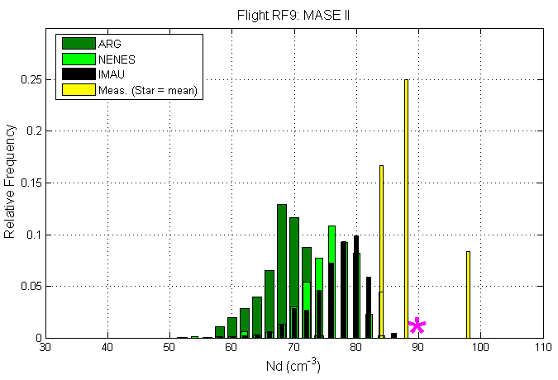
MOTIVATION: MCMC; In-situ observations
Couple two droplet activation parameterisations and a cloud parcel model to an MCMC algorithm and observations of CDNC from MASE II campaign.
Input Parameter (PRIOR) Ranges
N2 = 20:73 cm⁻³
R2 = 50:83 nm
GSD2= 1.3:1.84
Sigma-W = 0.4:0.5
Soluble MF (NH4HSO4) = 0.6:1
Irrespective of parameter values from observed prior range over 5-D parameter space cannot match the observations for the cleanest marine Sc cloud.
Indicative of parameteric uncertainty (for a parmaeter held constant, i.e. the mass accomodation coefficient), or structural error present.

Slide 5
How physically consistent/representative are droplet activation parameterisations used in GCMs?
High number of input parameters to parameterisation in GCMs (>20).
Would require many simulations in to robustly evaluate parameterisations against cloud parcel models for the entire parameter space.
Inverse Modelling Framework: MCMC
Use a Markov Chain Monte Carlo (MCMC) algorithm to automatically search through the entire parameter space.
Efficiently and transparently highlight regions of the multi-dimensional parameter space in which there exists the largest discrepancies between parameterisation and cloud parcel models calculation of N_{act}.
Identify whether the same input parameters control discrepancies in N_{act} across two independently developed cloud parcel models.

Slide 6

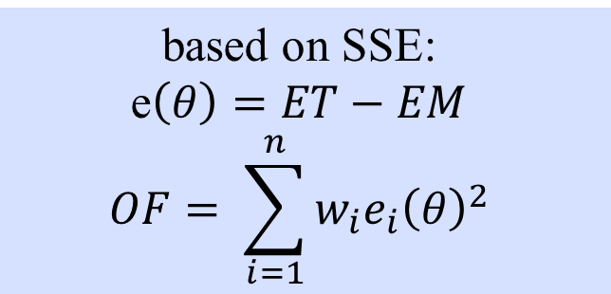
MCMC: Inverse Modelling Framework
Parameter | MIN | MAX
Updraft (ms⁻¹) | 0.05 | 5
Temp (K) | 275 | 290
MAC | 0.05 | 1
Soluble MF (Chem.) | 0.05 | 1
N1 (cm⁻³) | 30 | 1000
D1 (nm) | 10 | 100
GSD1 | 1.3 | 1.9
N2 (cm⁻³) | 30 | 1000
D2 (nm) | 120 | 600
GSD2 | 1.3 | 1.9
Define error threshold (ET, 30%) and parameter ranges
Randomly generate parameter values
Call cloud parcel model
Call parameterisation
Iterate to find parameter values r$esulting in error ≥|30\%|.$
ARG: Abdu-Razzak & Ghan (2000)
SW: Shipway (2015)
BN: Barahona et al., (2010)
MN: Morales & Nenes (2014)
Calculate error metric (EM):
Absolute percentage difference in number of activated droplets.
ICPM: Roelofs & Jongen (2004)/ Partridge et al., 2011;2012
DROPS: Arabas & Pawlowska (2011)
based on SSE:
e$\left(θ\right)=ET−EM$
$$OF= \sum_{i=1}^{n}{w_{i}e_{i}{\left(θ\right)}^{2}}$$
Calculate likelihood function from error threshold and error metric.

Slide 7
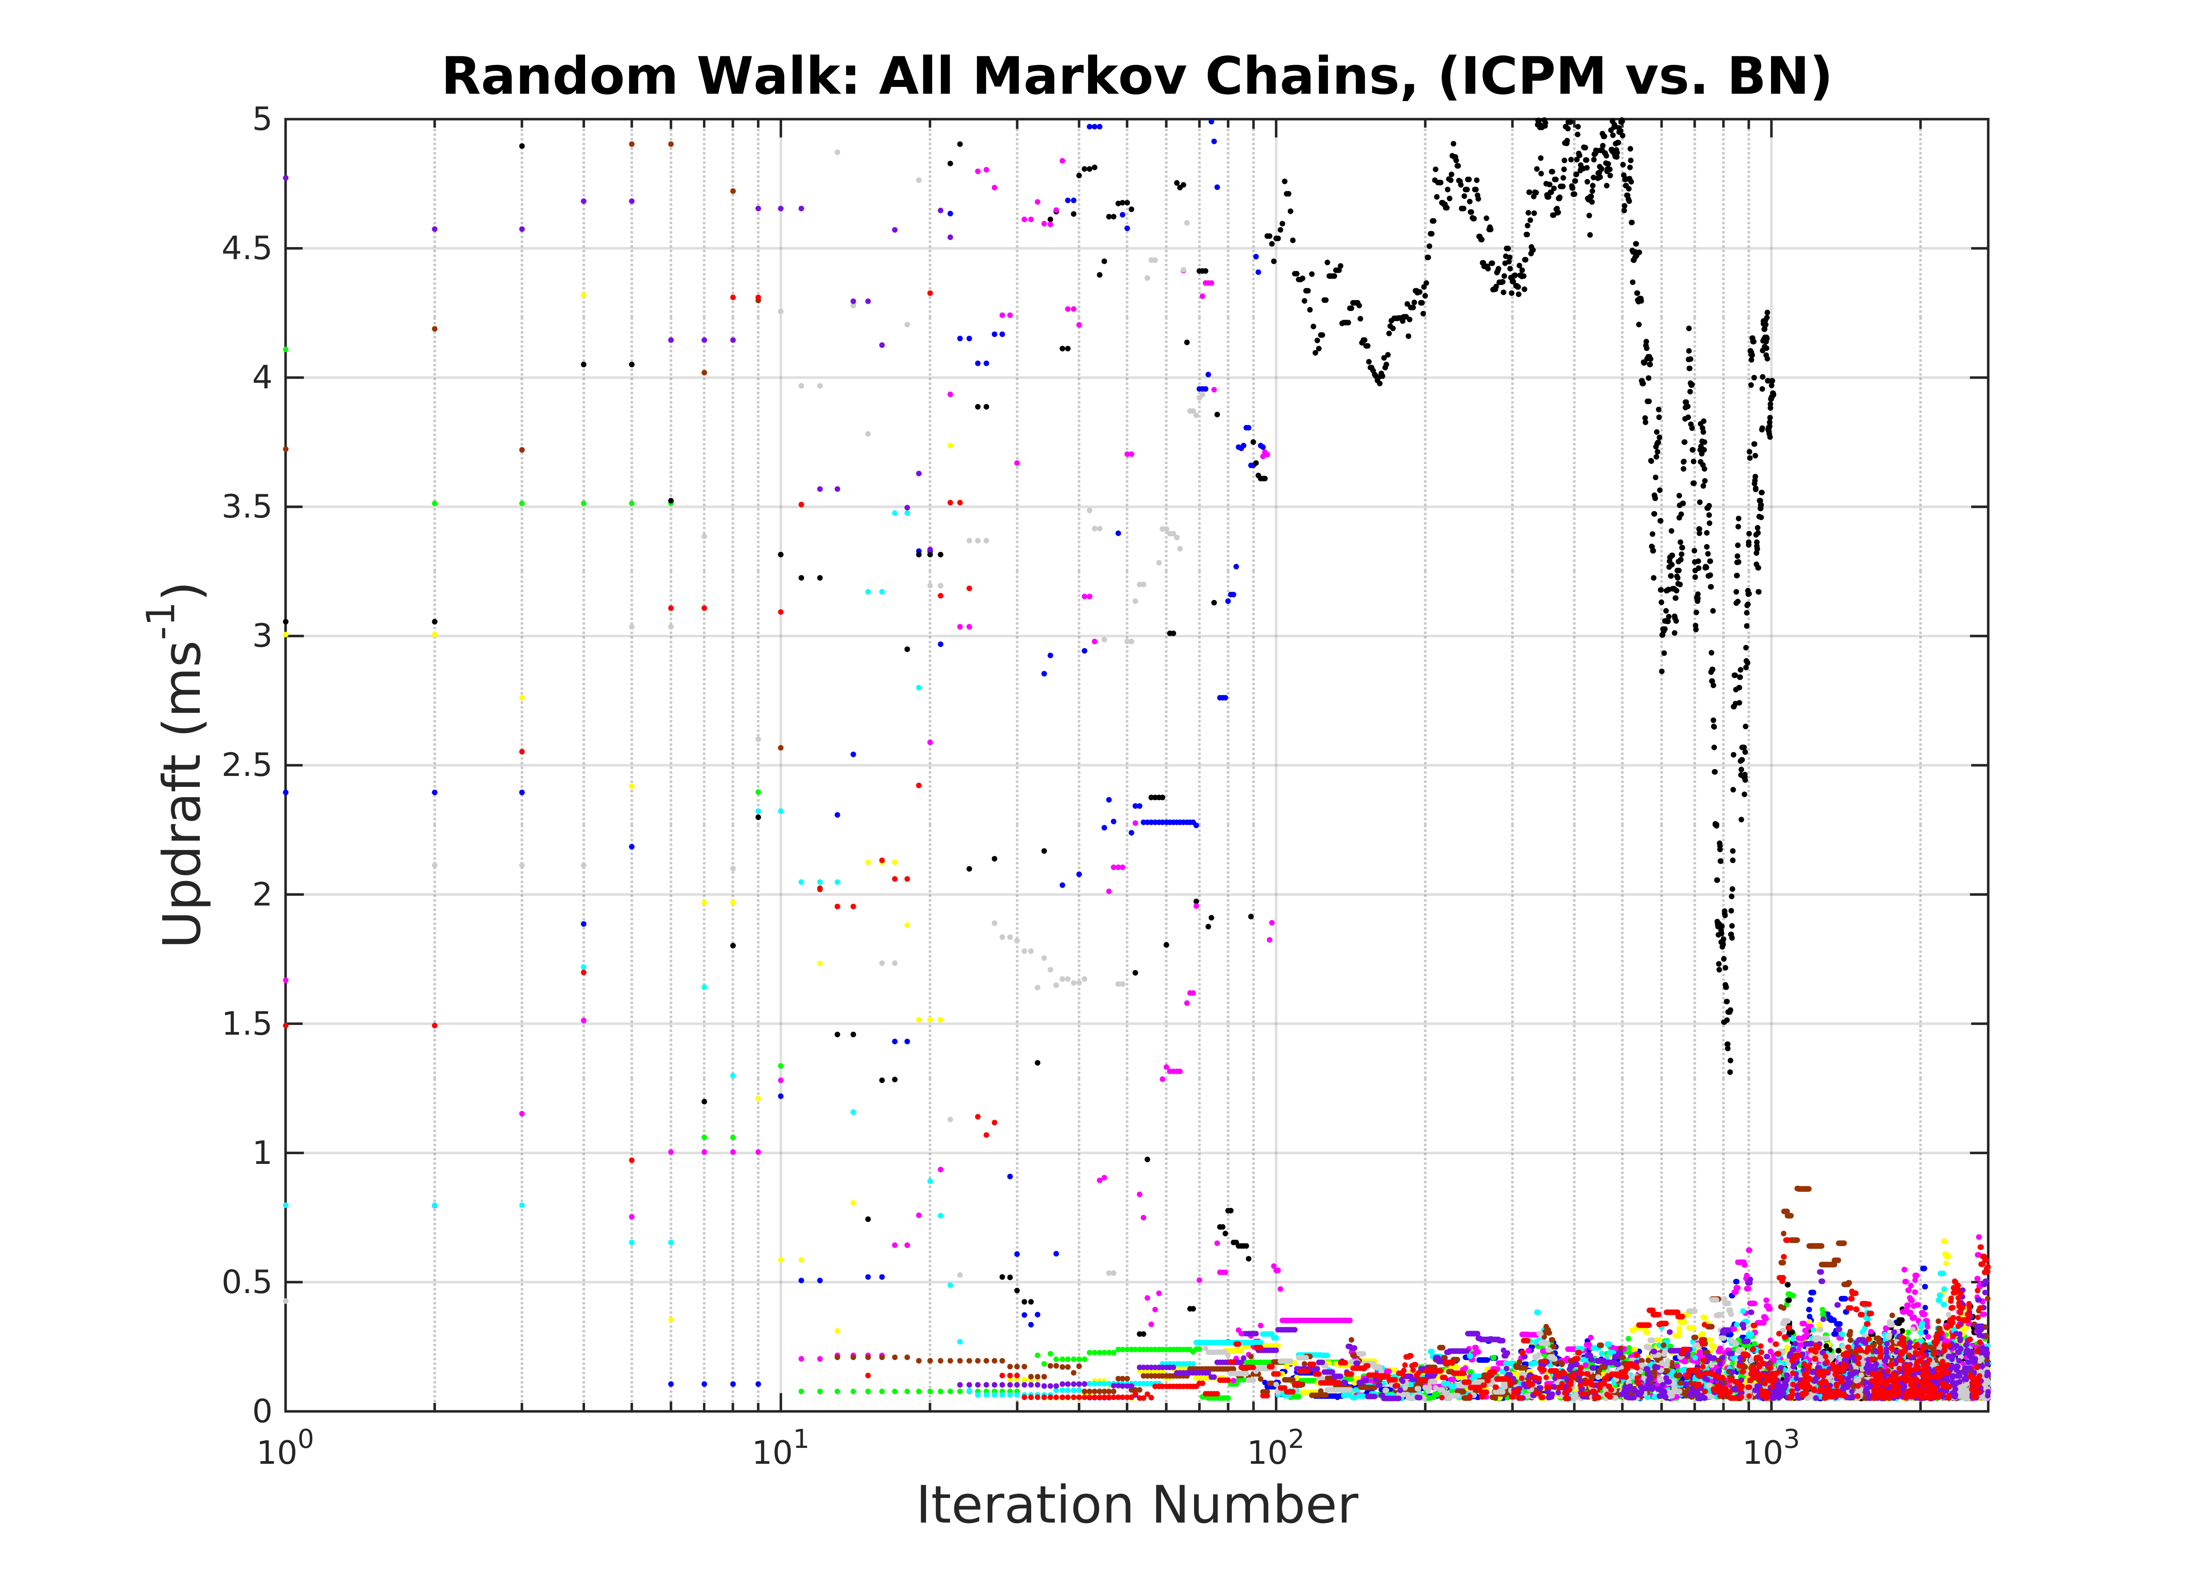
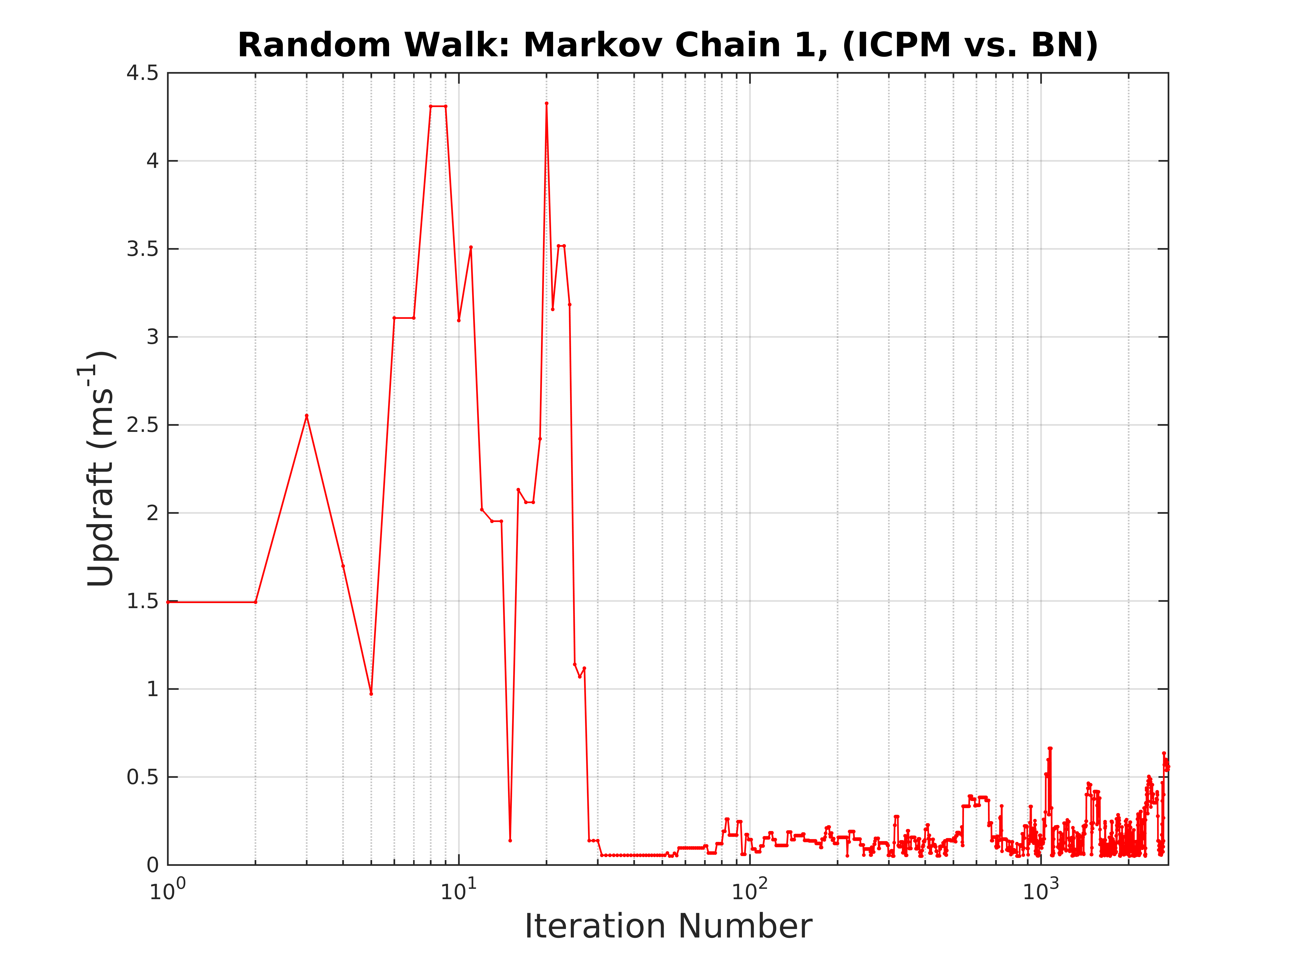
Automatically identifying input parameter values associated with largest deviation from parcel model
Error < |30%|
Error > |30%|
For Barahona et al., 2010 (BN) parameterisation only the updraft velocity controls the error.

Slide 8
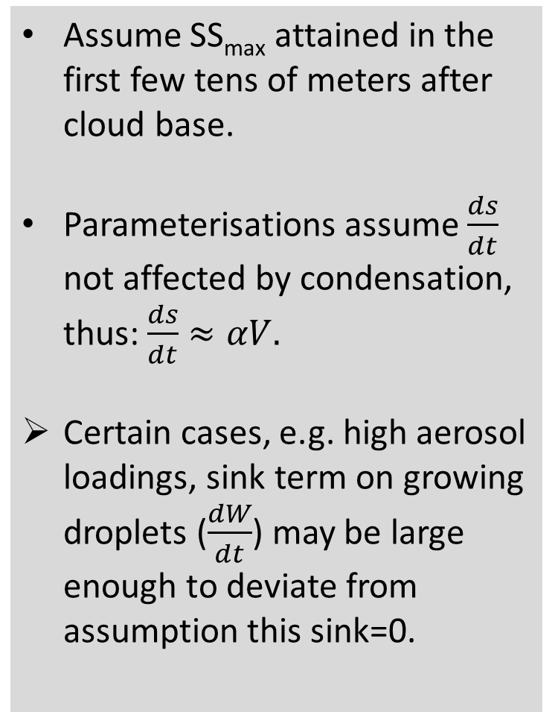
Evaluating Barahona et al., 2010 parameterisation
Assume SS_{max} attained in the first few tens of meters after cloud base.
Parameterisations assume $\frac{ds}{dt}$ not affected by condensation, thus: $\frac{ds}{dt}≈αV.$
Certain cases, e.g. high aerosol loadings, sink term on growing droplets ($\frac{dW}{dt}$) may be large enough to deviate from assumption this sink=0.
|30%| error threshold
High mass loading /
Low updraft velocity:
Low SS_{max}

Slide 9
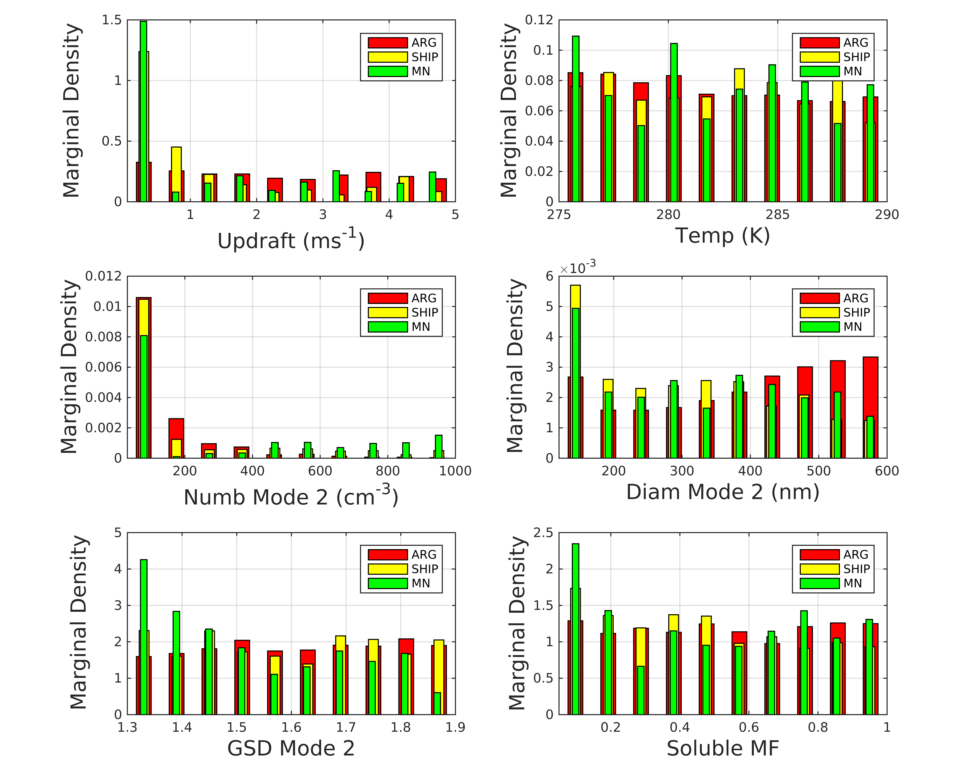
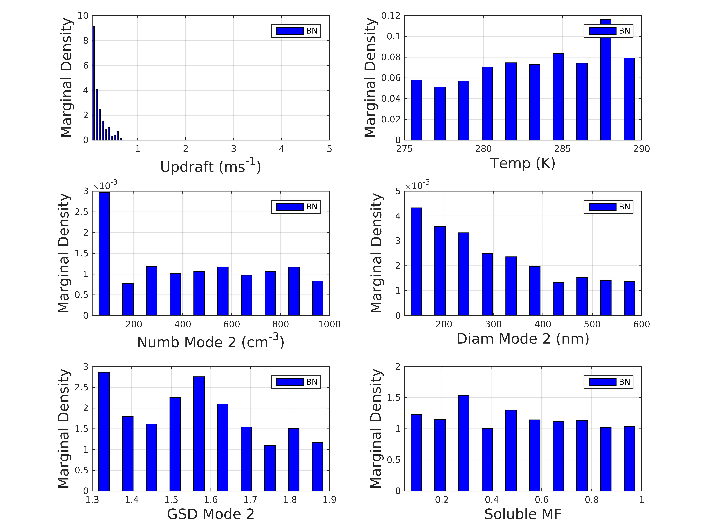
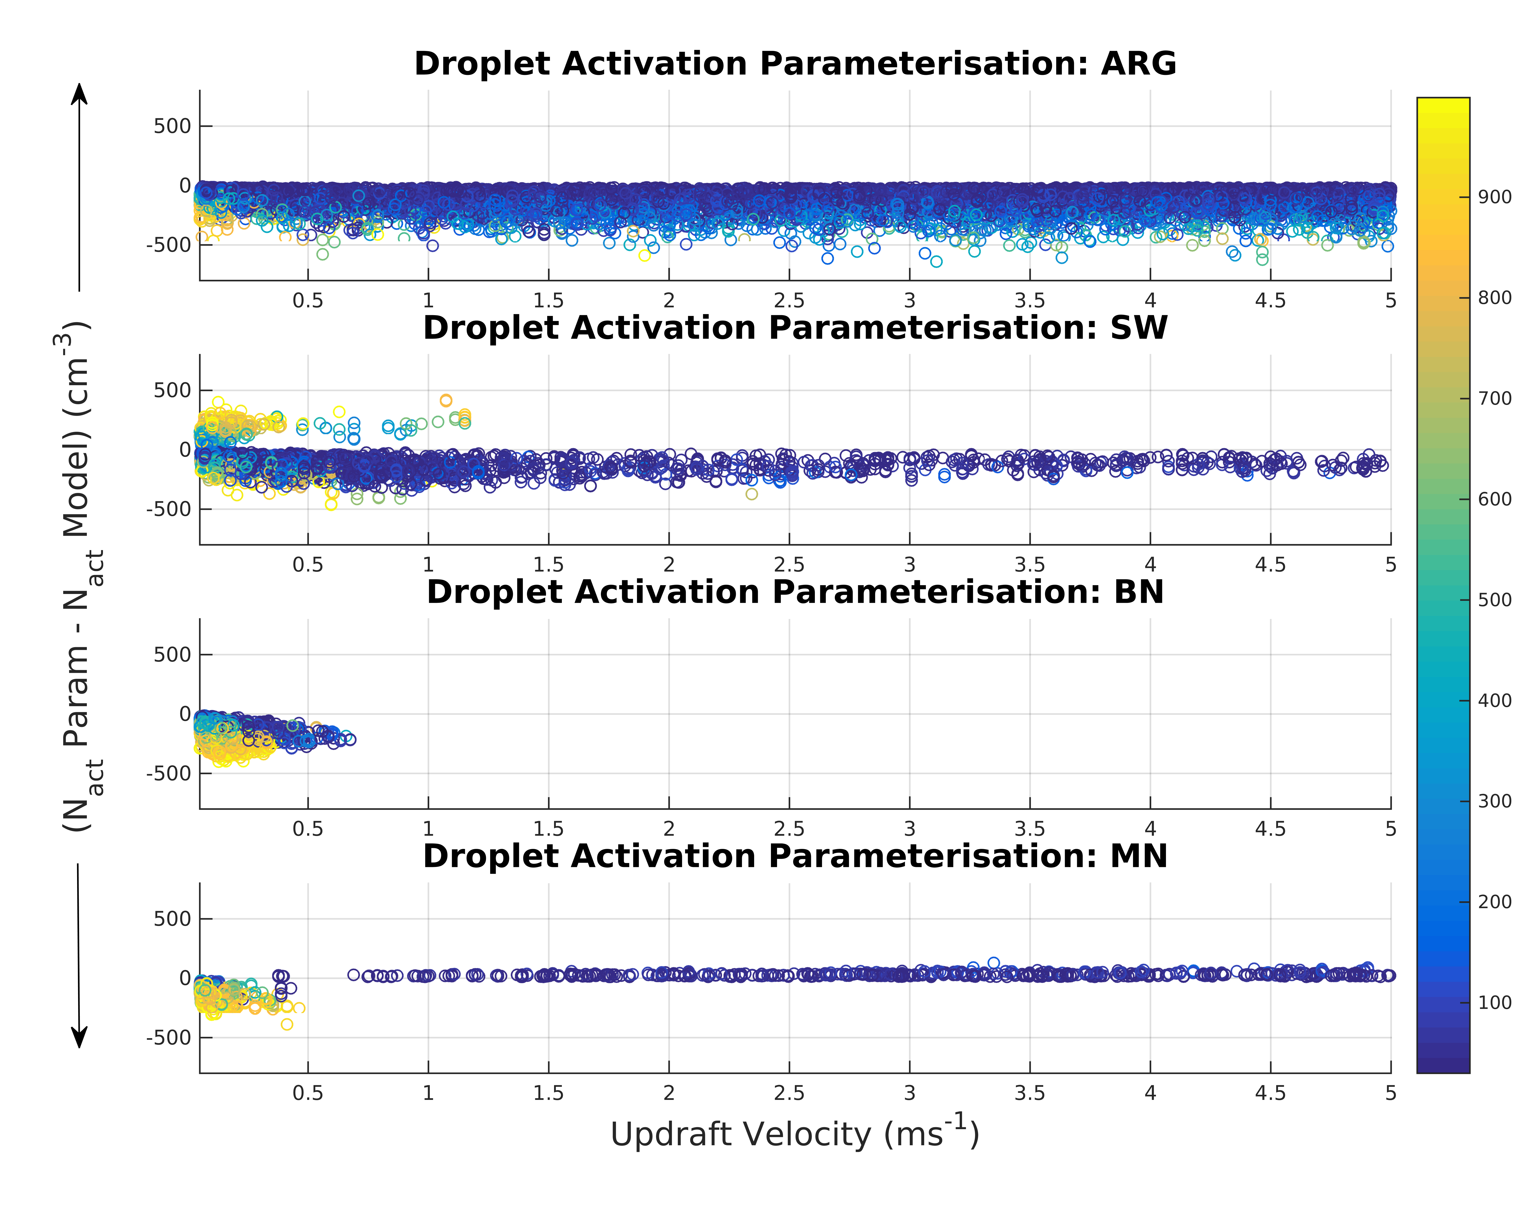
Evaluating 4 Droplet Activation Parameterisations
Iterative parameterisations show smallest region of parameter space with error > |30%|.

Slide 10
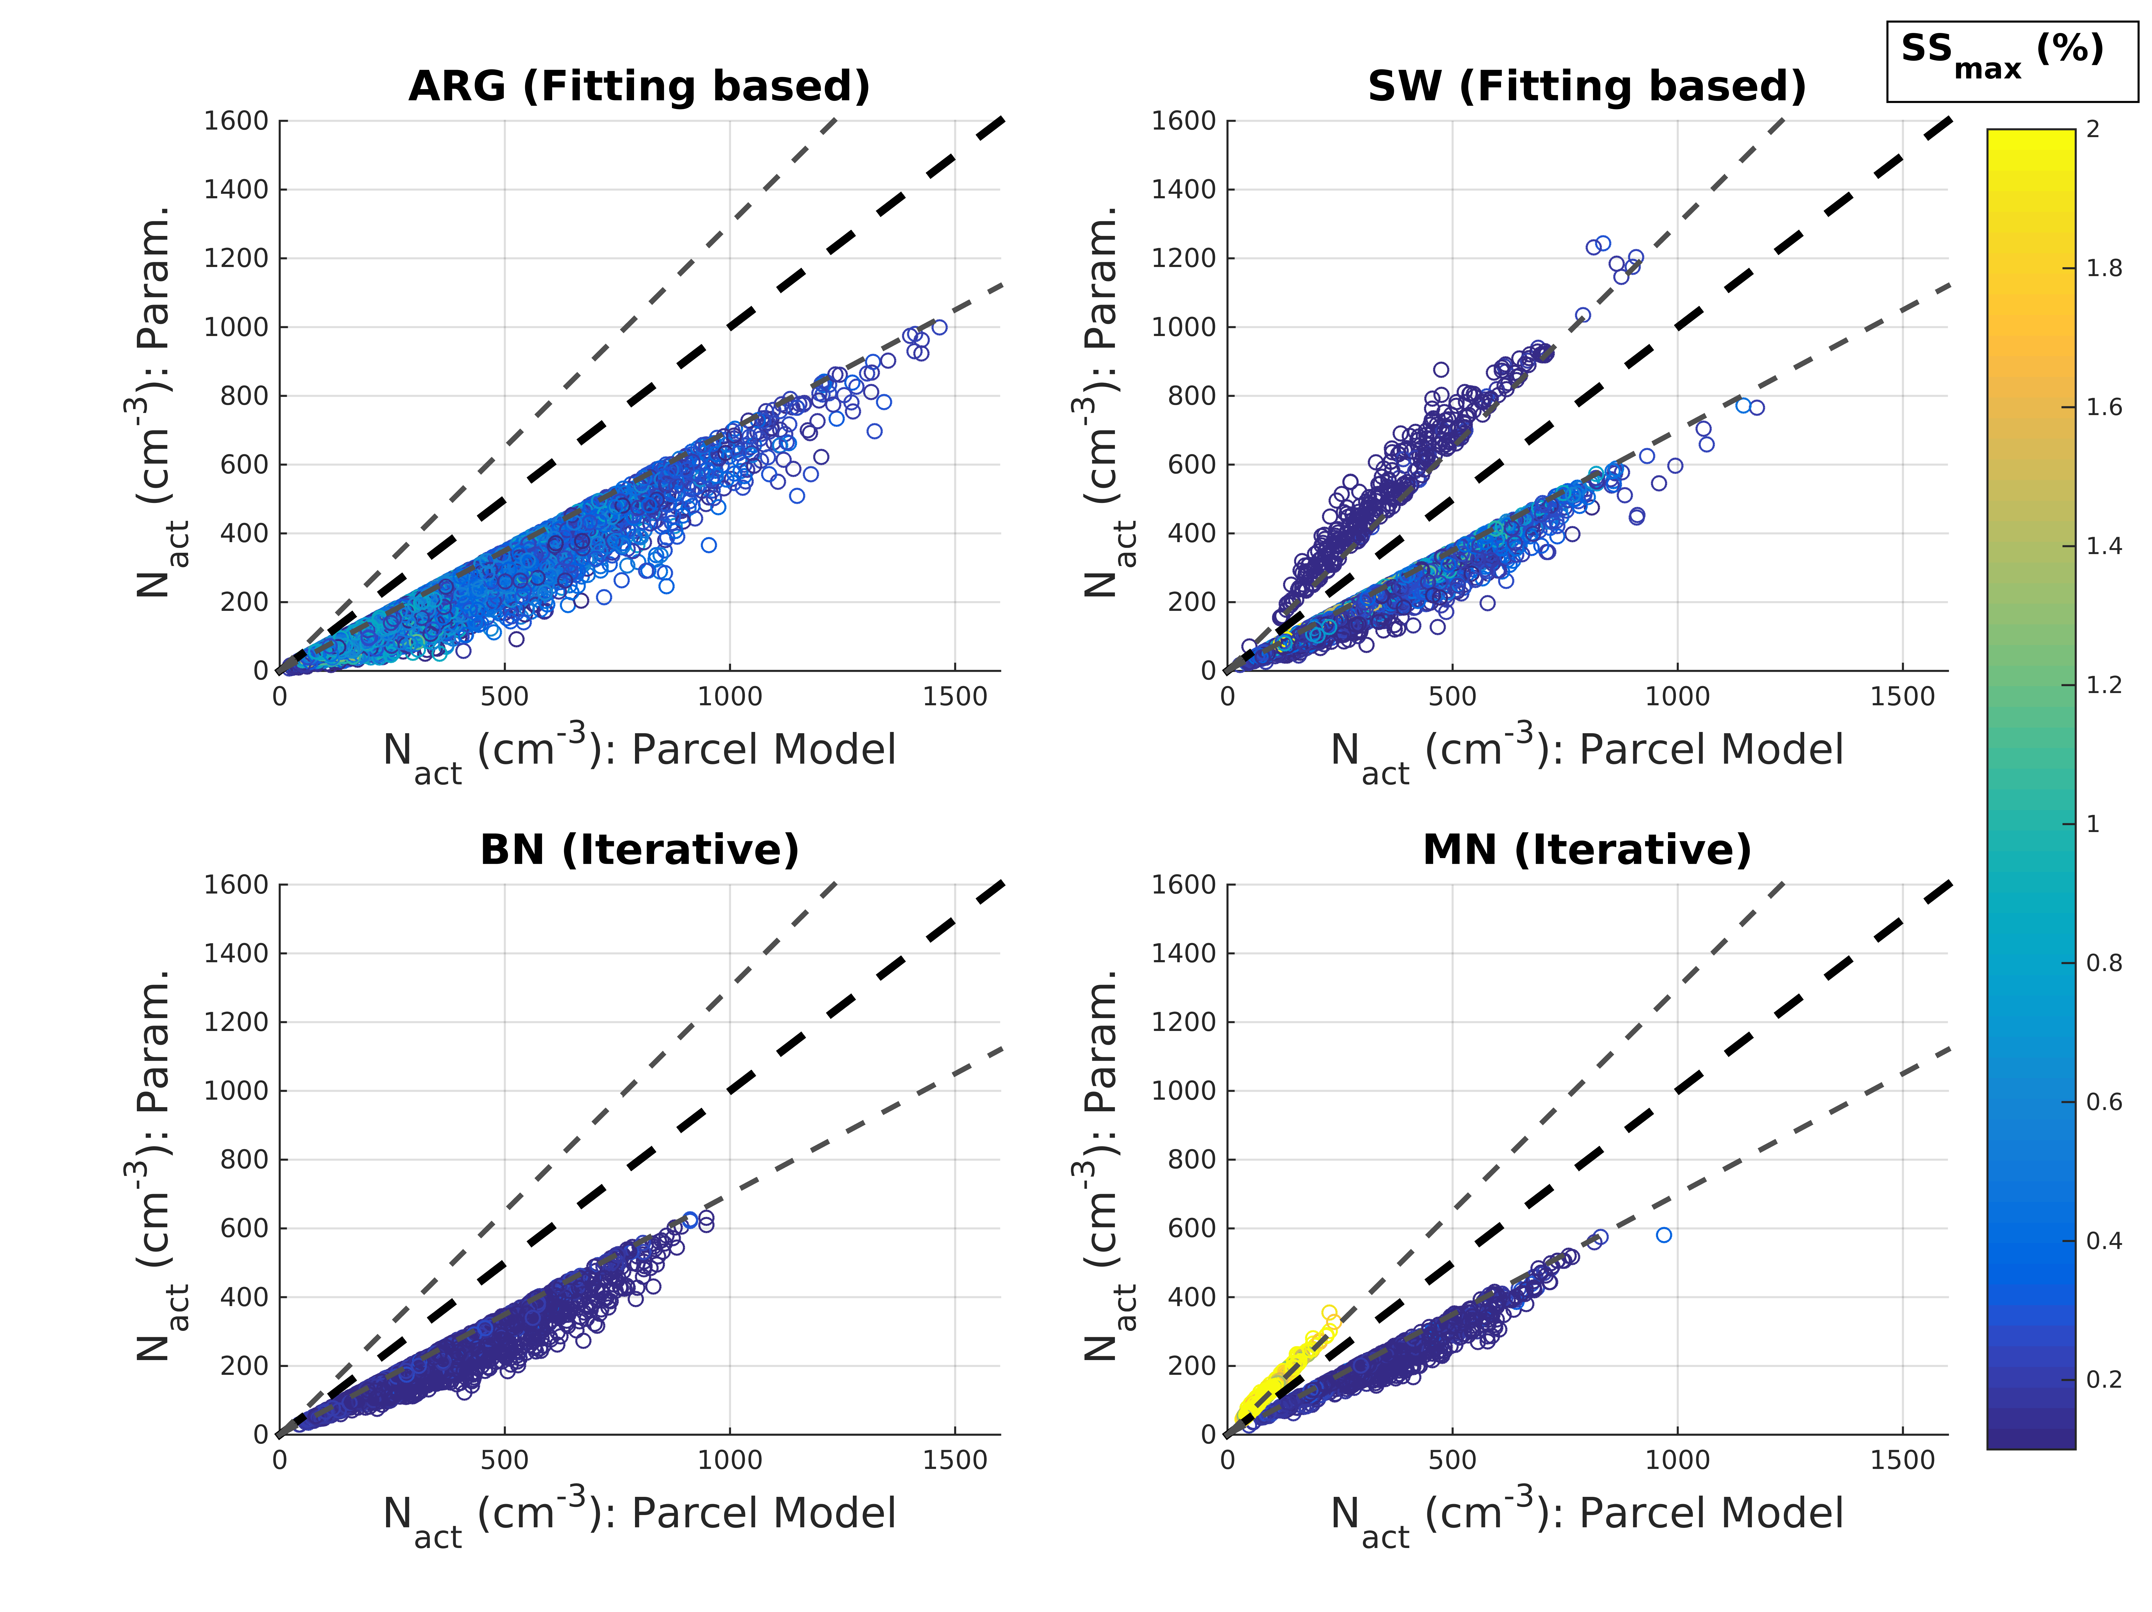
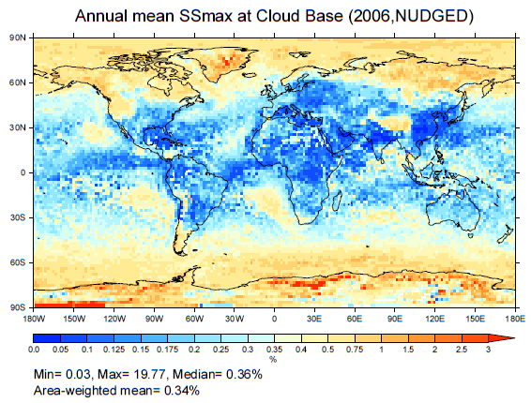
Implications for GCM ECHAM-HAM

Slide 11
Summary
Successfully demonstrated framework automatically find regions of highest error.
Fast: Convergence after 1000 iterations for 10-D parameter space, thus a framework for comparing to more detailed slower models.
Simpler fitting-based droplet activation parameterisations exhibit larger error than more complex iterative schemes, especially for clean marine aerosol regions.
Thus, whilst computationally more efficient, not recommended for GCMs.
All schemes show systematic biases compared to cloud parcel model for low (<0.5 ms⁻¹) updraft velocity (especially when high aerosol conc.) due to assumptions made when solving SS_{max}.

